Slide 1
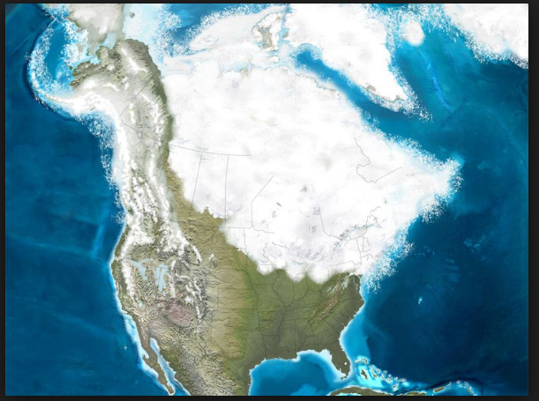
Ice age NOTES

Slide 2
5 ICE AGES HAVE HAPPENED ON EARTH
Huronian (2.4-2.1 billion years ago),
Cryogenian (850-635 million years ago),
Andean-Saharan (460-430 mya),
Karoo (360-260 mya) and
Quaternary (2.6 mya-present)

Slide 4
WHAT CAUSES AN ICE AGE?
JUST A 6 TO 9 DEGREE CELSIUS DROP IN AVERAGE GLOBAL TEMPERATURE
[this does not mean that EVERYWHERE is that much colder. Equator area is still quite warm and tropical]

Slide 5
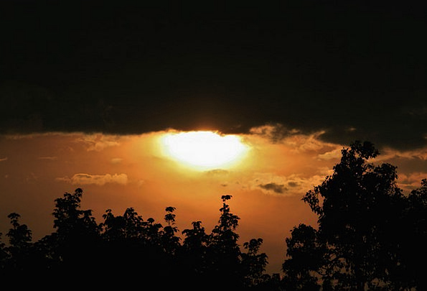
POSSIBLE CAUSES OF THE DROP:
a) Change in sun's energy output [thermostat turned down in sun?]

Slide 6
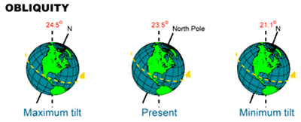
b) Change in tilt of earth's axis (maybe not 23.5, maybe only 21 degrees]

Slide 7
c) Continental plate movement

Slide 8
d) Volcanic ash blocking out sunlight
e) Nearby star explodes disrupting flow of energy from the sun

Slide 9
e) Nearby star explodes disrupting flow of energy from sun

Slide 10
WHERE DOES THE WATER COME FROM TO MAKE A GLACIER?
comes from oceans
They drop their levels several hundred feet
[evaporated water hits land, freezes, then oceans lower]

Slide 11
Humans then could walk across a land bridge between Siberia and Alaska

Slide 12
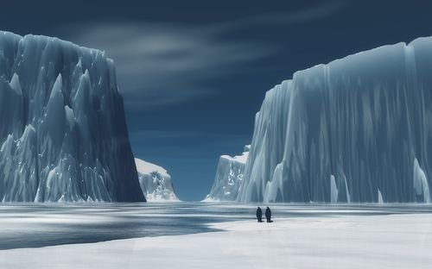
WHERE ARE GLACIERS FOUND, AND HOW BIG ARE THEY?
Glaciers move from poles towards the equator and
may be 2-3 miles thick

Slide 13
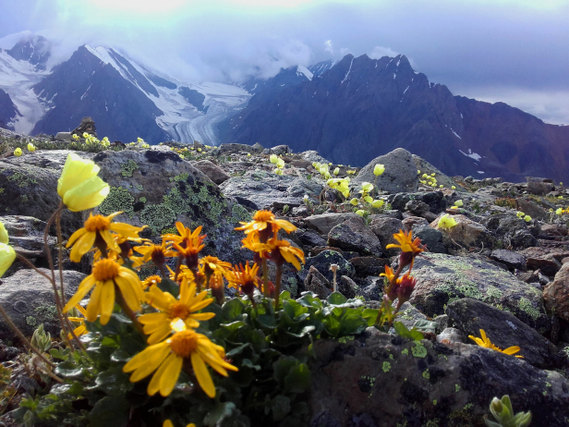
WHAT PLANTS GREW NEAR THE GLACIERS?
Lichens,
moss,
fast flowering plants

Slide 14
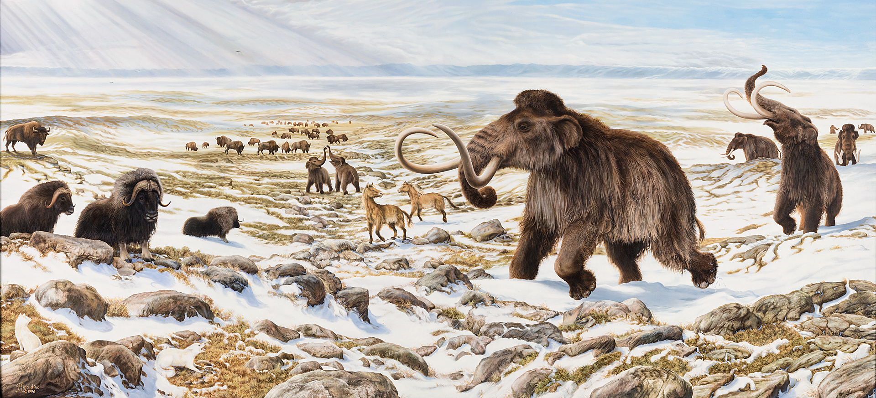
WHAT ANIMALS LIVED NEAR GLACIERS?

Slide 15
1. Caribou,

Slide 16
2. musk ox,

Slide 17
3. mammoths, 9ft tall and ate over 400 lbs of grass a day!

Slide 18
4. Sabertooth [hunted to extinction probably because they were brave and invaded human camps],

Slide 19
5. wolves, [were domesticated- dogs.. for protection?]

Slide 20
6. bears [called cave bears and were 12 feet tall!]

Slide 21
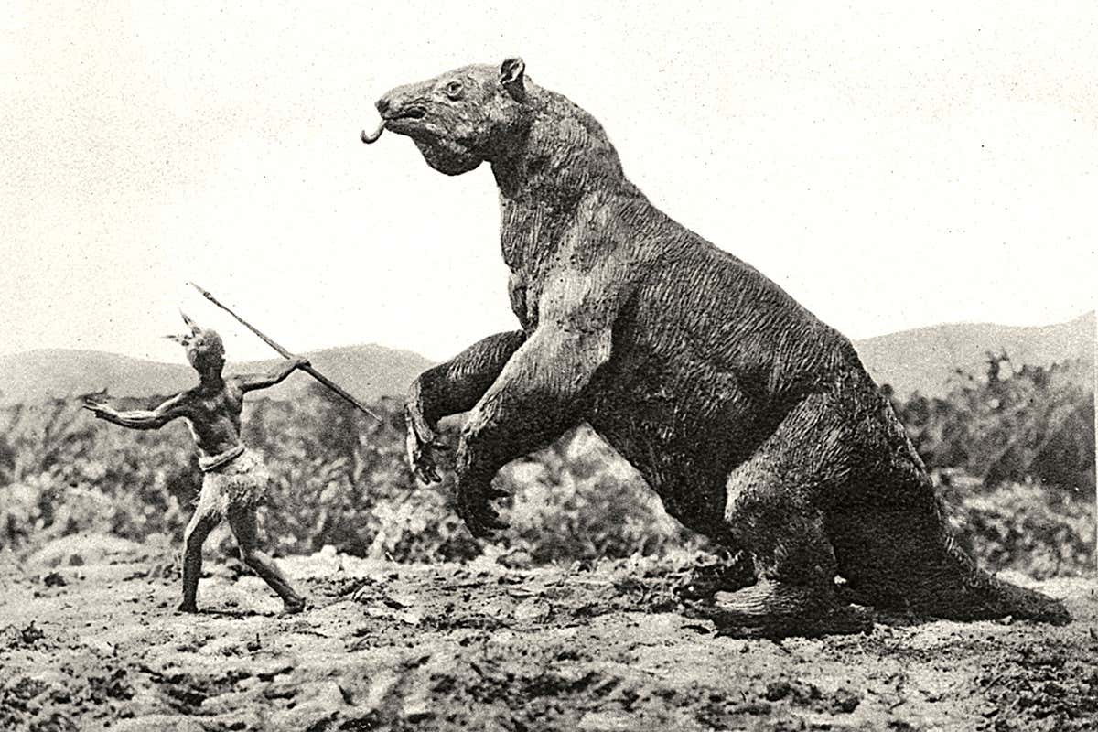
Ground sloth, 9ft tall!

Slide 22
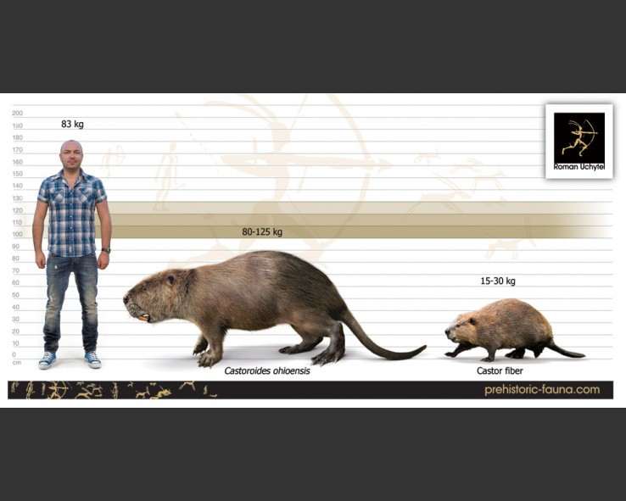
6ft long- biggest rodent on North America ever!

Slide 23
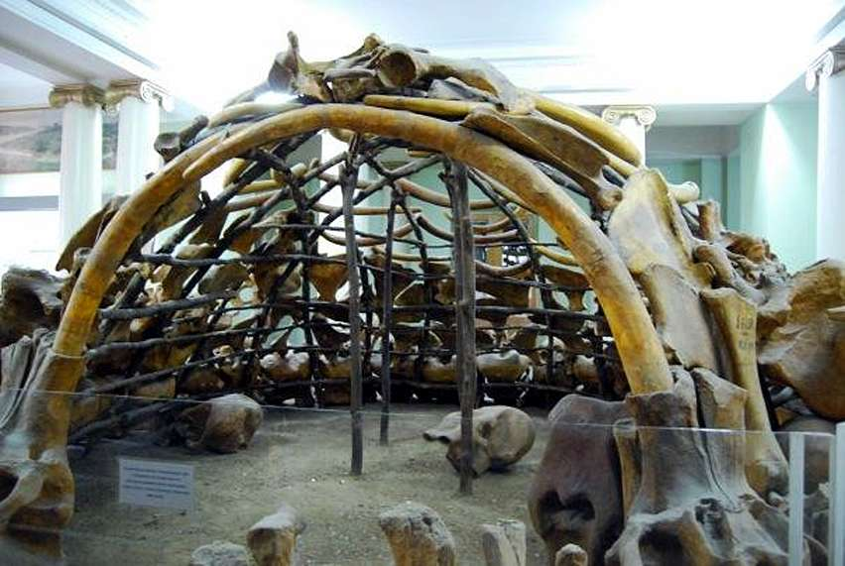
WHERE DID HUMANS LIVE?
Humans likely used temporary housing that could pack and travel, since they were following the animals for food
Massive mammoth structure

Slide 24
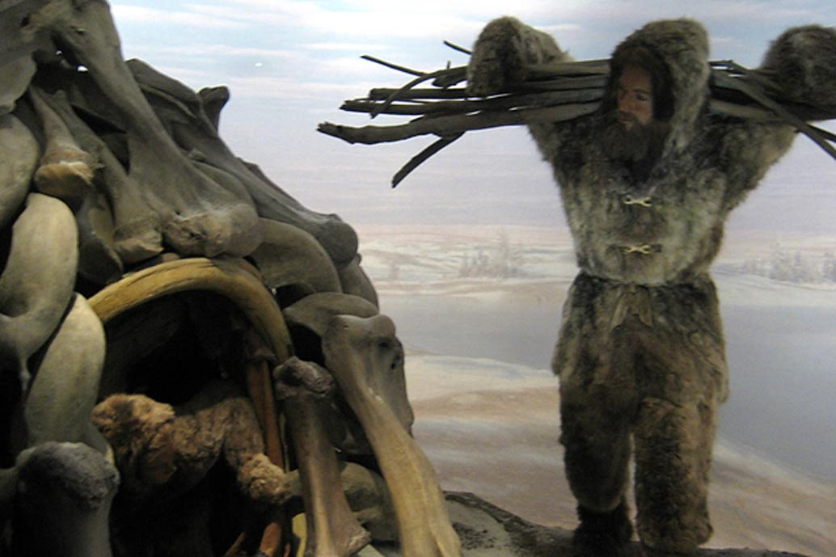

Slide 25
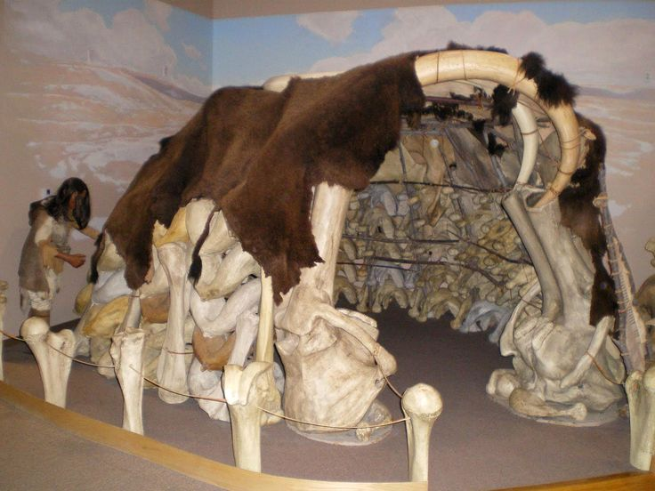

Slide 27
If caves were available, they may have lived there, but evidence suggests that they actually used caves for temporary shelter, for art, and for ceremonies.

