Slide 1
Glacier movement, glacier types and the 4 glaciations

Slide 2
Glacier- large mass of recrystallized snow that is on land and is moving
Snow compacts into firn (granular ice) then firn compacts into glacial ice
Accumulation the amount of snow added annually
Ablation – the amount of ice lost annually

Slide 3
4 mechanisms responsible for ablation
Melting
iceberg calving- pieces of ice break off and form icebergs when a glacier reaches a shoreline
sublimation- ice turns directly into gas
wind erosion- strong winds can cause melting and sublimation

Slide 4
II. GLACIER MOVEMENT—ultimately, movement occurs due to gravity
internal plastic deformation, (or internal flow or ductile flow)
the glacier's weight becomes too much to support itself
ice layers slip within the glacier
glacier moves downhill like a deck of cards being spread
top layers move more quickly than the bottom layers due to friction at base

Slide 5
BASAL SLIDING
Pressure at the base of the glacier causes a thin layer of ice to melt.
This reduces friction,
the entire glacier moves as a single unit like it’s on a water slide

Slide 7
Dry glaciers: In colder climates, basal melting is minimal or absent, and flow is entirely through internal plastic deformation.
Wet glaciers: In warmer climates, basal slip can predominate.

Slide 8
Glaciers always move forward, never backward
Stationary --If it moves forward at the same rate as the front of the glacier melts
Advancing – when a glacier moves forward faster than it melts
Retreating—when a glacier melts faster than it moves forward

Slide 9
Move 300ft (100 m) per year, and mostly in summer

Slide 10
III. TYPES OF GLACIERS
Continental glaciers / Ice Sheets -large mass of ice that covers almost all surface features (must cover at least 36,000 square miles (50,000 Km)
Examples: Antarctica, Greenland
2-3 miles thick!

Slide 11
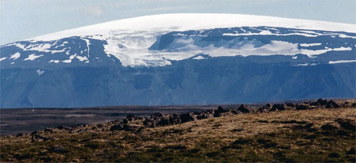

Slide 12
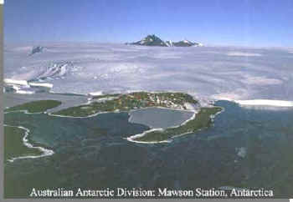

Slide 13
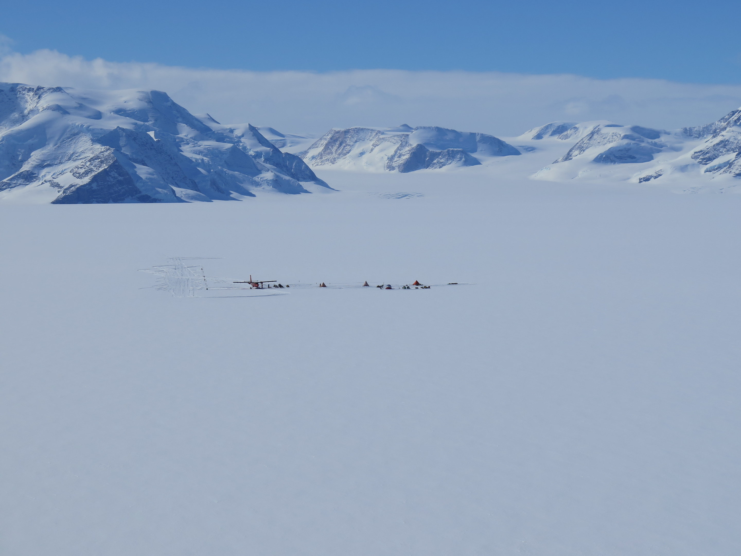

Slide 14
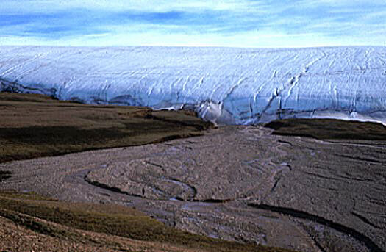

Slide 16
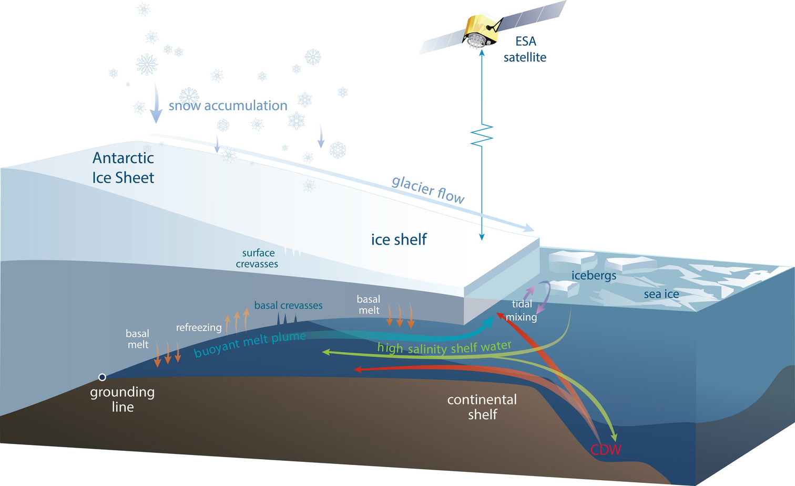

Slide 17
Alpine/ valley/ mountain glacier - between 2 mountains
Examples: Andes, Rockies, Himalayas, Alps, Mt Kilamenjaro, Mt Kenya

Slide 18
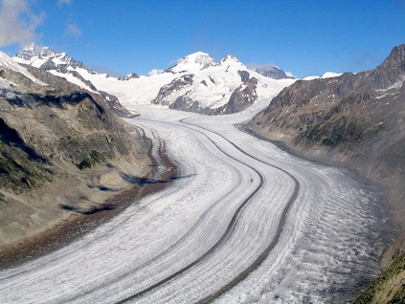

Slide 19
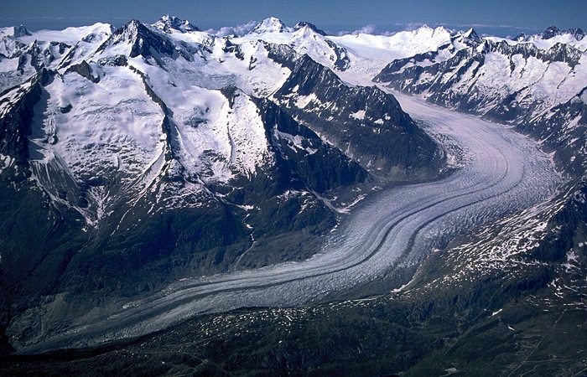

Slide 20
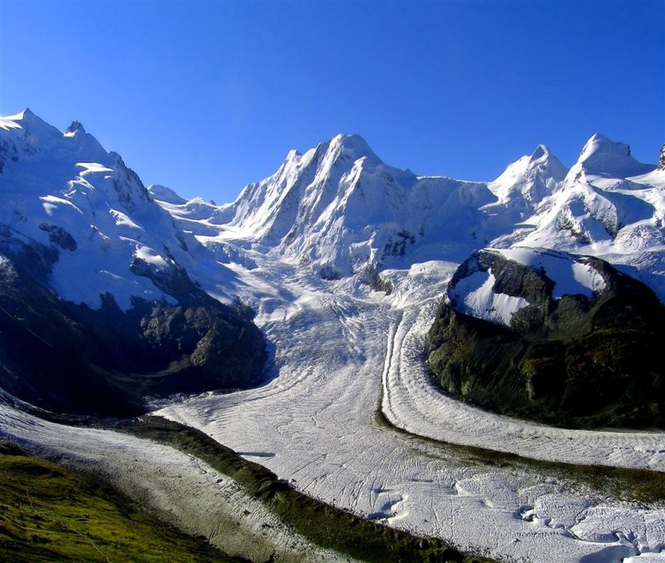

Slide 21
Piedmont glacier - a valley glacier that enters a lowland plain and spreads out like a fan
Example: Malaspina glacier in Alaska

Slide 22
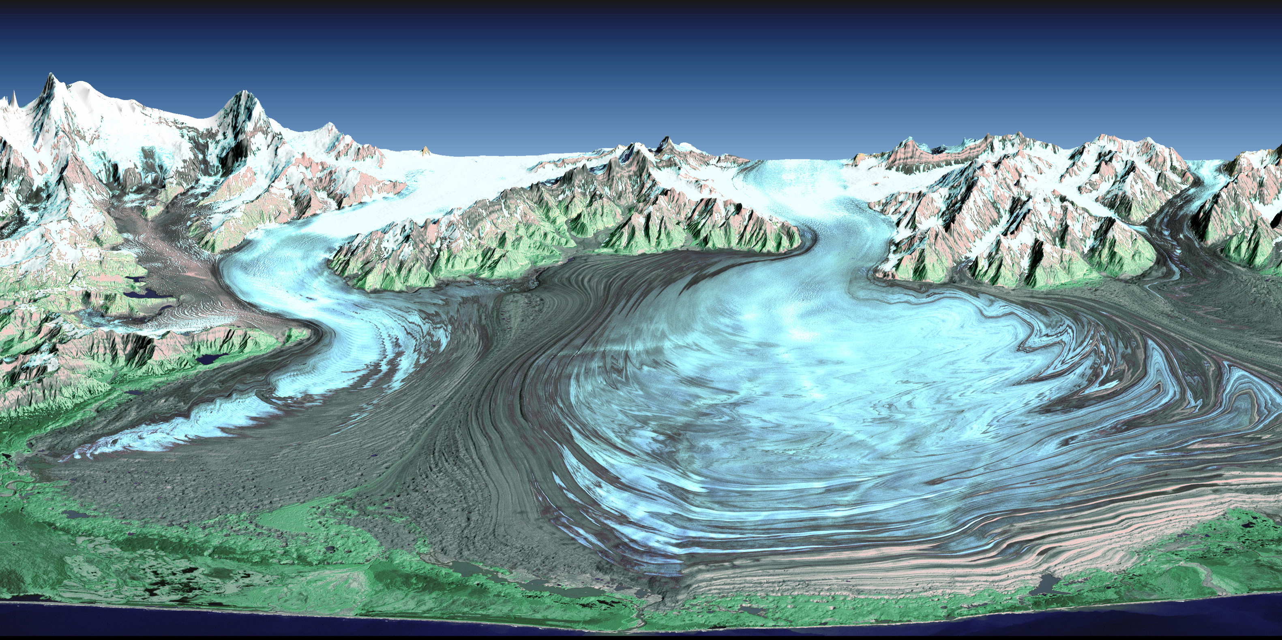

Slide 23
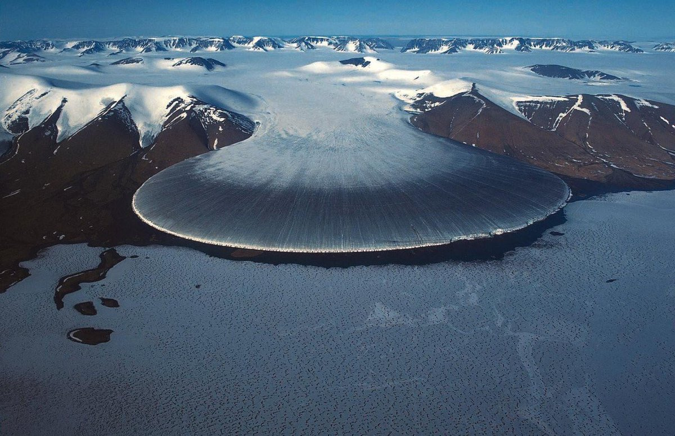

Slide 24
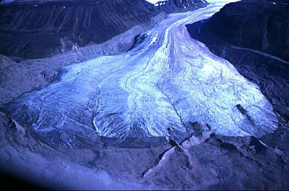

Slide 25
Cirque glacier- glacier fills “bowl” on mountainside then eventually feeds valley glaciers
Example: Swiss Alps

Slide 29
IV. 4 glaciations of the last ice age (2,000,000 ya to 10,000 ya)
Glaciation - the temporary enlargement of a glacier during an ice age
Named by the state that the ice reached

Slide 30
Nebraskan = 2,000,000 ya Kansan = 1,250,000 ya Illinoisan = 500,000 ya Wisconsin = 40,000 ya

