Slide 1
Notes- GLACIAL DEPOSITION, LANDFORMS, EROSION, AND THE FORMATION OF THE GREAT LAKES

Slide 2
Glacial flour- sliding rocks and ice grinding up soft rock into powder

Slide 3
Till- unsorted (large and small) rock and sediments that are placed by a glacier

Slide 4
Dunes- forms when sand is blown by wind when lake water level is low. Example: (sleeping bear dunes)

Slide 5
Glacial erratic- large boulders that were moved long distances by glaciers and are dropped off in a new location. They are completely different from the surrounding rock.

Slide 6
Terminal (End) moraine- an accumulation of till at the end (tip) of a glacier

Slide 7
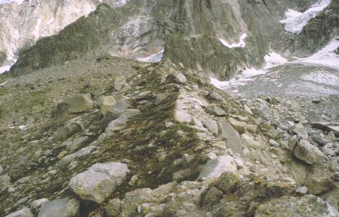
Ground moraine- gently rolling hills that form when till is dropped in place as a glacier melts. Ithaca is on the Owosso moraine

Slide 8
Lateral moraine- ridges of till along sides of a glacier [bulldozer with dirt streaks left to the sides]

Slide 9
Esker- snakelike ridges that form when meltwater carries small sediments and deposits them in a narrow path under the glacier- Example: mason esker [most has been used up for road construction]

Slide 10
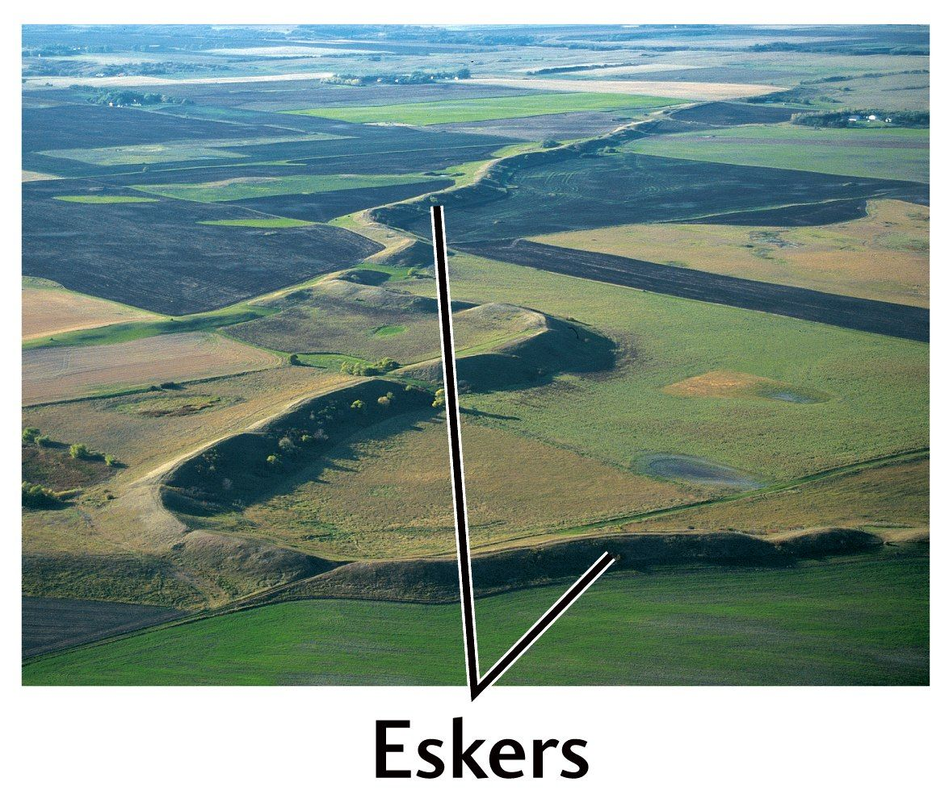

Slide 11
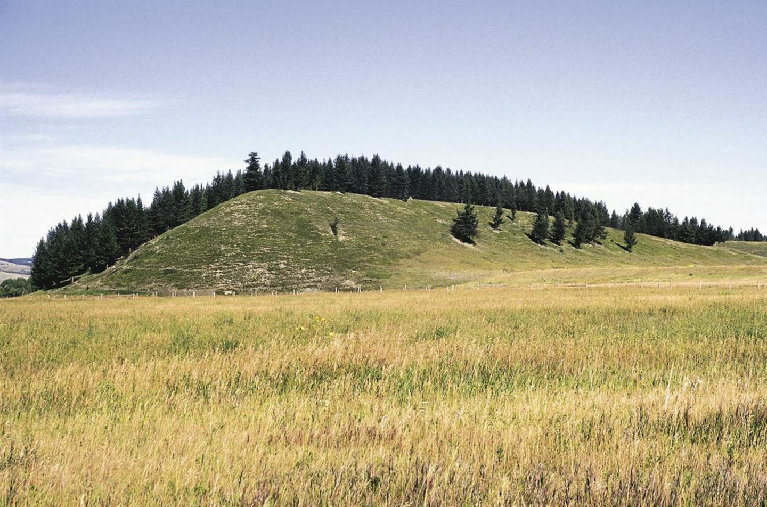
Drumlin – egg shaped small hill. The tapered end of each hill points in the direction of glacier flow.

Slide 12
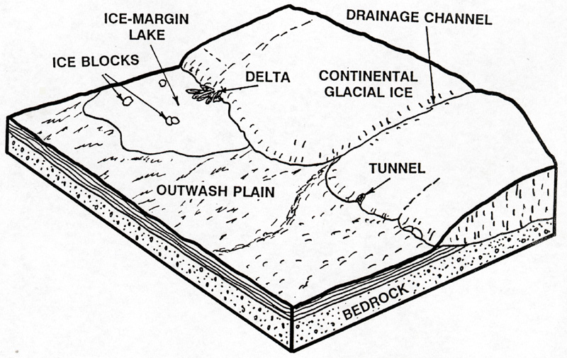
Outwash Plain--meltwater carries small sediments (clay, sand, small gravel) and deposits it in a fan- like pattern [bad agricultural land--too sandy]

Slide 13
Lake plains- flat, fertile land caused by sediments being layed down by wave action Example: Saginaw river valley

Slide 14
Kettles- formed when large blocks of ice break off, create a dent due to their weight, then melt and fill in the dent. Many of Michigan’s lakes were formed this way.

Slide 15
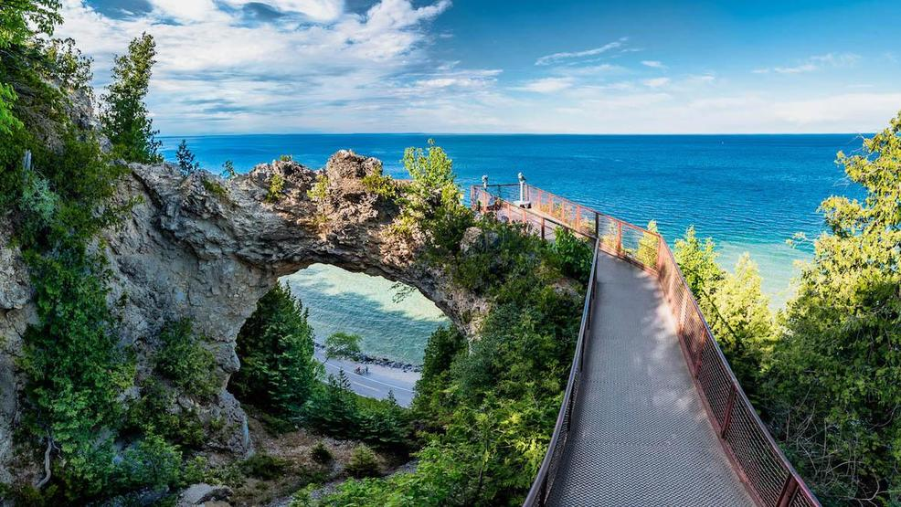
Rock outcrop- a section of rock that stands out higher than the surrounding land. Form due to erosion by the flow of water past soft, sedimentary rock. examples: Mackinac island, Drummond Island, Castle Rock, Wisconsin Dells

Slide 16
Cirques- carved out bowl shapes on mountains

Slide 17
Aretes- sharp ridges formed by back to back cirque glaciers

Slide 18
Hanging valleys- u shaped valley carved by cirque glaciers that often have a steep drop off, thus making great waterfalls

Slide 19
Horns- sharp mountain peaks formed by cirque glaciers on the sides of mountains

Slide 20
U valleys- shape created by valley glacier carving and eroding the space between mountains

Slide 21
Lateral moraines- long ridges that form along the sides of a glacier (like the dirt on the sides of a bulldozer)

Slide 22
1 Plucking- water melts into cracks of rocks then refreezes. It grips the rock, then the Ice moves forward breaking the rock up. The attached rock can now be used as a grinding tool. 2 Abrasion- rubbing of rocks in the glacier on the rock of the Earth. A. Creates glacial flour if rock is soft or B. Striations (scratches) if rock is hard. Striations show the direction the glacier moved.

Slide 23
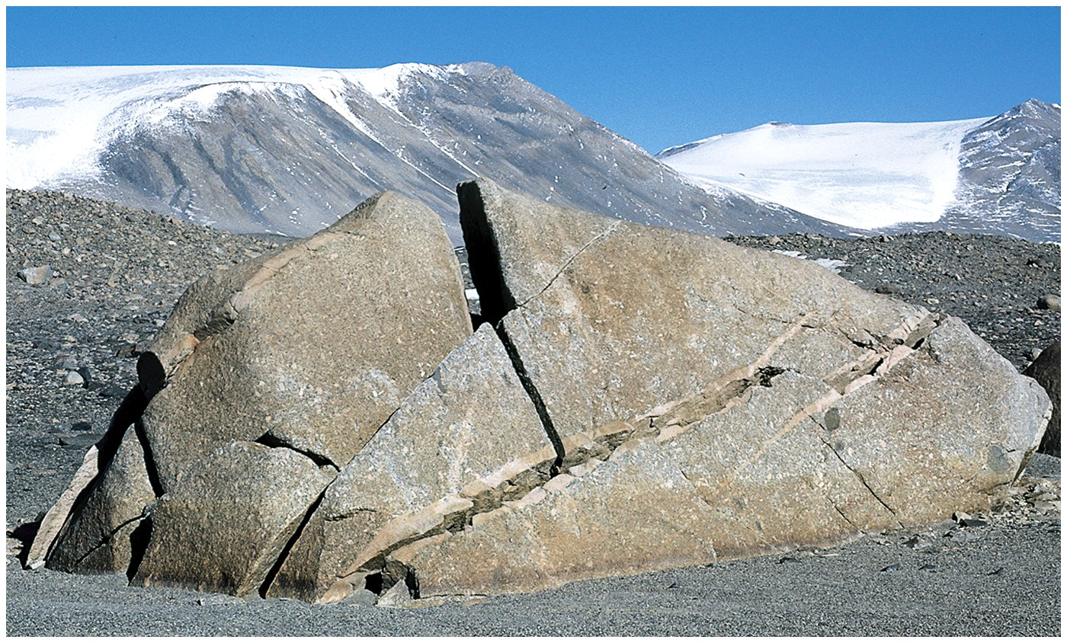
Frost wedging is the opening of crevasses (a crack) in rock due to freezing and thawing water. It is another method glaciers use to pulverize rock.

Slide 24
How the Great Lakes formed– occurred during last glaciation

Slide 25
Before glaciers ever happened, we were under oceans for 300 million years laying down soft sedimentary rock

Slide 26
After oceans left, water erosion (due to rainfall) and wind erosion carved ancient river basins for 280 my (these became the "trail' the glaciers would follow as they grew into Michigan)

Slide 27
2 million years ago an ice age began and 1 million years ago glaciers fell off the Canadian Shield and into the soft sedimentary rock, crushing the land 300 - 800 feet and following the ancient river basins. This carved the deep basins of the great lakes.

Slide 28
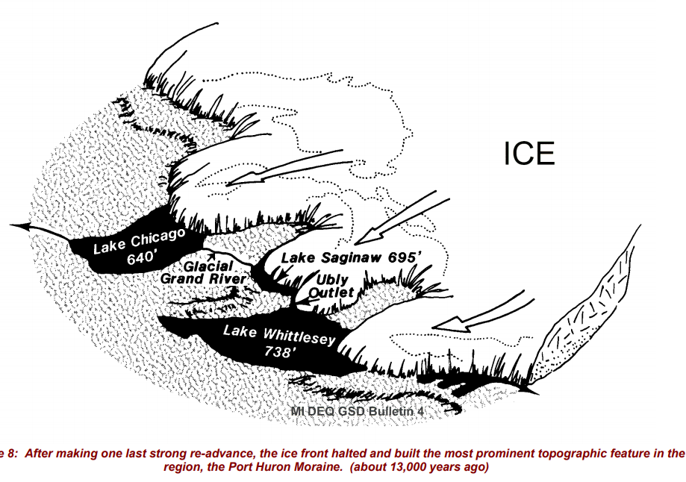
Glaciers began to melt/recede 15,000 years ago leaving meltwater behind which filled the basins.

Slide 30
Lake levels fell until sediment “plugged up” the outlet

Slide 31
Many times lake levels rose and fell eroding and depositing material on shores and allowing wind to blow sand, forming dunes.

