Slide 1
It’s time for….

Slide 3
100
PHASES
ECLIPSES
FEATURES
TIDES
MISC.
100
100
100
100
200
200
200
200
200
300
300
300
300
300
400
400
400
400
400
500
500
500
500
500

Slide 4
This phase is invisible

Slide 5
What is the new moon?

Slide 7
What is waning crescent?

Slide 9
What is waxing gibbous?

Slide 10
The amount of the moon that is lit up during waxing crescent

Slide 11
What is half?

Slide 12
The name of the side of the moon seen during full moon.

Slide 13
What is the near side?

Slide 14
Name of the eclipse when the sun is blocked from view

Slide 15
What is a solar eclipse?

Slide 16
The name of the eclipse when the moon casts a shadow on earth.

Slide 17
What is a solar eclipse?

Slide 18
The number of times we enter eclipse season (per year).

Slide 19
What is 2?

Slide 20
What has to happen with the moon’s orbit in order to have a lunar or solar eclipse.

Slide 21
What is an intersection with the orbit plane of earth and sun?

Slide 22
The amount of time that a lunar eclipse lasts.

Slide 23
What is two hours?

Slide 24
Dark region on the moon formerly thought to be oceans

Slide 25
What are maria?

Slide 26
Round pit created when an asteroid strikes the moon.

Slide 27
What is a crater?

Slide 28
Lunar dust made from vaporized asteroids.

Slide 29
What is regolith?

Slide 30
Straight ridges of regolith and rocks formed from recent impact events.

Slide 31
What are rays?

Slide 32
Curvy lines that used to be considered riverbeds, but are now known to be collapsed lava tubes.

Slide 33
What are rilles?

Slide 34
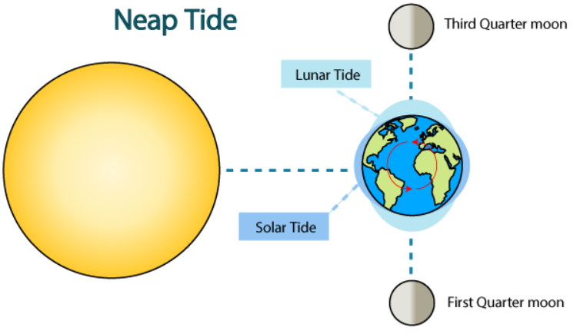
The type of tide shown here:

Slide 35
What is a neap tide?

Slide 36
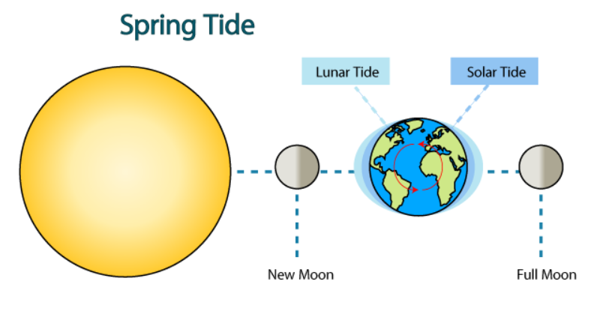
The type of tide shown here:

Slide 37
What is a spring tide?

Slide 38
The force responsible for all tides.

Slide 39
What is gravity?

Slide 40
The number of high tides that occur each day.

Slide 41
What is 2?

Slide 42
The astronomical object that assists the moon during a spring tide.

Slide 43
What is the sun?

Slide 44
The size of the moon’s diameter compared with earth.

Slide 45
What is one forth?

Slide 46
The name of our moon

Slide 47
What is Luna?

Slide 48
A large object hits earth while it is still molten. This event launched …..?

Slide 49
What is the formation of the moon?

Slide 50
The type of eclipse that requires glasses.

Slide 51
What is solar?

Slide 52
The date of the most recent solar eclipse which is a driveable distance from Michigan. Or, the next one to happen in Michigan

Slide 53
What is April 8, 2024? What is Sept 14, 2099? (75 years from now)

