Slide 1
NOTES 12-3
ABSOLUTE DATING

Slide 2
ABSOLUTE AGE-
The ACTUAL age of an object in years

Slide 3
A] ABSOLUTE dating method
1) Radiometric Dating-- a dating method that compares parent isotopes with daughter isotopes
more parent = younger
more daughter = older

Slide 5
a) radioactive decay-- the process in which a radioactive isotope breaks down into a stable isotope

Slide 6
b) isotope -- an atom with the same number of protons as other atoms, but a different number of neutrons
(1) parent isotope -- the unstable radioactive isotope
(2) daughter isotope-- the stable isotope produced after a radioactive decay

Slide 7
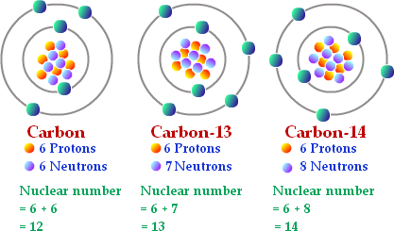

Slide 8
c) half-life -- the time it takes one half of the parent material to decay into daughter material

Slide 10
d) types of radiometric dating

Slide 11
Practice problems
Which method would NOT be good for finding the age of dinosaur bones?

Slide 12
Practice problems
A sample from a mummy is dated using the Carbon 14 method. It has 50% parent material and 50% daughter material. How old is it?
5730 years old

Slide 13
Practice problems
An ancient brachiopod fossil is dated using the Uranium 235 method. It has 25% parent material and 75% daughter material. How old is it?
1408 million years old / 1.408 billion years old

