Slide 1
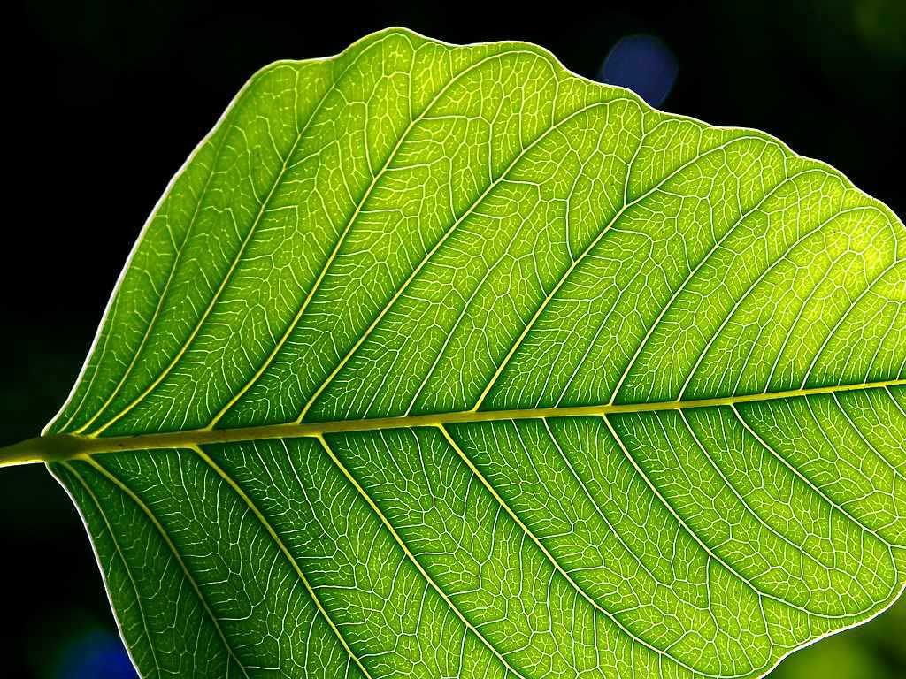
Plant unit review

Slide 2
The process where a cell uses CO₂ and H₂ O and sunlight to make C₆H₁₂O₆ and O₂
_{PHOTOSYNTHESIS}

Slide 3
. The process where a cell uses C₆H₁₂O₆ and O₂ to make energy with the waste products CO₂ and H₂O.
_{CELL RESPIRATION}

Slide 4
This group of plants is the most abundant on earth. They are the flowering plants
_{ANGIOSPERMS.}

Slide 5
This group of plants makes seeds, but they are not covered in fruit, nor are they fertilized through the help of a flower. Pine trees, firs, and other cone bearing trees are in this group.
_{GYMNOSPERMS}

Slide 6
If a plant does not make true seeds, how will it reproduce itself?
_{SPORES}
(OR BULBS, TUBERS, RHYZOMES, RUNNERS)

Slide 7
Since non-vascular plants don’t have xylem or phloem, how do they get water and food distributed (moved around) inside themselves?
_{DIFFUSION}

Slide 8
Where is chlorophyll located?
_{INSIDE CHLOROPLASTS.}

Slide 9
Why is chlorophyll such an important chemical?
CAPTURES SUNLIGHT/ DOES PHOTOSYNTHESIS

Slide 10
A fibrous root system is different than a taproot system in that
FIBROUS ROOTS ARE MORE BRANCHED.

Slide 11
This group of plants has parallel veins, one cotyledon, scattered vascular tissue, and flower petals in 3s
_{MONOCOTS}

Slide 12
Pollination is the time when
_{POLLEN MEETS STIGMA}

Slide 13
Fertilization is the time when
_{SPERM MEETS EGG}

Slide 14
What is the most important purpose of a flower?
SEXUAL REPRODUCTION

Slide 15
During photosynthesis, what gas do plants release?
_{OXYGEN}

Slide 16
. During cellular respiration, what gas do plant cells use to produce energy from food?
_{OXYGEN}

Slide 17
Photosynthesis is important because photosynthetic organisms make
ALMOST ALL THE FOOD ON THE PLANET

Slide 18
After fertilization takes place in a flower, the ovule develops into a
_{SEED}

Slide 19
After fertilization takes place in a flower, the ovary develops into a
_{FRUIT}

Slide 20
Why is nitrogen (which is taken up by roots) so important to a plant?
_{IT IS USED TO MAKE PROTEIN}

Slide 21
Where does a plant get its nitrogen?
_{THE SOIL}

Slide 22
Because mosses and liverworts lack a vascular system, they live in areas that
_{HAVE LOTS OF WATER}

Slide 23
What is a difference between a spore and a seed?
SPORE= 1 CELL BIG
SEED=HAS STORED FOOD

Slide 24
How is water important to the reproduction of ferns and mosses?
SPERM SWIMS THROUGH IT TO GET TO EGG

Slide 25
Angiosperms are most important to humans because
_{THEY MAKE ALL OUR FOOD}

Slide 26
How are mosses and liverworts important to our ecosystems?
They are first to live in an environment,
so when they die, they make soil

Slide 27
. How is a plant’s size related to its method of transporting water and nutrients?
SMALL ONES USE DIFFUSION
BIG ONES USE XYLEM AND PHLOEM TUBES

Slide 28
WHAT ARE THE 3 FUNCTIONS OF A STEM?
TRANSPORT MATERIALS FROM ROOT TO LEAVES & LEAVES TO ROOT
STORE FOOD
HOLD PLANT UP

Slide 29
WHY DO PLANTS MAKE FRUIT?
SO ANIMALS WILL EAT THEM AND SPREAD SEEDS/
PROTECT SEEDS

Slide 30
How is tissue different from individual cells?
TISSUE IS MANY CELLS WORKING TOGETHER

Slide 31
Plants are able to make what 3 food components?
FATS, PROTEINS, AND CARBOHYDRATES

Slide 32
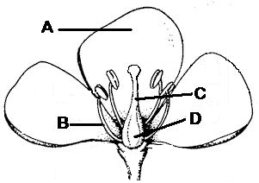
LABEL
. A=PETALS B=STAMEN (OR FILAMENT)
C= PISTIL (OR STYLE) D=OVARY

Slide 33
This plant part houses the ovules (eggs). After fertilization they will grow into seeds
_{OVARY}

Slide 34
A fertilizer company is trying out a new product. The soil of the experimental plant was treated with a substance high in nitrogen. The soil of the control plant was not treated with any substance. The researchers were careful to follow rules for good experimental design.
Why was the experimental plant able to grow more?
MORE NITROGEN

Slide 35
A fertilizer company is trying out a new product. The soil of the experimental plant was treated with a substance high in nitrogen. The soil of the control plant was not treated with any substance. The researchers were careful to follow rules for good experimental design.
What was the point of having a control plant?
SO YOU CAN COMPARE RESULTS

Slide 36
A fertilizer company is trying out a new product. The soil of the experimental plant was treated with a substance high in nitrogen. The soil of the control plant was not treated with any substance. The researchers were careful to follow rules for good experimental design.
What variables should be controlled? (kept the same for a fair test)
Same sunlight, same plant type, same soil, same amount of water, etc.

Slide 37
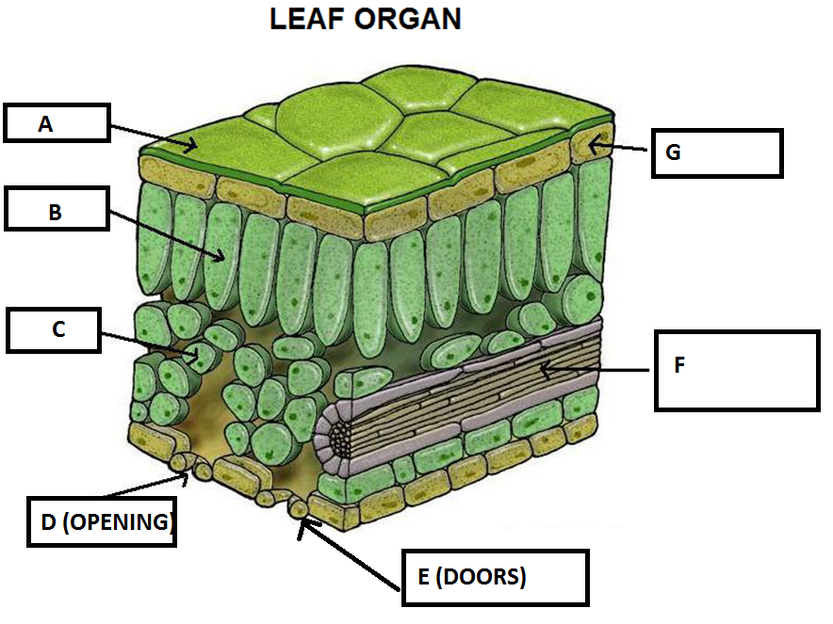
LABEL.
.

Slide 38
WHICH DOES PHOTOSYNTHESIS
_{B-PALISADE}

Slide 39
WHICH ALLOWS GAS EXCHANGE?
_{C-SPONGY}

Slide 40
WHICH CLOSES STOMA?
E-GUARD CELL

Slide 41
WHICH MAKES CUTICLE?
_{G-EPIDERMAL LAYER}

Slide 42
WHICH MOVES FOOD AND WATER?
_{F-VASCULAR TISSUE}

Slide 43
WHY IS THIS CALLED AN ORGAN?
DIFFERENT TISSUES WORKING TOGETHER

Slide 44
Plants are autotrophs meaning they make their own food. Which other word describes them?
PRODUCER

Slide 45
A mineral found in soil, taken up by the roots, and used in a plant to make proteins
_{NITROGEN}

Slide 46
If the plant gets light from only one direction, the shoots will likely
_{GROW TOWARD LIGHT}

Slide 47
If the plant is tipped on its side, the shoots will likely
_{TURN AND GROW UPWARD}

Slide 48
Root tips of most plants grow toward the center of the earth. This action is called
POSITIVE GRAVITROPISM

Slide 49
What will happen to a plant if the soil is low in nitrogen?
won’t be able to make proteins/
can’t grow well

Slide 50
Imagine an insect boring a hole into a stem. Which stem type is best adapted to withstand this?
woody stem

Slide 51
HOW DO PLANTS REPRODUCE SEXUALLY?
By using flowers

Slide 52
HOW DO PLANTS REPRODUCE ASEXUALLY?
Plantlets , tubers, bulbs, rhyzomes.

Slide 53
WHAT IS THE ADVANTAGE OF SEXUAL REPRODUCTION IN A PLANT?
VARIETY OF OFFSPRING/
SOME MAY SURVIVE A DISASTER

Slide 54
ESSAY- Describe the steps of photosynthesis in detail. Be prepared to write an entire paragraph on tomorrow’s test.

