Slide 1
List the 6 levels of organization that ecologists study from smallest to largest
Organisms →
Populations →
Communities →
Ecosystems →
Biomes →
BIOSPHERE

Slide 2
All the organisms that live in a place
PLUS their non-living environment
ecosystem
Another name for autotrophs
producers

Slide 3
The portion of the Earth in which all life exists
biosphere
Make a food chain out of the following:
herbivore omnivore autotroph
autotroph → herbivore → omnivore

Slide 4
WHICH ORGANISMS are responsible for removing nitrogen from and returning nitrogen to the atmosphere?
BACTERIA in soil
The process of taking nitrogen from the atmosphere and changing it into a form plants can use is called ______________________
The process of converting soil nitrogen back into atmospheric form is called _______________________
NITROGEN FIXATION
DENITRIFICATION

Slide 5
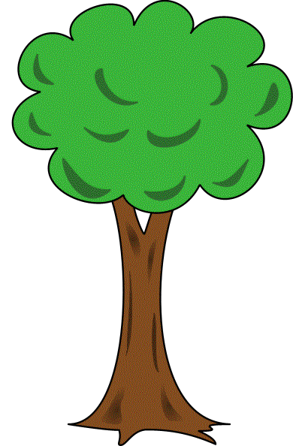
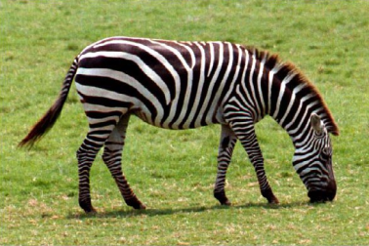
Energy moves through ecosystems in ______________
food chains/webs biogeochemical cycles
Food chains
Which of these is a decomposer?
↑ Fungi and SOME bacteria are decomposers

Slide 6
Organism that eats both plants and
meat
omnivore
Process in which water from plant
leaves evaporates into the atmosphere
transpiration

Slide 7
Give an example of a decomposer
Bacteria or fungi
Which group of organisms is always
found in the first trophic level of
every food chain or web?
Autotrophs or producers

Slide 8
Primary consumers are eaten by __________________
Secondary consumers

Slide 9
Why is only about 10% of the energy in an organism transferred in a food chain?
Some is used by organism for life processes such as movement, transport, metabolism, growth, reproduction, and rest is lost as HEAT
Give an example of an ABIOTIC factor
Climate, temperature, precipitation, wind, soil type, water availability, sunlight

Slide 10
Who is it?
Heterotroph that obtains energy by
eating only plants ___________________
Heterotroph that eats both plants and animals _____________________
Heterotroph that breaks down organic
matter (Ex: Fungi & bacteria) __________________
Heterotroph that feed on dead plants and animal remains (EX:Crabs & worms)
and has a mouth ___________________
Heterotroph that eats only meat ___________________
HERBIVORE
OMNIVORE
DECOMPOSER
SCAVENGER/ DETRITIVORE
CARNIVORE

Slide 11
Primary producers are eaten by ________________
Primary consumers
Which of these is an herbivore?
↑ Zebras are herbivores

Slide 12
Tell two ways water returns to the
atmosphere in the water cycle.
Evaporation and transpiration

Slide 13
Name a limiting factor that could
cause a population to decrease
Competition- for food, shelter, territory
Predation
Disease/Parasitism
Drought/climate change
Human disturbance

Slide 14
Organism that captures and eats
another
predator

Slide 15
This diagram shows a ____________
Which of the organisms above is:
a primary producer ? ___________
How many trophic levels are shown?
food chain
BIOLOGY; Miller and Levine; Prentice Hall; 2006
algae
5
Notes:
*

Slide 16
Symbiotic relationship in which
both organisms benefit from their close
association
mutualism
An “organism’s job” that includes what it eats,
what eats it, where in the habitat it lives, how it
acts, and when & how it reproduces?
niche

Slide 17
Which of the organisms above is:
a secondary consumer?
BIOLOGY; Miller and Levine; Prentice Hall; 2006
Small fish
Notes:
*

Slide 18
Which of the organisms above is:
a tertiary consumer? _____________
BIOLOGY; Miller and Levine; Prentice Hall; 2006
squid
Notes:
*

Slide 19
Group of organisms so similar that they can breed and produce fertile offspring
species
An organism that is captured and
eaten by another
prey

Slide 20
Symbiotic relationship in which one
organism benefits but the other is
neither harmed nor helped
commensalism
The scientific study of interactions
between organisms and between
organisms and their environment
ecology

Slide 21
Relationship in which organisms attempt to use the same resource at the same time and place
competition

Slide 22
Each step in a food chain or web
trophic level

Slide 23
Which of the organisms above is:
a quaternary consumer? __________
BIOLOGY; Miller and Levine; Prentice Hall; 2006
shark
Notes:
*

Slide 24
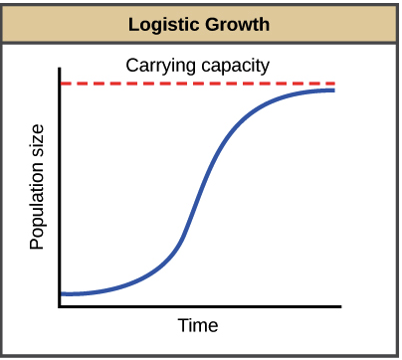
The maximum population size an environment can support is called
Carrying capacity

Slide 25
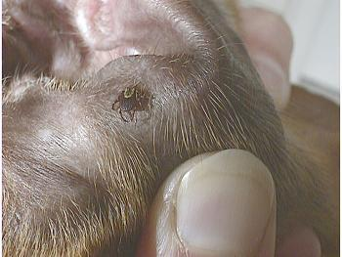
A tick sucking a dog’s
blood is an example of which kind of symbiosis?
parasitism

Slide 26
Process in which green plants use
energy from sunlight to produce
carbohydrates
photosynthesis

Slide 27
Cycle in which photosynthesis and
cellular respiration participate
Carbon cycle

Slide 28
Any relationship in which two species
live closely together
symbiosis

Slide 29
Interaction in which one organism captures and feeds on another.
predation
Network of complex interactions
linking all the food chains in an ecosystem
food web

Slide 30
Cycle in which volcanic activity and burning fossil fuels plays a role
Carbon cycle
Cycle which is dependent on bacteria
for nitrogen fixation and denitrification
Nitrogen cycle

Slide 31
Which type of organism is always on the first trophic level of every food chain
A producer

Slide 32
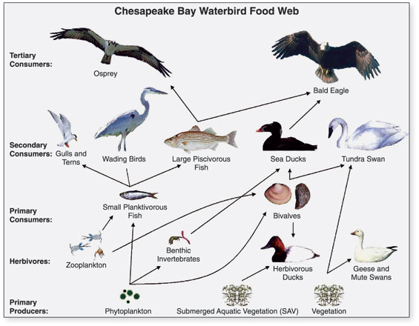
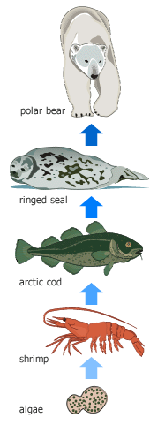

Slide 33
