Slide 1
FOOD CHAINS & ENERGY PYRAMIDS
Watch when doing the worksheet “food chains & energy pyramids”

Slide 2
A food chain shows how energy flows from one organism into another. The arrow always points to the EATER, because chemical energy is going into the eater.

Slide 3
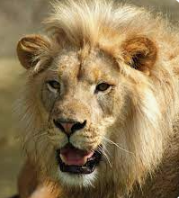
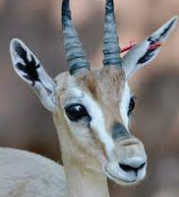
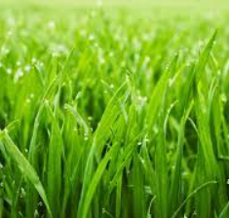
This is a good food chain
grass
gazelle
lion

Slide 4
This is not
grass
gazelle
lion

Slide 5
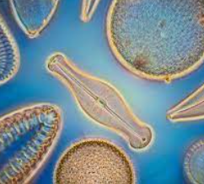
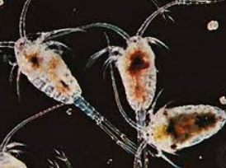
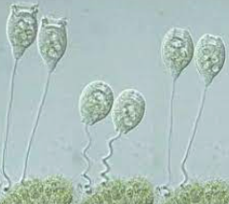
In nature would you expect to see more diatoms or vorticella?
diatom
copepod
vorticella

Slide 6
Make a simple food chain from the cards
Leopard seal
Killer whale
Krill shrimp
Cod fish
algae

Slide 7
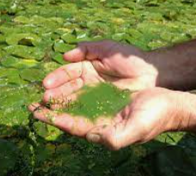
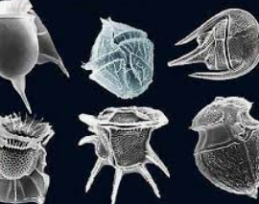
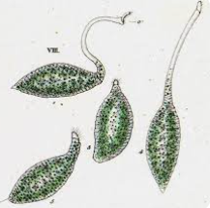
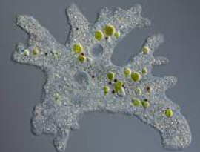
What might happen to the other organisms if blue green algae were removed?
Blue green algae
dinoflagellate
Amoeba
Lacrymaria
The other populations would have less to eat.
The other populations would go down.

Slide 8
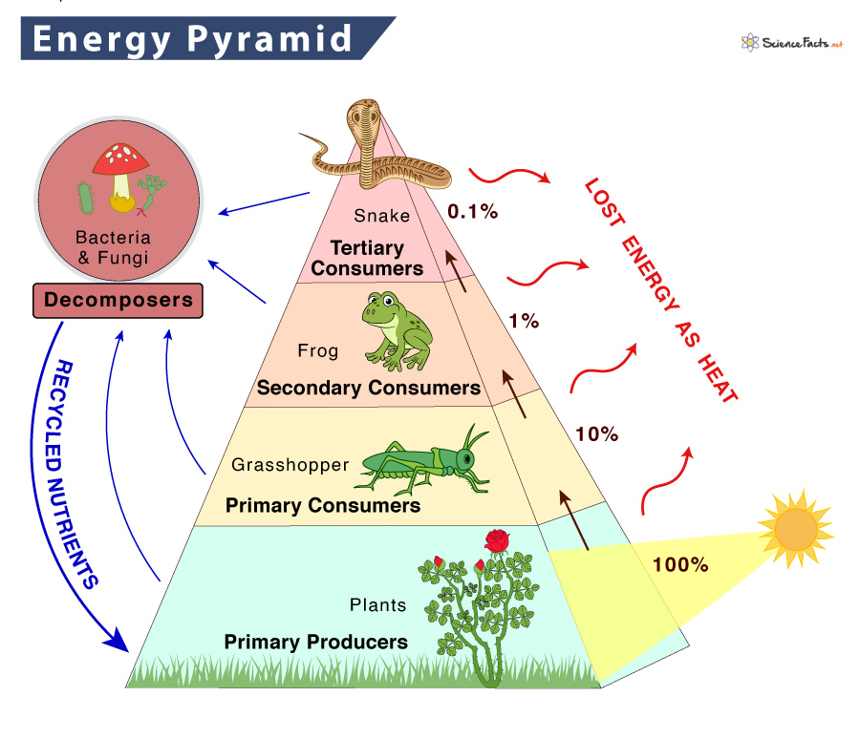
THE SUN POWERS THE BOTTOM LAYER. USEABLE ENERGY IS LOST EVERY LAYER YOU GO UP

Slide 9
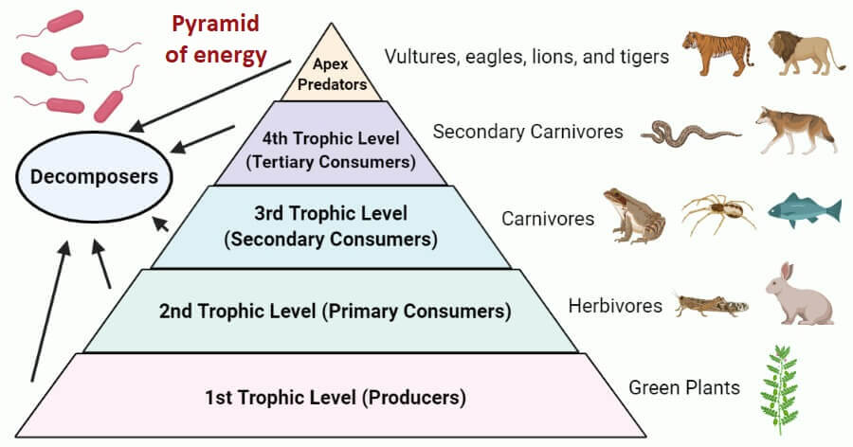
TWO DIFFERENT NAMES CAN BE GIVEN TO THE ORGANISMS IN EACH LEVEL (PRIMARY CONSUMERS & HERBIVORES)

Slide 10
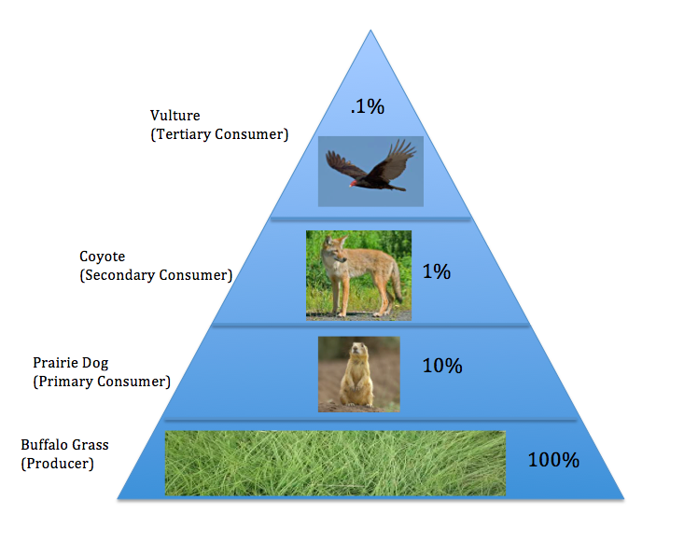
ABOUT 90% OF THE USEABLE ENERGY IS LOST EVERY TIME YOU MOVE UP A TROPHIC LEVEL
IF YOU COUNT THE TOTAL CALORIES AVAILABLE IN THE BOTTOM LAYER (ALL THE GRASS) AND COMPARE IT TO ALL THE CALORIES IN THE BODIES OF THE PRAIRIE DOGS, THE ANIMALS WOULD HAVE ONLY 1/10 AS MANY

Slide 11
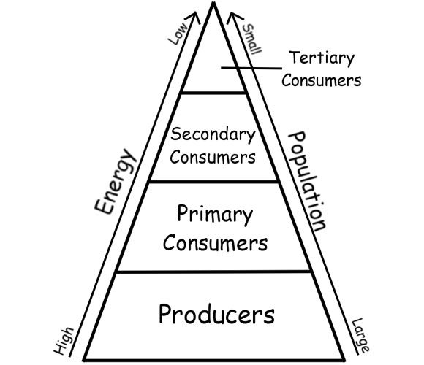
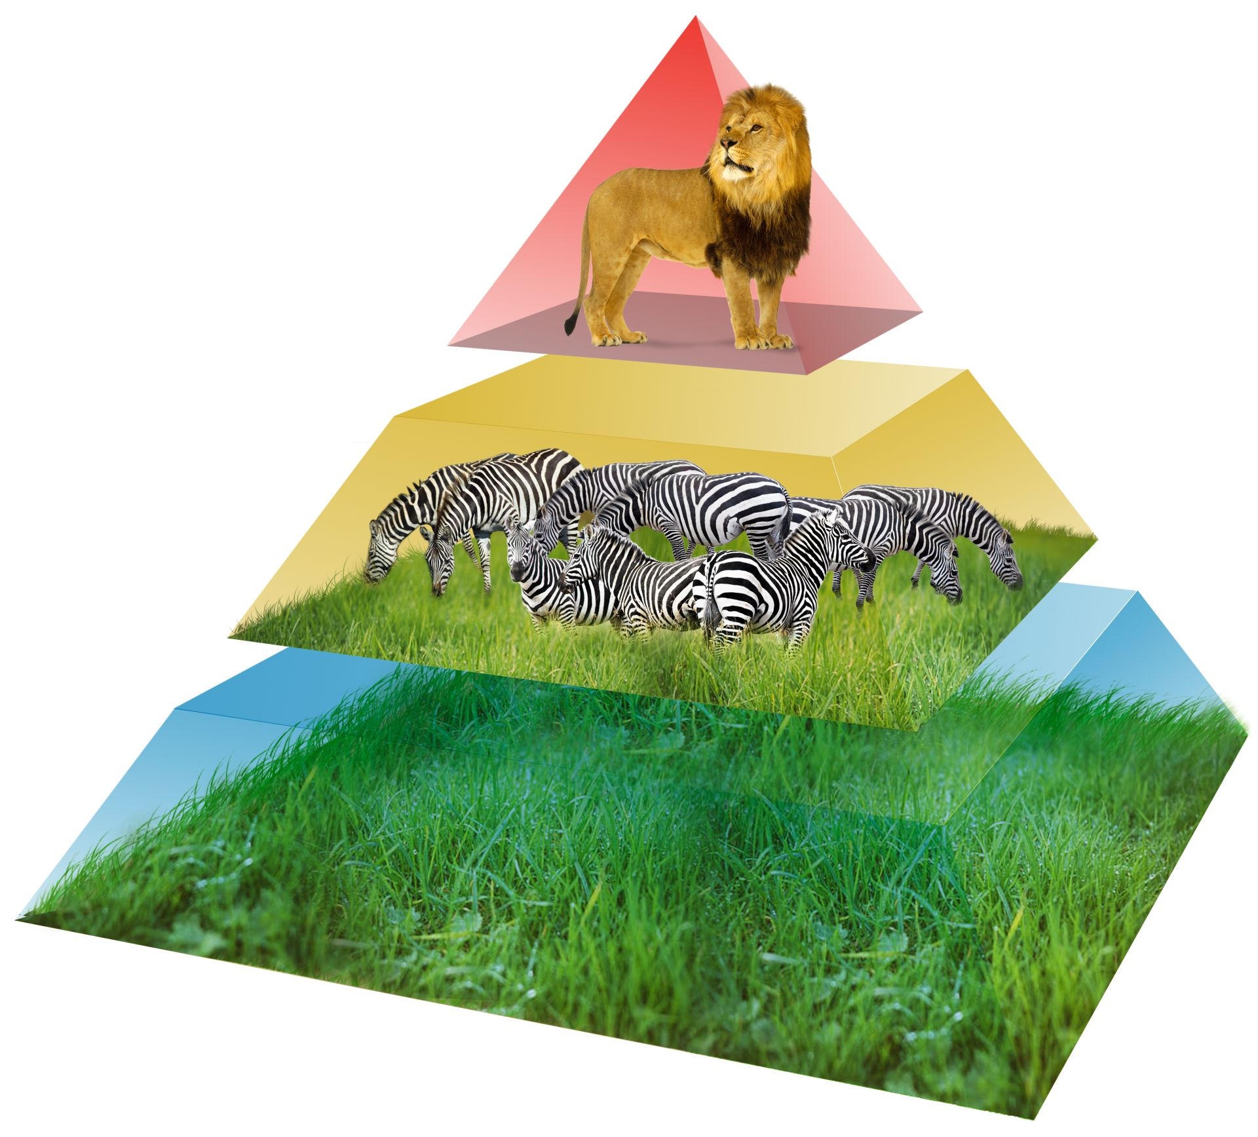
THE POPULATION NUMBERS IN THE LOWEST TROPHIC LEVEL IS THE HIGHEST, AND THE TOP LEVEL HAS THE FEWEST MEMBERS IN ITS POPULATION.

Slide 12
How does the energy change as you go up the pyramid?

Slide 13
How does the number of organisms change as you go down the pyramid?

Slide 14
What are the levels of the energy pyramid called?

Slide 15
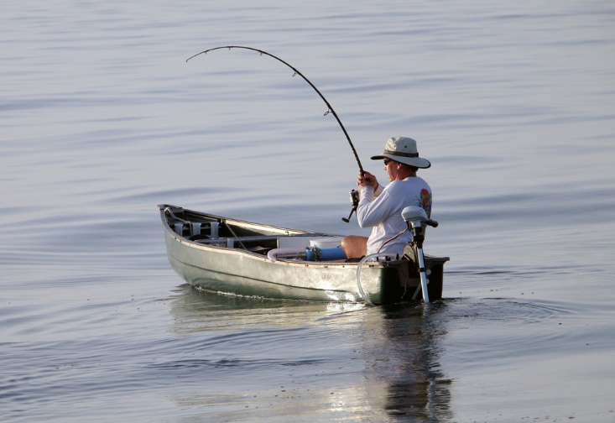
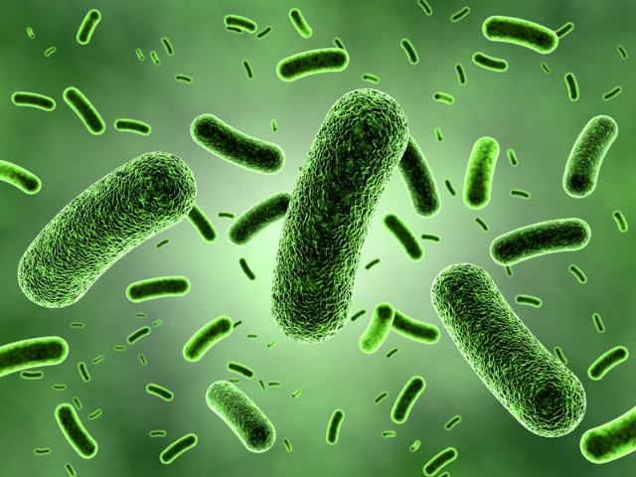
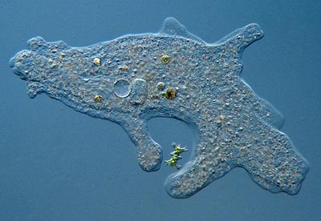
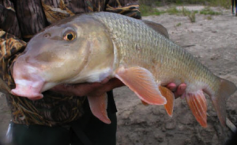
Place into the pyramid
Amoeba
Bacteria
Fisherman
Sucker fish

Slide 16
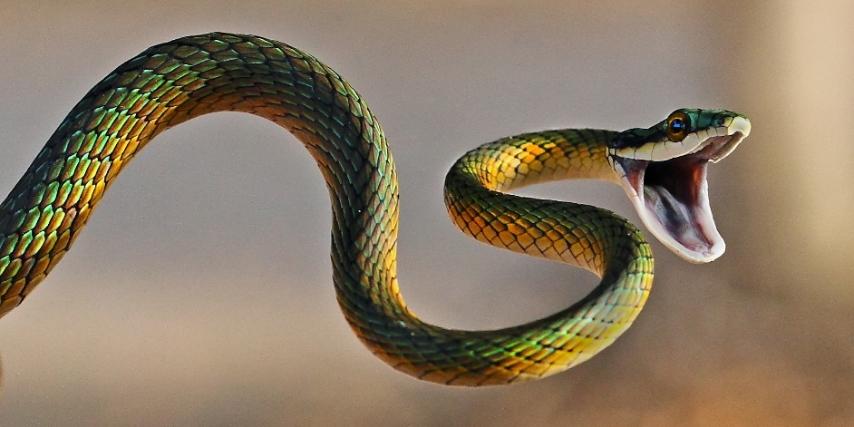
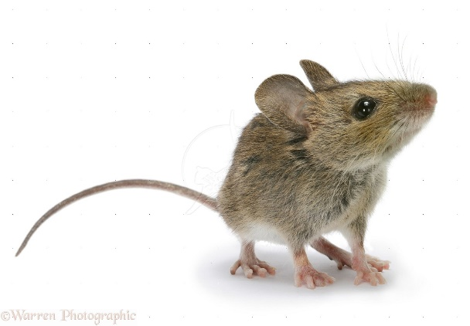
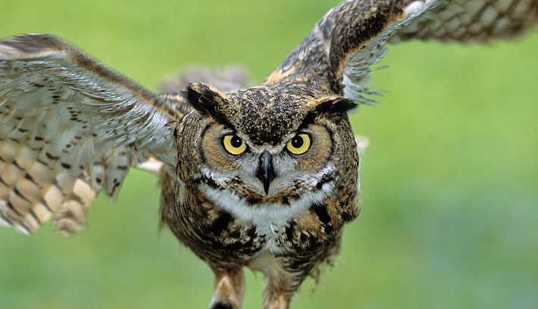
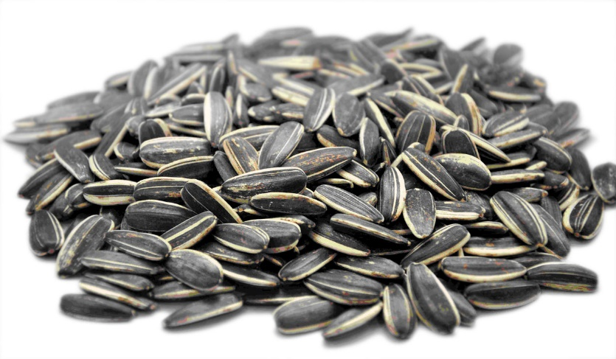
Place into the pyramid
Snake
Mouse
Owl
Sunflower seed

Slide 17
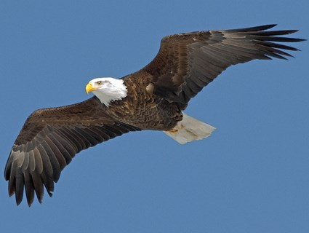
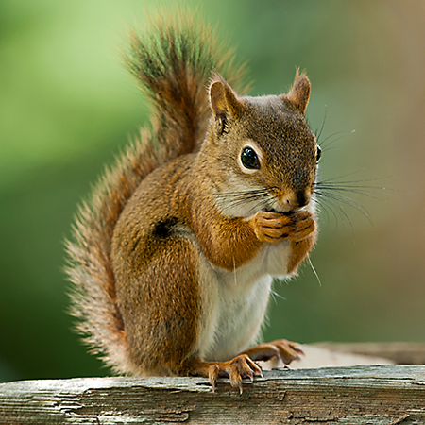
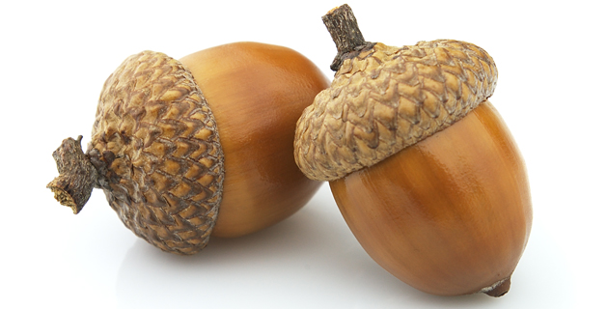
Place into the pyramid
Acorn
Squirrel
Eagle

Slide 18
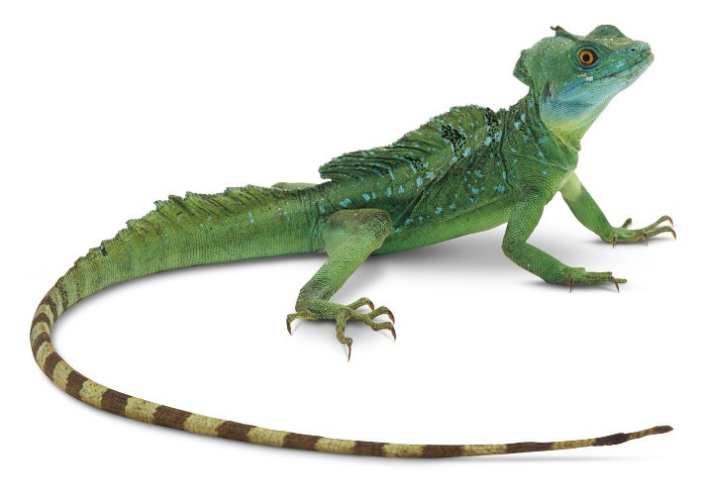
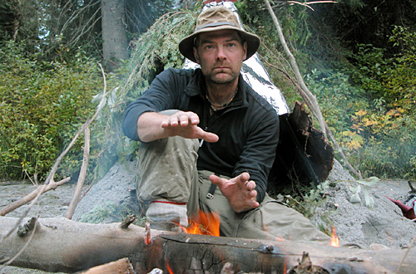
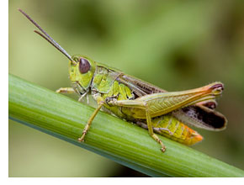
Place into the pyramid
Lizard
Survivorman
Grasshopper
leaf

Slide 19
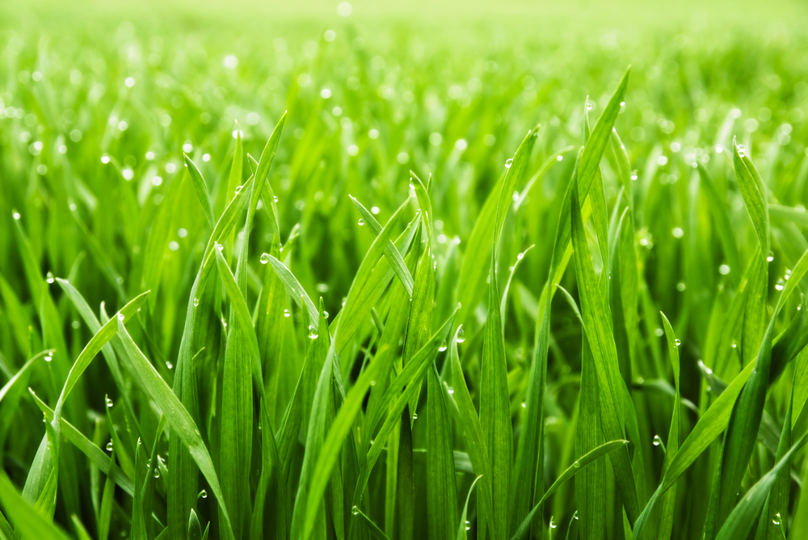
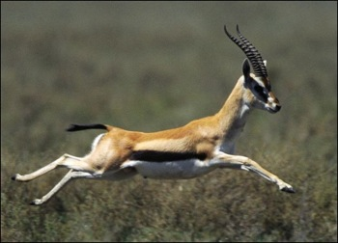
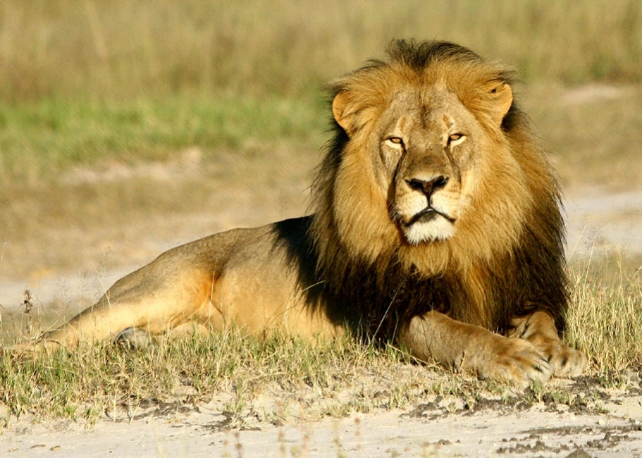
Place into the pyramid
Lion
Gazelle
grass

