Slide 1
Rock graph review

Slide 3
Which mineral needs the highest temperature to become liquid?

Slide 4
Which mineral remains in the liquid/crystal state longest?

Slide 5
How does the amount of calcium a mineral has affect its melting temperature?

Slide 6
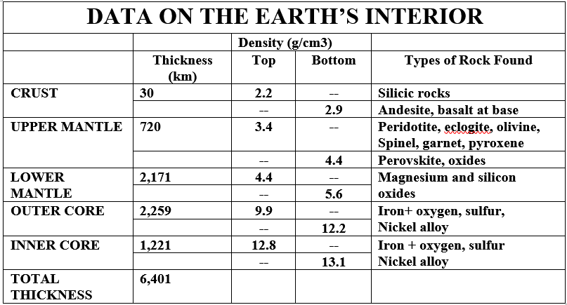

Slide 7
Where would you find basalt?

Slide 8
Which layer is the greatest percent of total thickness?

Slide 9
Why is garnet (a precious gem) rare?

Slide 10
What is the trend for density as you move toward the center of the Earth?

Slide 11
Which step best represents weathering and erosion?

Slide 12
Which step best represents the formation of igneous rock?

Slide 13
Which step best represents the formation of metamorphic rock?

Slide 14
Which step best represents the formation of sedimentary rock?

Slide 15
Draw the rock cycle

