Slide 1
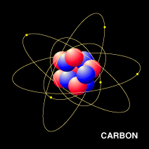
The importance of carbon in cells

Slide 2
Carbon is found throughout plant, animal, protist, fungi, and moneran cells

Slide 3
Carbon atoms are used to make:
Cell membranes
Fats
Carbohydrates
Proteins
DNA
Enzymes
Structural items in cells and outside of them (collagen, microtubules, cytoskeleton)

Slide 4
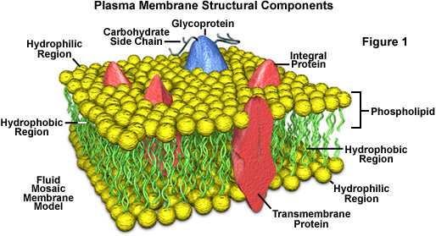
Cell membranes are filled with carbon atoms
Cell membrane animations HERE

Slide 5
Fat molecules—look at all the carbon atoms

Slide 6
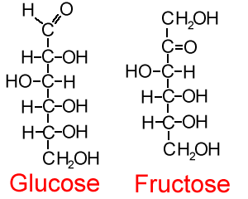
Carbohydrate molecules—look at all the carbon atoms

Slide 7
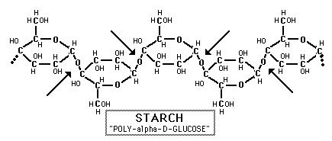
Carbohydrates usually form in rings. Look at all the carbon atoms

Slide 8
Protein molecules are made from amino acids. Each amino acid has plenty of carbon atoms

Slide 9
All the amino acids that exist

Slide 10
The amino acids get chained together. The shortest protein has 9 amino acids, the longest has over 50,000!

Slide 11
Chains twist into globs called protein

Slide 12
Pay attention to all the carbon atoms as a cell builds proteins
Protein building animation HERE

Slide 13
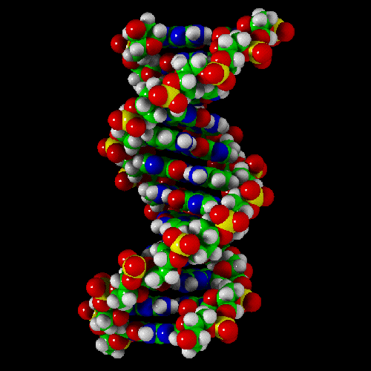
DNA, the instructions for all living things, is made with carbon atoms
DNA structure animation HERE
This is just one tiny snippet of DNA

Slide 14
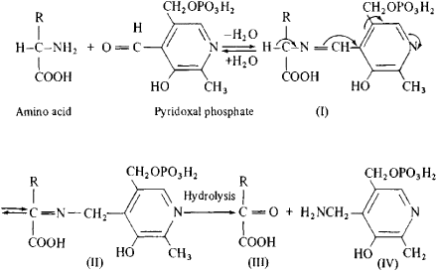
Enzymes—notice the carbons. This enzyme can transform amino acids

Slide 15
Moral of the story:
Cells are incredibly complicated units of life
All cell molecules contain carbon atoms
Carbon is the basis of all life

