Slide 1
Video
https://www.youtube.com/watch?v=WPA-KpldDVc

Slide 2
El Nino & La Nina
The History:
-First identified in the 1600s by a fisherman!
-Warm southward-flowing ocean current during Christmas.
-“The Little Boy” or “Christ Child”

Slide 5
What is El Nino?
The Trade Winds weaken!
How bad can that be? What’s the worse that can happen?

Slide 6
What is El Nino…continued

Slide 7
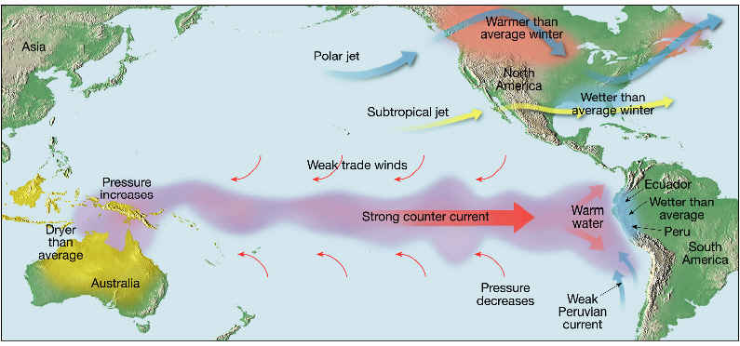
What is different? What will happen?

Slide 8
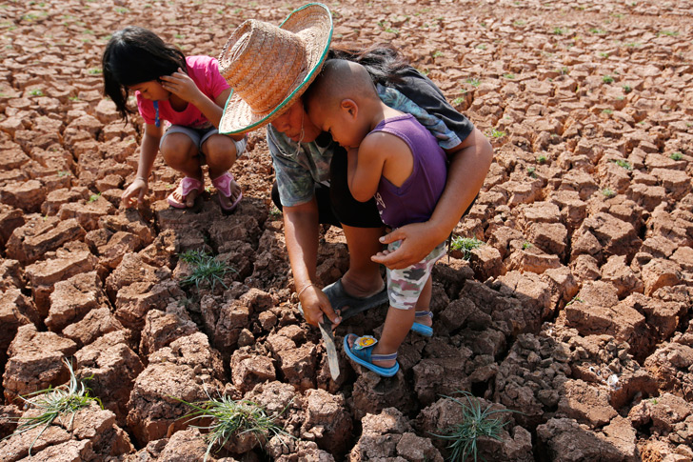
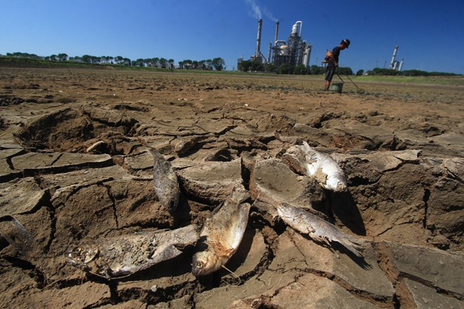
Devastating Droughts in Asia

Slide 9
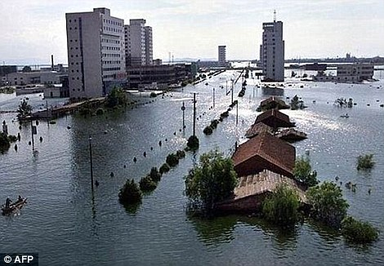
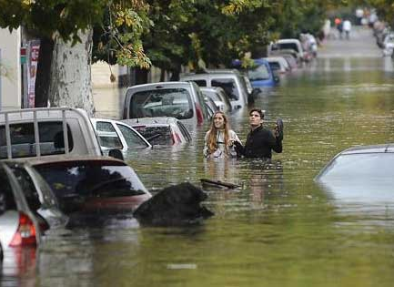
Flooding in S. America

Slide 10
El Nino in Michigan.
Notes:
Generally speaking El Niño is associated with warmer-than-average temperatures and drier-than-average conditions in the Great Lakes region. El Nino doesn't typically have much influence on Michigan's summer weather (more on that later), but can greatly alter our winter pattern. Michigan's winter has a pretty good chance of being warmer and drier than normal during a strong El Nino.
If you've ever golfed in December, it was most likely during a strong El Nino. Do you remember Christmas Day 1982? Detroit hit 64 degrees after a morning low of 50 degrees. In the strong El Nino of 1997-1998 Michigan had five January days in a row above 50 degrees.

Slide 11
La Nina in Michigan
Notes:
Generally speaking El Niño is associated with warmer-than-average temperatures and drier-than-average conditions in the Great Lakes region. El Nino doesn't typically have much influence on Michigan's summer weather (more on that later), but can greatly alter our winter pattern. Michigan's winter has a pretty good chance of being warmer and drier than normal during a strong El Nino.
If you've ever golfed in December, it was most likely during a strong El Nino. Do you remember Christmas Day 1982? Detroit hit 64 degrees after a morning low of 50 degrees. In the strong El Nino of 1997-1998 Michigan had five January days in a row above 50 degrees.

Slide 12
El Nino or La Nina?

