Slide 1
TIDES
How do they work?

Slide 2
WATCH THESE MINI MOVIES
https://www.youtube.com/watch?v=l37ofe9haMU https://www.youtube.com/watch?v=tcGEjzt_4is https://www.youtube.com/watch?v=3RdkXs8BibE https://www.youtube.com/watch?v=yg6t2rZBWGY

Slide 6
TIDES CAN BE PREDICTED BY THE HOUR AND BY THE AMOUNT THE WATER RISES

Slide 11
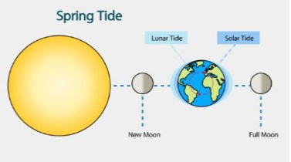

Slide 13
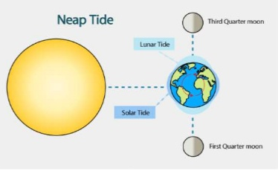

Slide 15
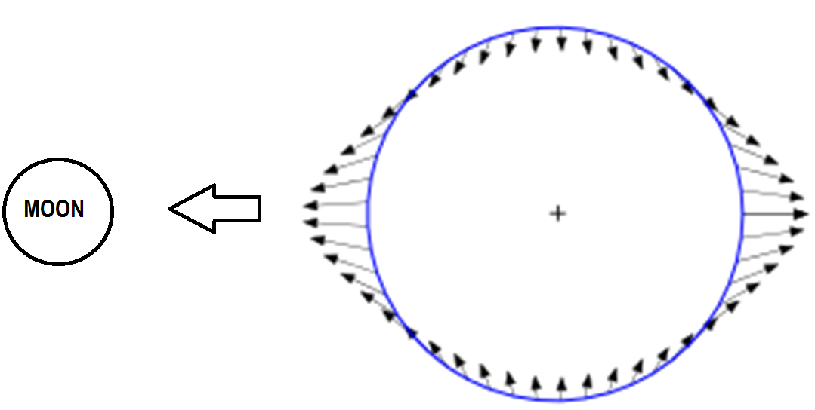
TIDAL FORCES ON AN ASTRONOMICAL BODY LOOK LIKE THIS

Slide 16
THE POLES ARE COMPRESSED TOWARD THE CENTER OF THE PLANET AND THE MIDDLE ZONES BULGE OUT TOWARD THE OBJECT EXERTING A GRAVITATIONAL PULL

Slide 17
THE BULGE OCCURS IN BOTH THE WATER AND THE LAND, BUT THE LAND MOVES LESS AND SINCE YOU ARE STANDING ON IT AND MOVING UP AS WELL, YOU DON’T NOTICE

Slide 18
WHY DOES THE BACKSIDE BULGE OUT?
A IS MORE ATTRACTED THAN THE CENTER OF THE EARTH (BECAUSE IT’S CLOSER), AND THE CENTER OF THE EARTH IS MORE ATTRACTED THAN THE BACKSIDE (B), THUS B GETS “LEFT BEHIND” BECAUSE IT IS ATTRACTED THE LEAST

Slide 19
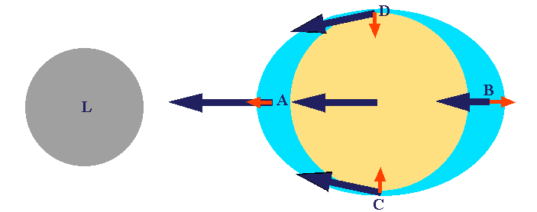
WHY IS THERE A LOW TIDE AT POINTS C AND D?

Slide 20
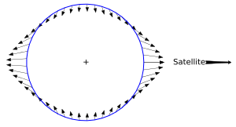
THE TIDAL FORCES ARE CAUSING THE WATER TO PUSH BOTH DOWN AND (ULTIMATELY SIDEWAYS) AND THAT HELPS MAKE THE BULGE EVEN BIGGER

Slide 21
IT IS NOT BECAUSE THE WATER IS RUSHING FROM POINTS D AND C TO POINTS A AND B. IF SO, THERE WOULD BE TIDAL CURRENTS THAT ARE HUNDREDS OF MPH

Slide 22
3 types of tides
Diurnal tide= one high and one low tide
Semidiurnal tide= 2 high and low tides of nearly equal heights
Mixed semidiurnal tide= 2 high and low tides of unequal heights

