Slide 1
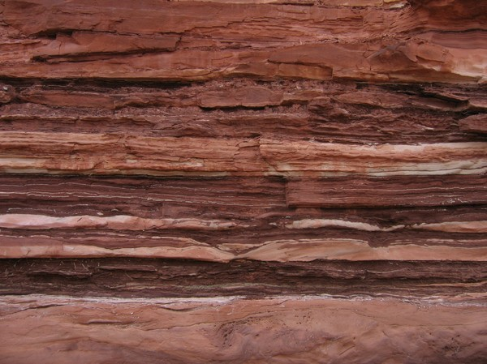
Rock notes chapter 3-1

Slide 2
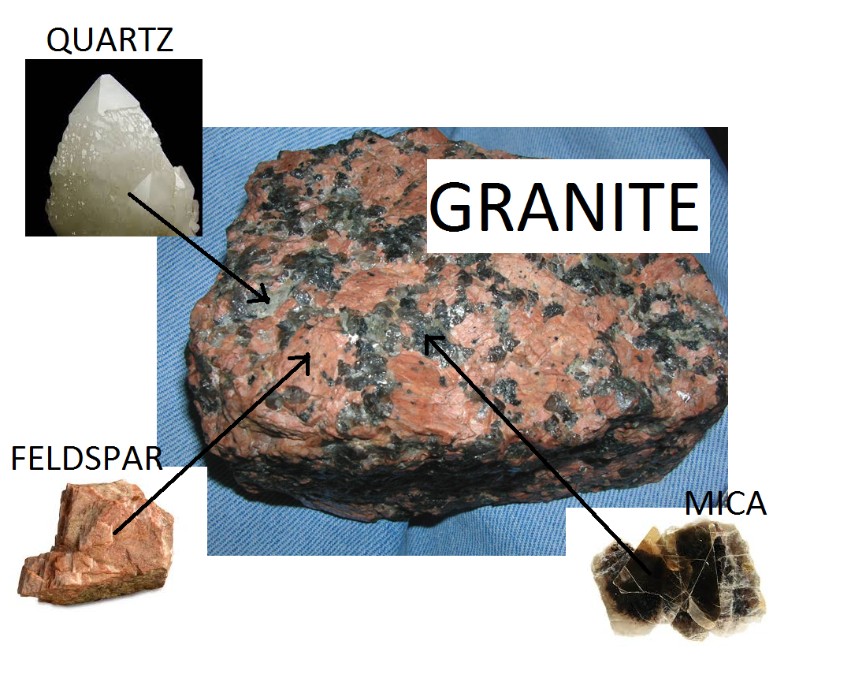
ROCK-A mixture of one or more minerals

Slide 3
A] Three major types of rock:
IGNEOUS – formed from magma or lava cooling and hardening
SEDIMENTARY– formed when sediment (tiny bits of rock) gets cemented together
METAMORPHIC– When existing rock is changed by heat and/or pressure

Slide 4
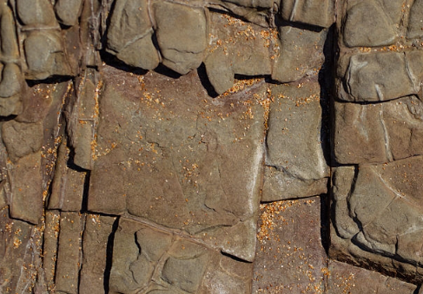
B] ROCK CYCLE
Shows the processes in which rock forms, is destroyed, and forms again.

Slide 5
IGNEOUS
WEATHER, ERODE, DEPOSIT,
COMPACT, CEMENT
MELTING AND COOLING
THE ROCK CYCLE
MELTING AND COOLING
HEAT AND PRESSURE
WEATHER, ERODE, DEPOSIT,
COMPACT, CEMENT
METAMORPHIC
METAMORPHIC
SEDIMENTARY
HEAT AND PRESSURE

Slide 6
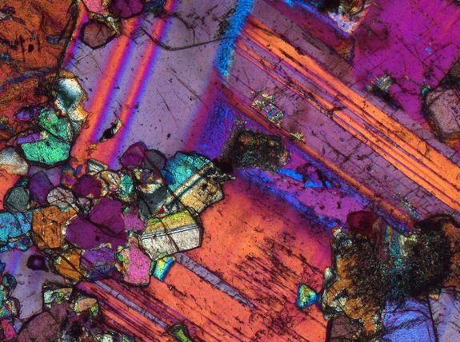
Much of the rock in Earth’s crust has passed through the rock cycle many times, but some rock does not.
These rocks help us to know the age of earth. Once a rock remelts, it’s age clock starts over.
The oldest rocks we have ever found on earth are 4.4 billion years old

Slide 7
By the way, this is a microscopic view of the crystals that formed in an igneous rock. With the naked eye, this just looks like a boring old rock.

