Slide 1
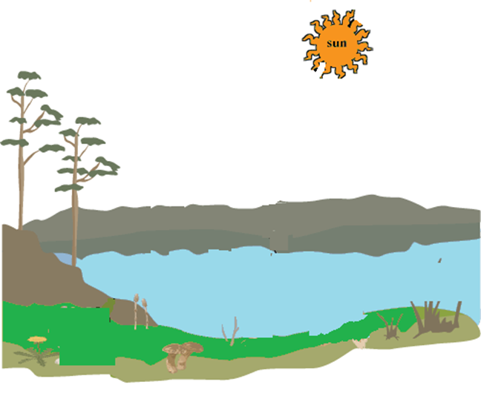
What are the abiotic factors in this picture?

Slide 2
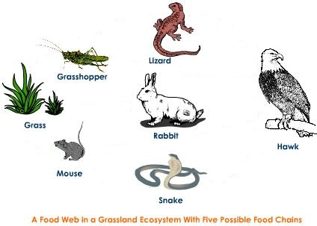

Slide 4
Deciduous forest ecosystem

Slide 5
Deciduous forest ecosystem

Slide 6
Freshwater ecosystem

Slide 7
Freshwater ecosystem

Slide 8
Grassland ecosystem

Slide 9
Grassland ecosystem

