Slide 1
deep sea CREATURES

Slide 2
Frilled shark

Slide 3
Atlantic Wolffish—

Slide 4
can crush mollusks, shellfish, and sea urchins

Slide 5
Fangtooth fish

Slide 6
Giant tube worms
These can get 12 ft long!

Slide 7
Vampire squid

Slide 8
Pacific viperfish-lure prey with bioluminescent photophores on their bellies.

Slide 10
Giant isopod—related to pillbug

Slide 12
Long-nosed Chimaera --A touch of the venomous spine on the first dorsal fin can kill a person. But they live 8000 ft down so it’s unlikely

Slide 13
Do you see the glow-in-the-dark (bioluminescent) fishing lure?

Slide 16
Bristle worm- found around deep sea vents

Slide 17
cephalopod

Slide 18
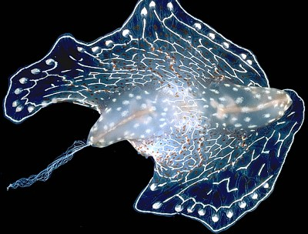
THIS IS A SLUG!

Slide 20
Telescope octopus

Slide 21
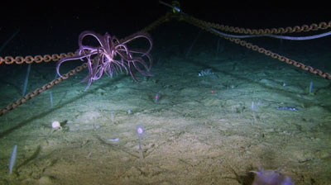

Slide 22
Dumbo octopus

Slide 23
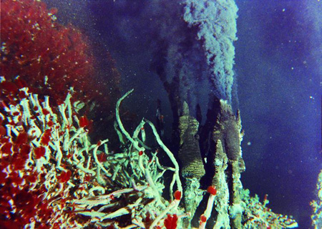
TUBE WORMS AND A SEA VENT

Slide 24
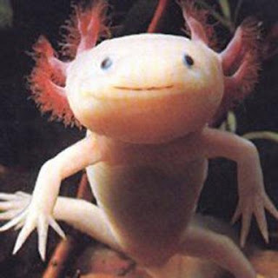
VENT SALAMANDER

Slide 25
Tripod fish

Slide 26
Blob fish

Slide 27
Pacific barreleye- its head really is transparent!
http://www.youtube.com/watch?v=RM9o4VnfHJU

Slide 28
Angler fish- a bioluminescent “lure” attracts prey right to its mouth.

Slide 30
Bioluminescent creatures
http://www.youtube.com/watch?v=XD7thJVRKmQ

Slide 31
More videos
BBC video
http://www.youtube.com/watch?v=saNgbeEe9Tc&feature=related

