Slide 1
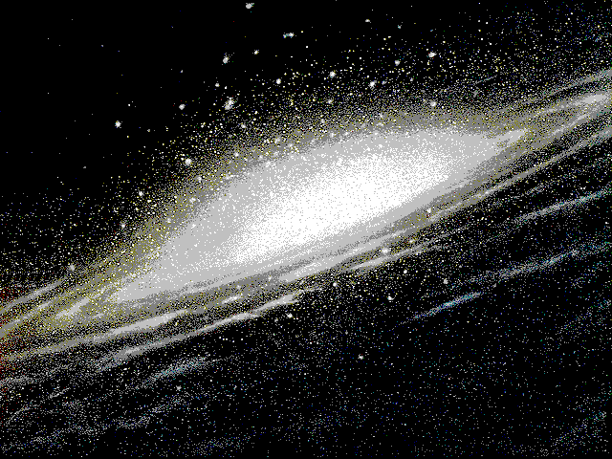
Each dot of light is a star.

Slide 2
A. Galaxy- Billions of stars, gas, and dust held together by gravity

Slide 3
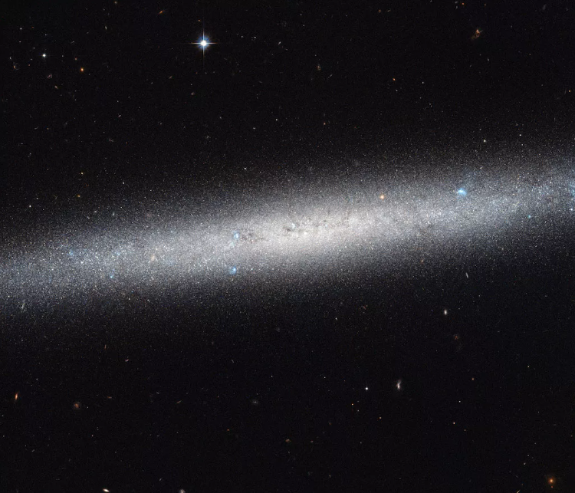
NGC 5023 galaxy

Slide 4
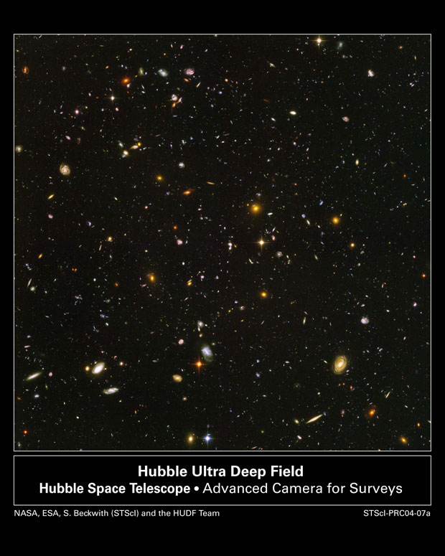
This picture came from a telescope pointed at a black, EMPTY patch of space. We let the light from
These objects come to us for 11 days. It was very
Faint light.

Slide 5
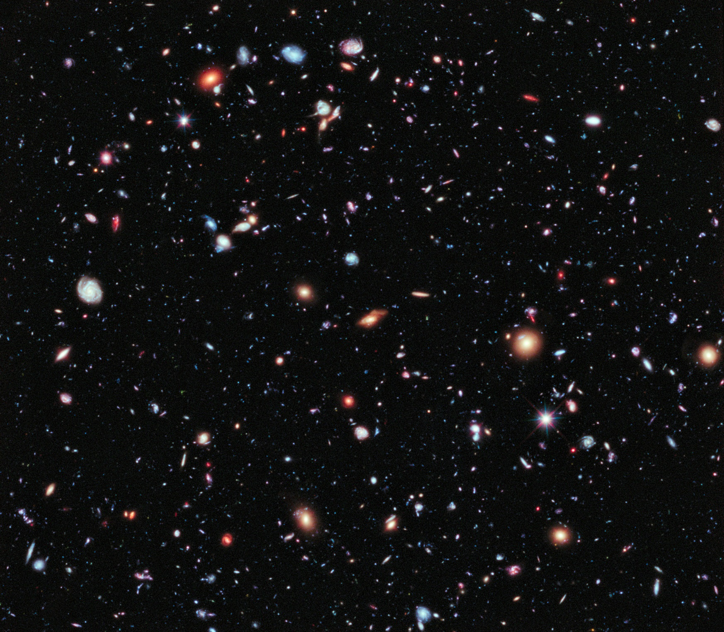
The estimate: 100-200 billion galaxies

Slide 6
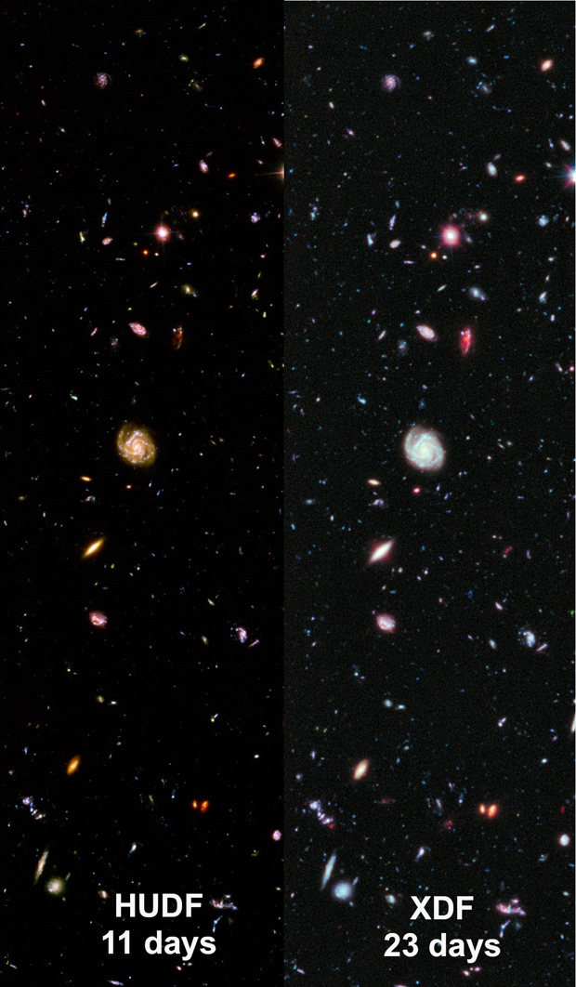
Recently we pointed the telescope at the same patch of sky for 23 days. Even more galaxies were revealed!! How many are there if we let the light soak in for 100 days? A 1000?
11 day exposure
23 day exposure

Slide 7
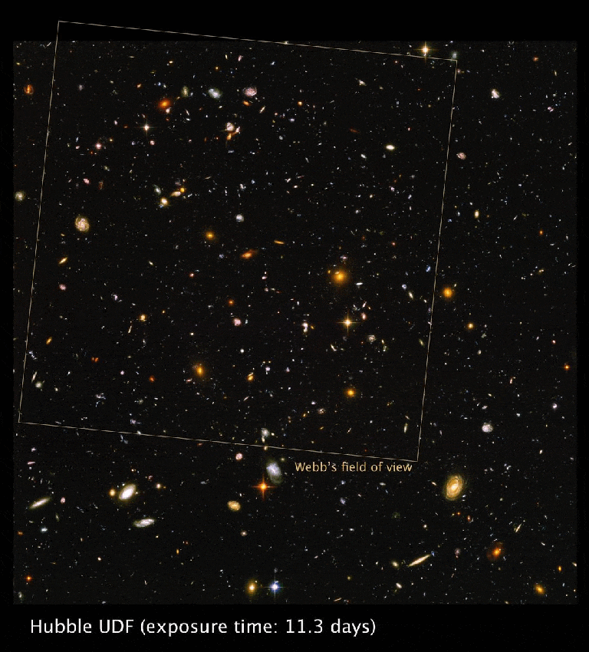
AND THEN WE MADE THE JAMES WEBB TELESCOPE WITH SUPERIOR TECHNOLOGY..

Slide 8
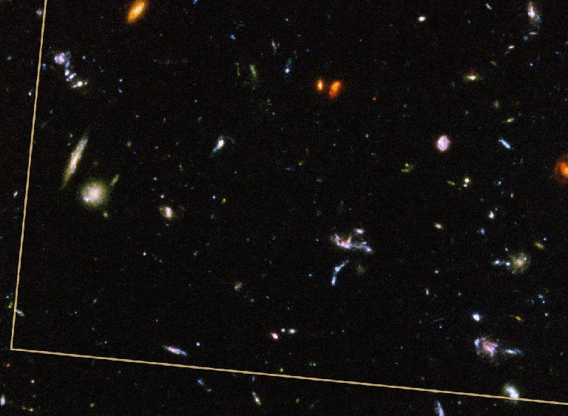
THE JAMES WEBB ULTRA DEEP FIELD REVEALED MUCH MORE
THIS WAS ONLY A 20 HOUR EXPOSURE!!

Slide 9
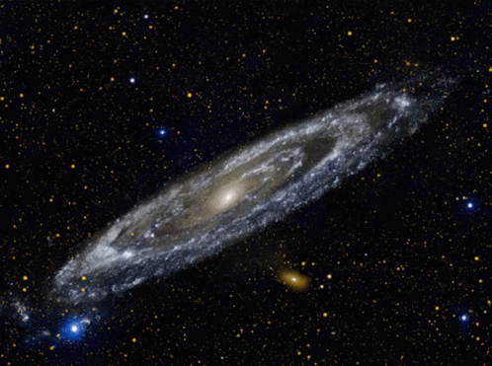
2. all galaxies are spinning on an axis

Slide 10
Types of Galaxies:

Slide 11
There are actually more categories..

Slide 12
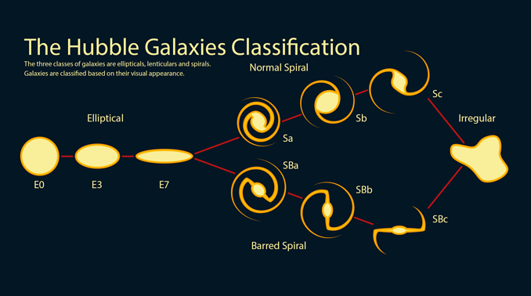
Time progresses as you move to the left. Gravity pulls all things round

Slide 13
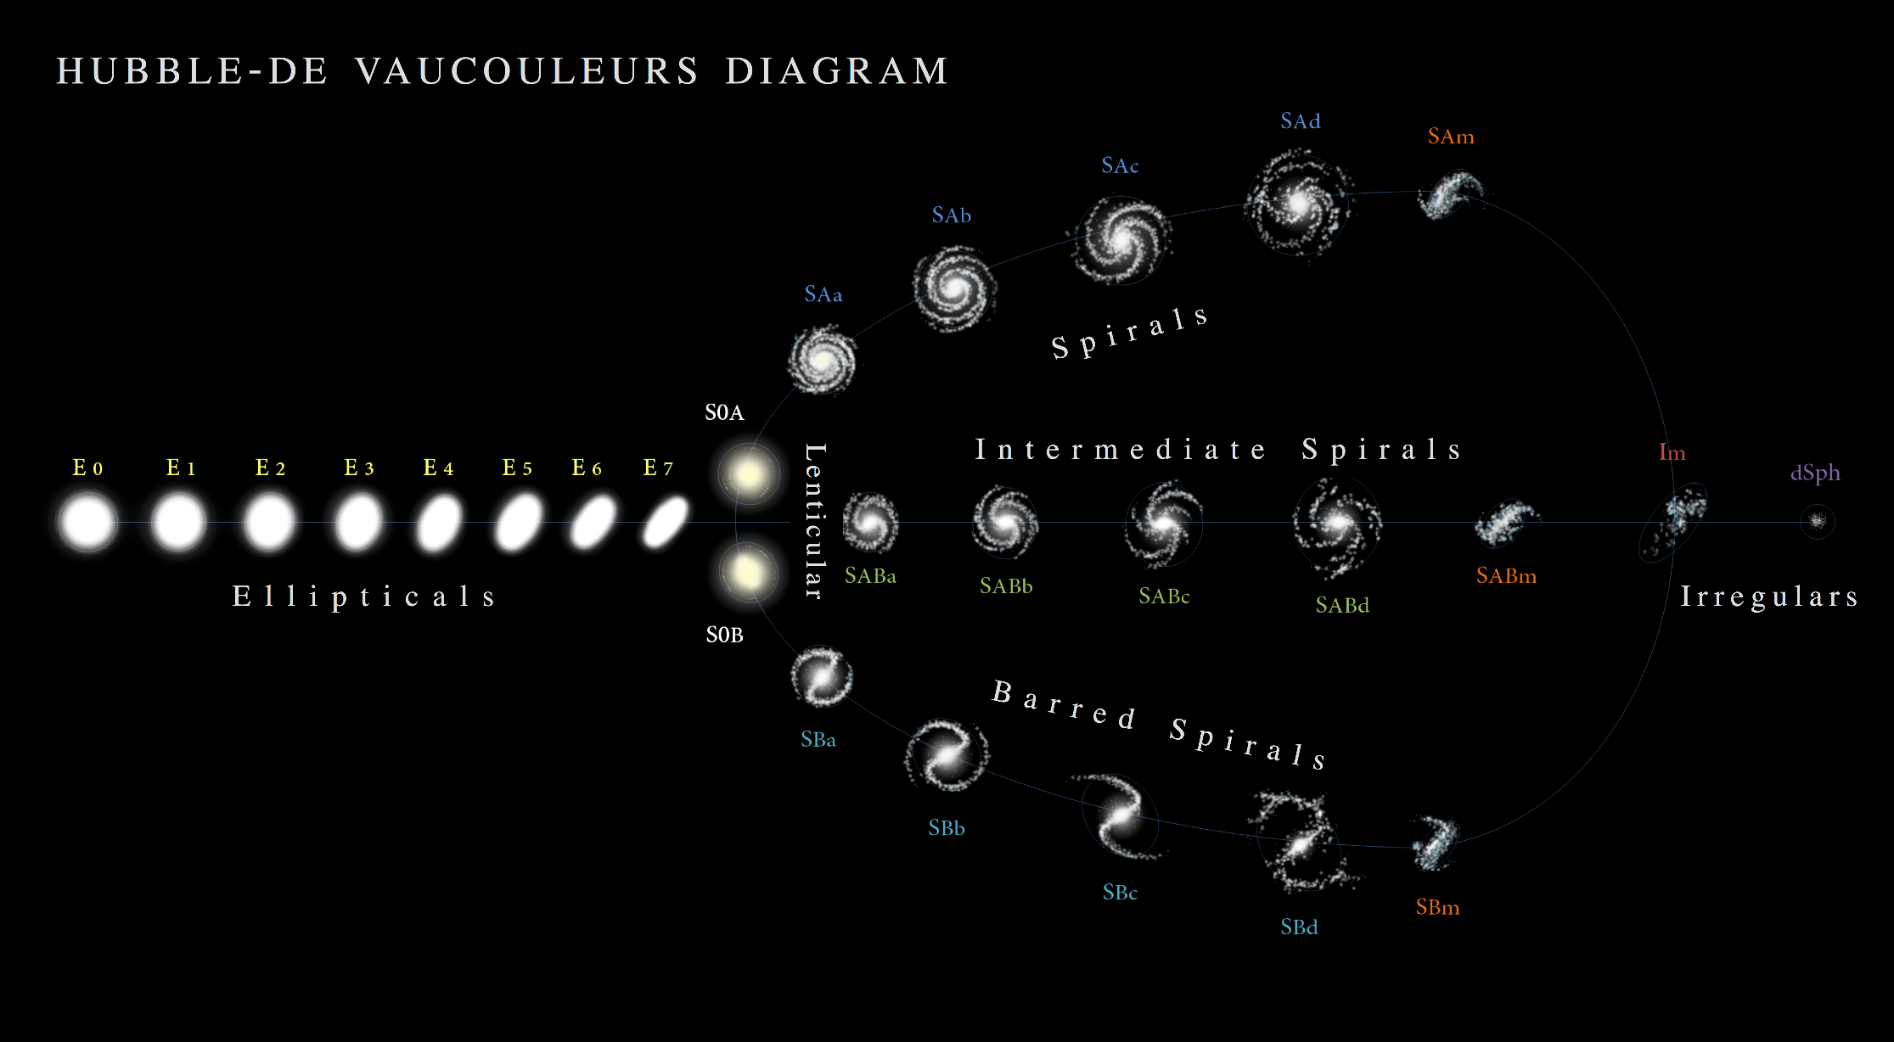
And even more detail…

Slide 14
3] Galaxies are moving away from each other, thus experience the doppler effect
A] large Doppler shift= high speed movement
B] smaller Doppler shift = lower speed

Slide 15
Hubble’s law= a] the farther away the galaxy, the faster it is moving away from us b] red shift proves the universe is expanding

Slide 16
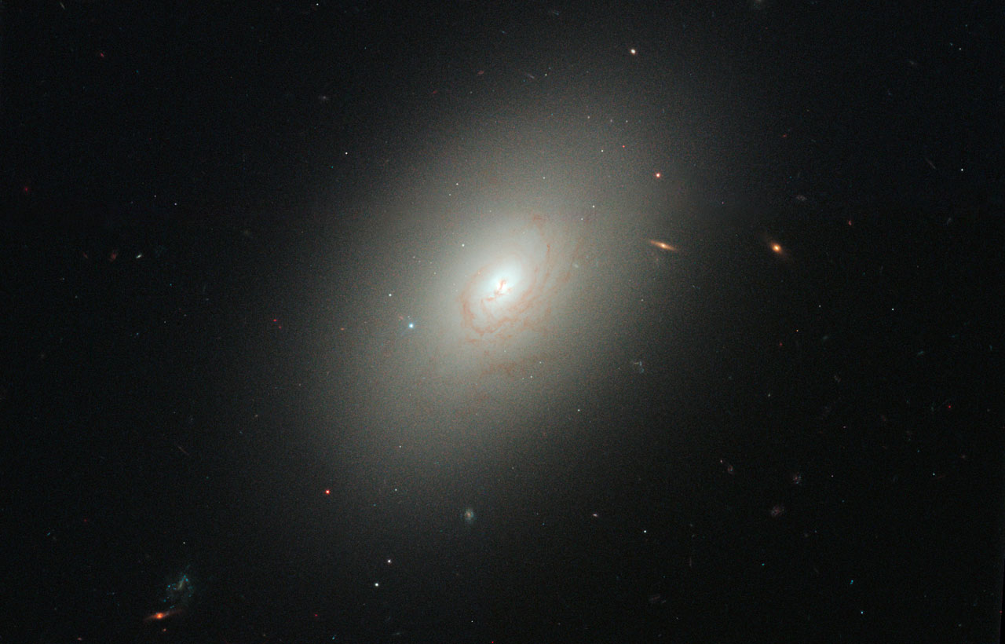
What type is this?

Slide 17
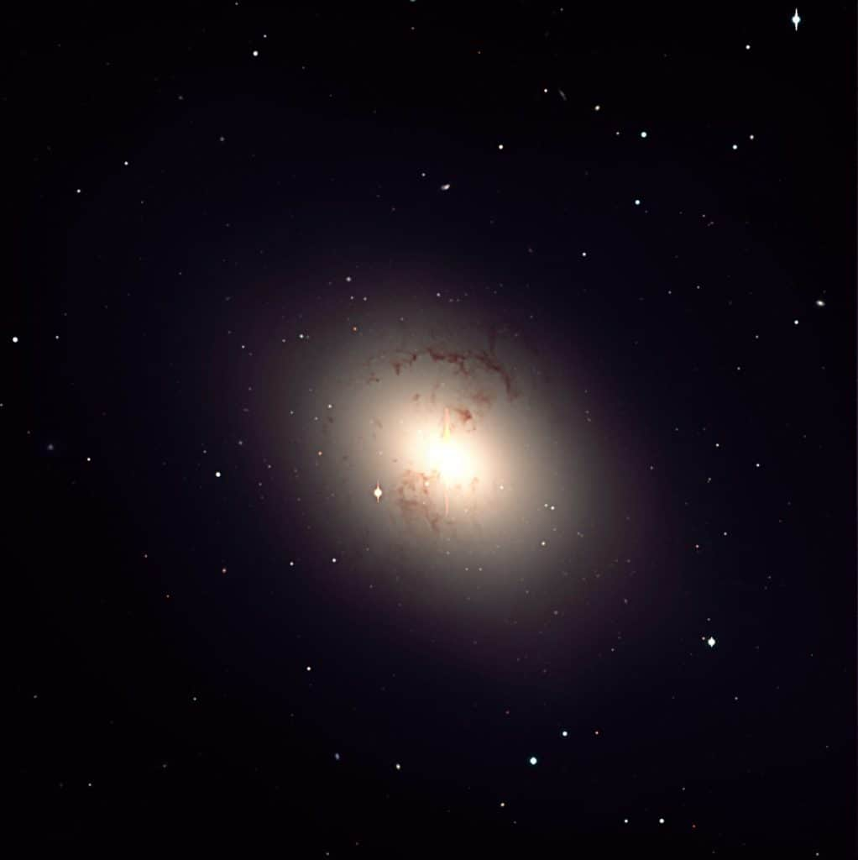

Slide 18
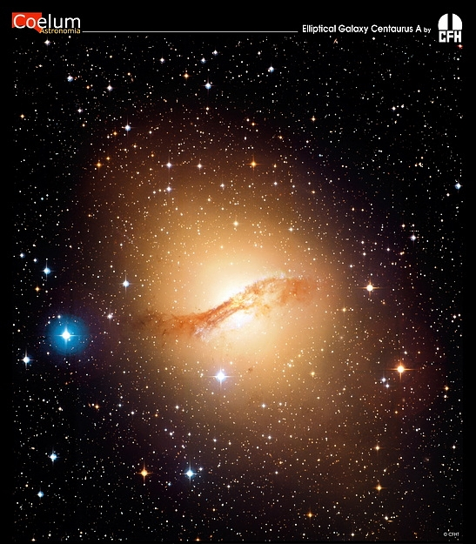

Slide 19
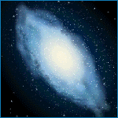
1 Elliptical- large three dimensional galaxies that are shaped like basketballs or footballs
A Most common type
B Oldest galaxies
C contains many old stars
D all galaxies eventually become elliptical. The gravity in the center pulls it all in
E some have over a trillion stars, some are so big it encompasses our entire local group

Slide 20
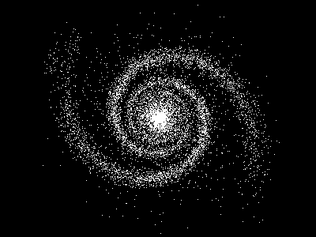
What type is this?

Slide 21
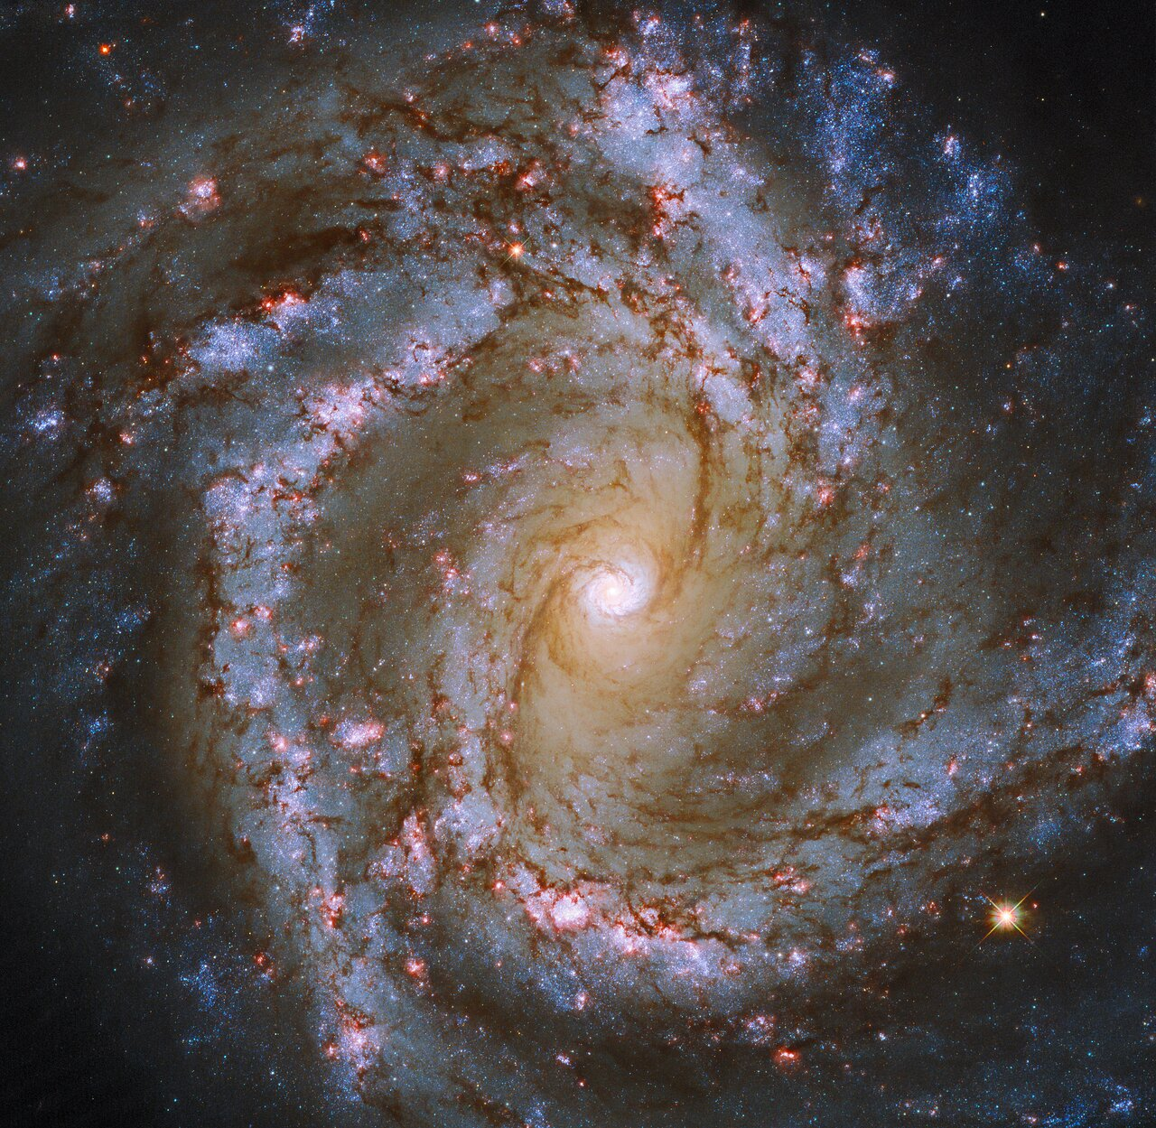

Slide 22
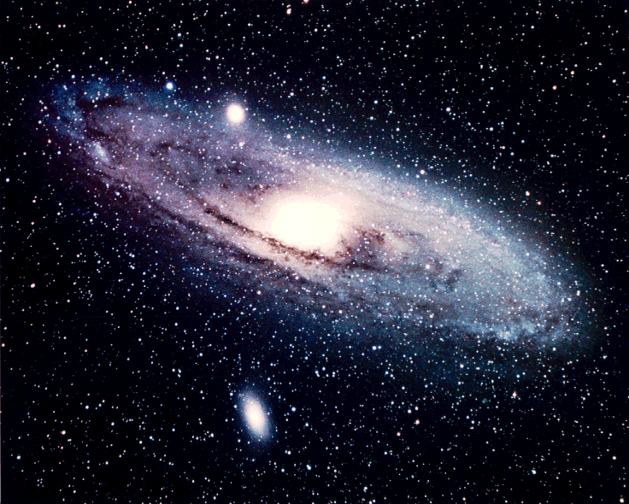

Slide 23
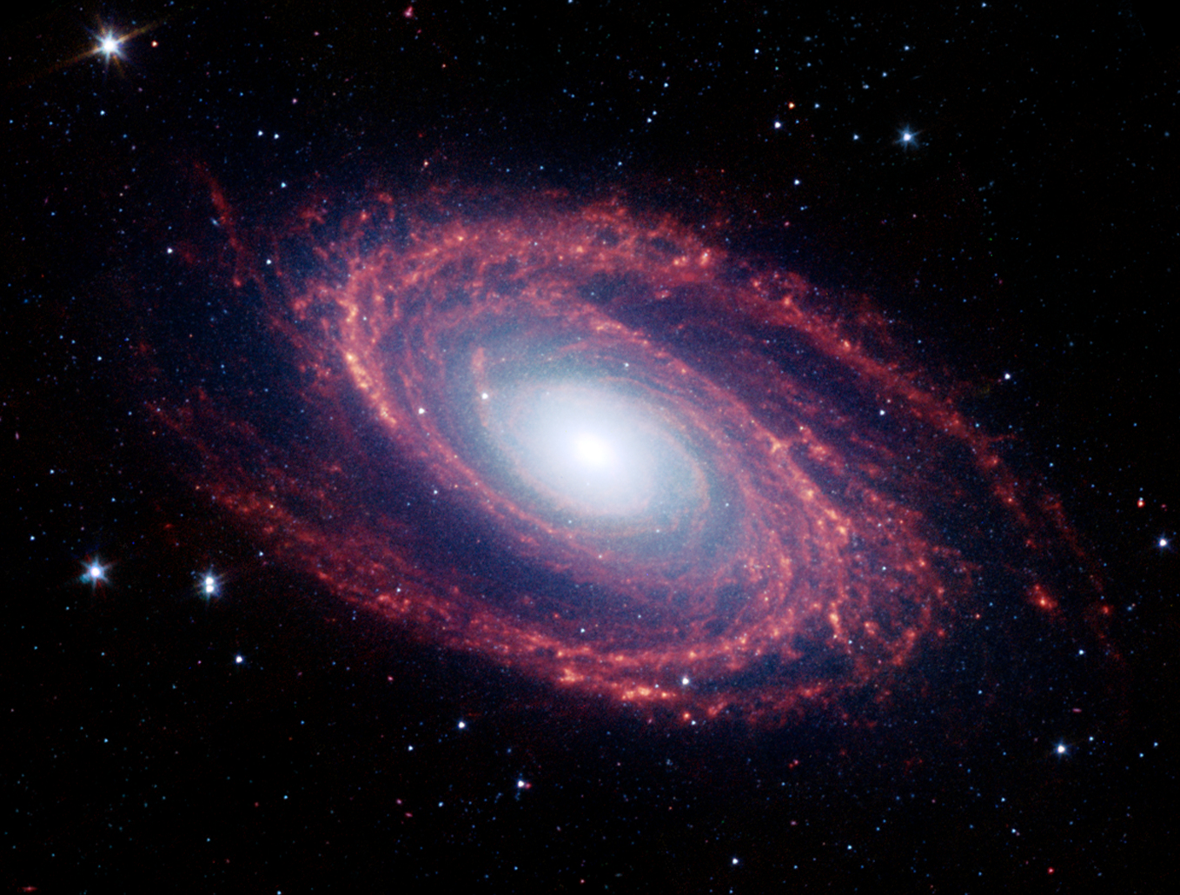

Slide 24
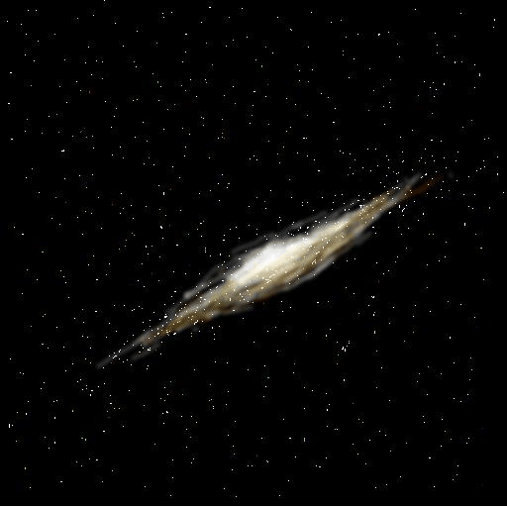
Spiral on its side

Slide 25
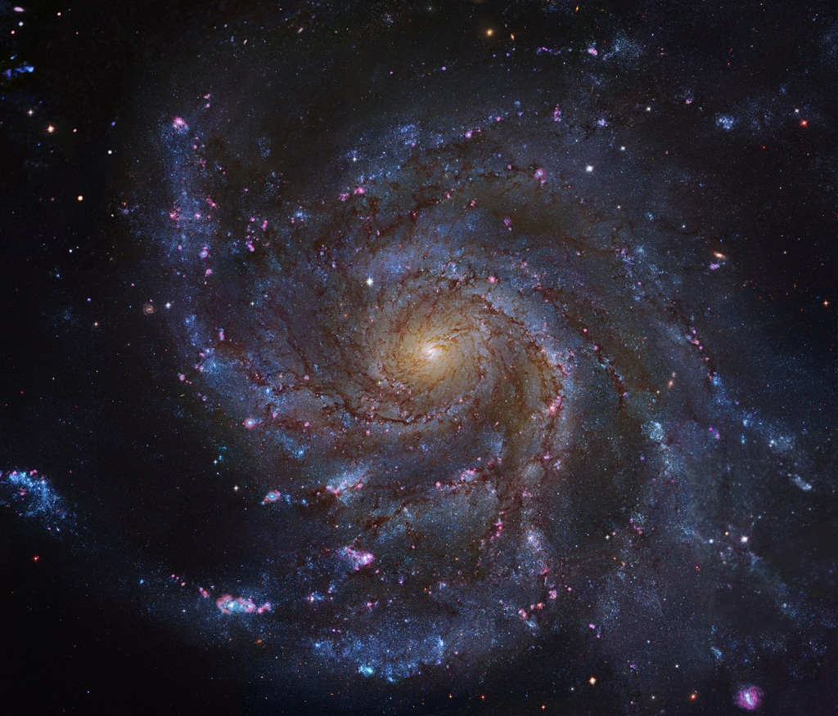
2 pinwheel spiral- arms extending outwards from a central hub
A middle aged
B will eventually become an elliptical

Slide 26
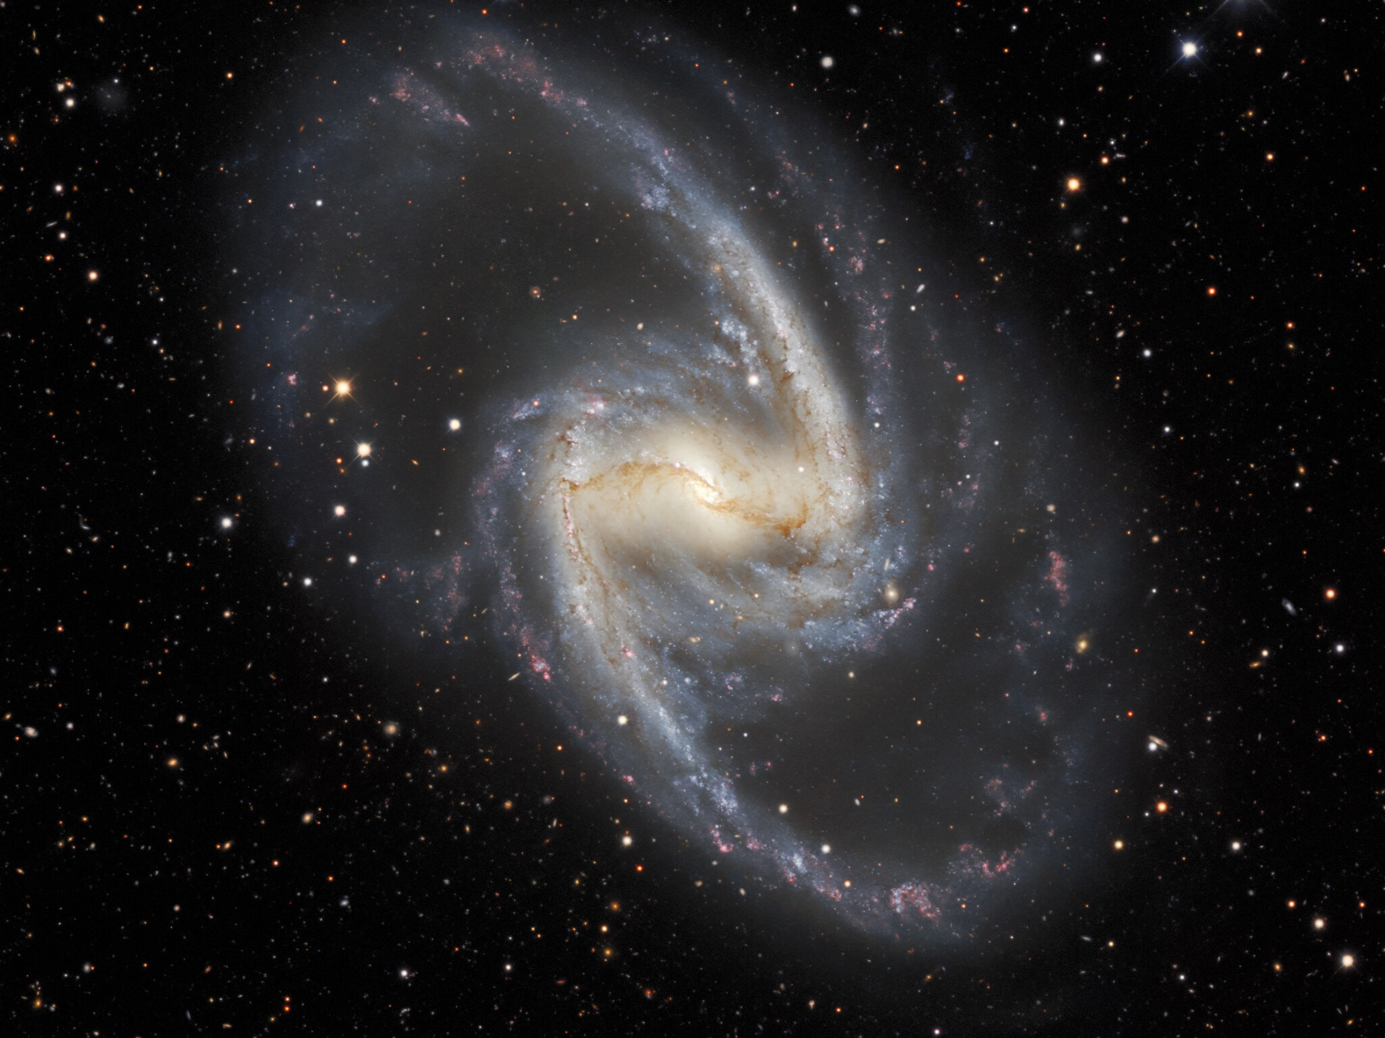
What type is this?

Slide 27
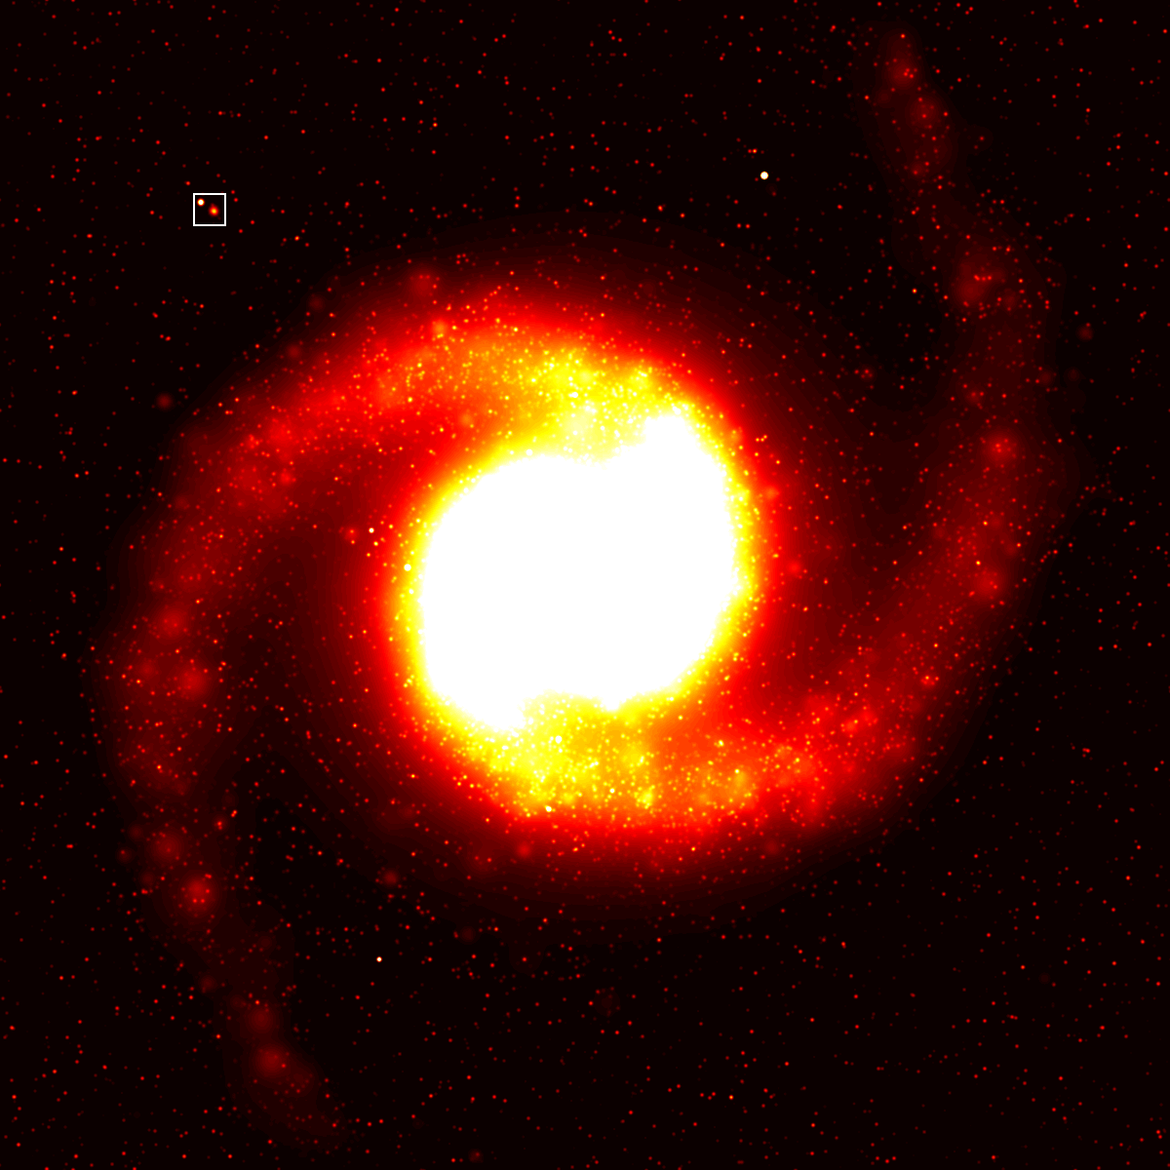
What type is this?

Slide 28
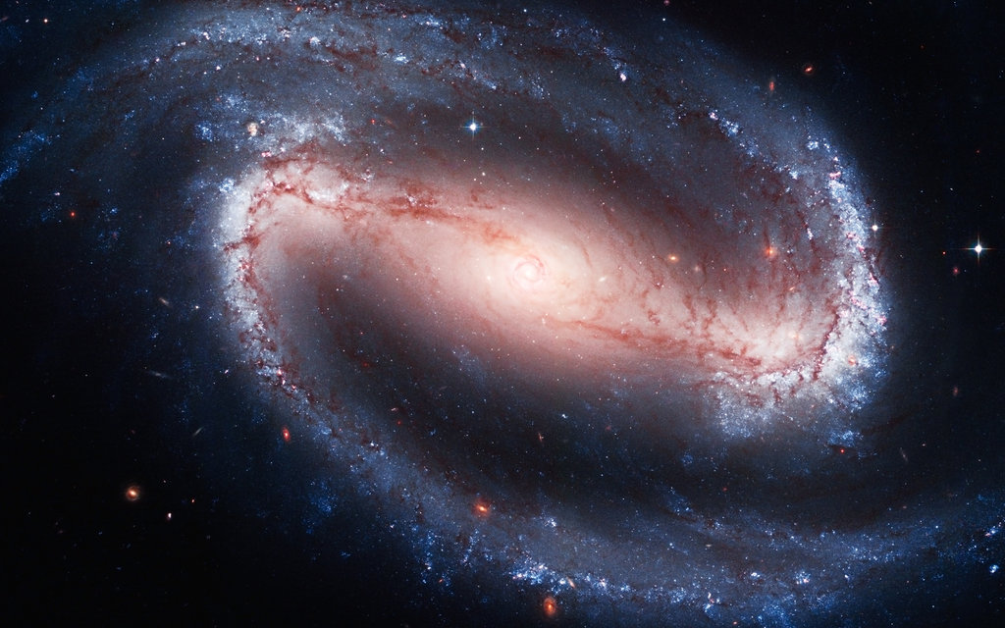

Slide 29
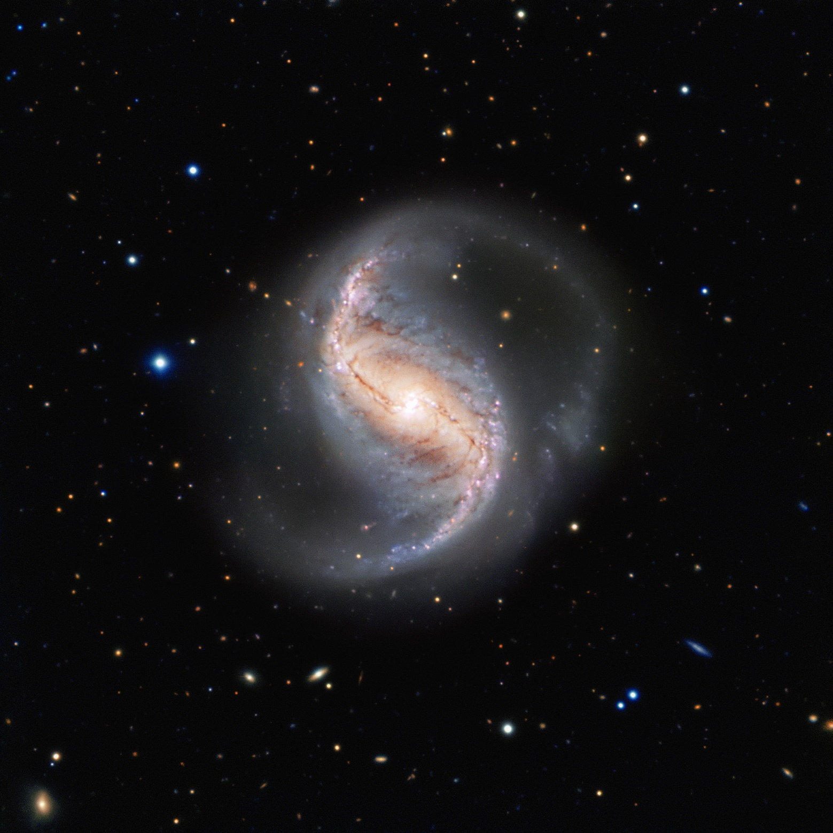
3 barred spiral – has only 2 arms extending from a central bar
A middle aged
B will eventually become an elliptical

Slide 30
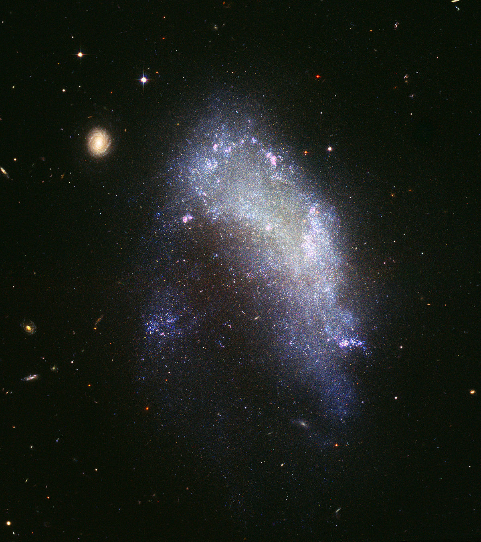
What type is this?

Slide 31
ZOOMED… notice you can see actual single stars and star clusters

Slide 32
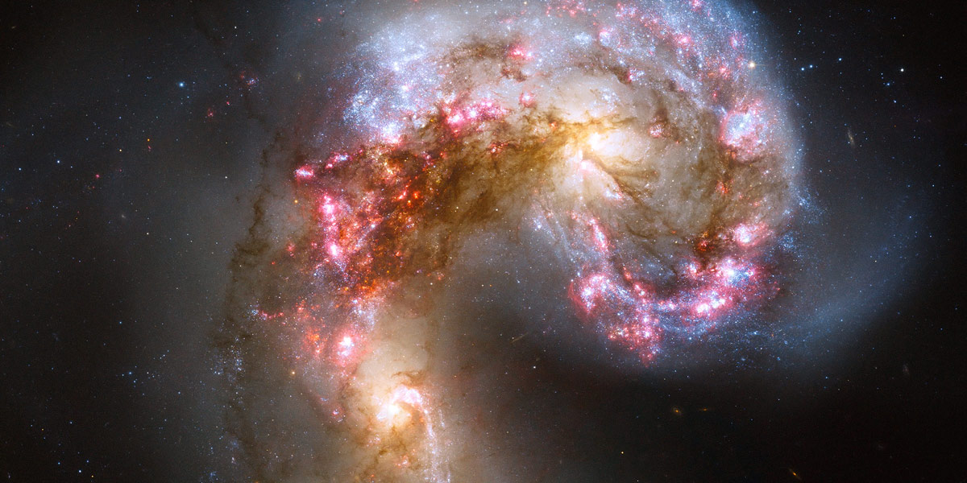

Slide 33
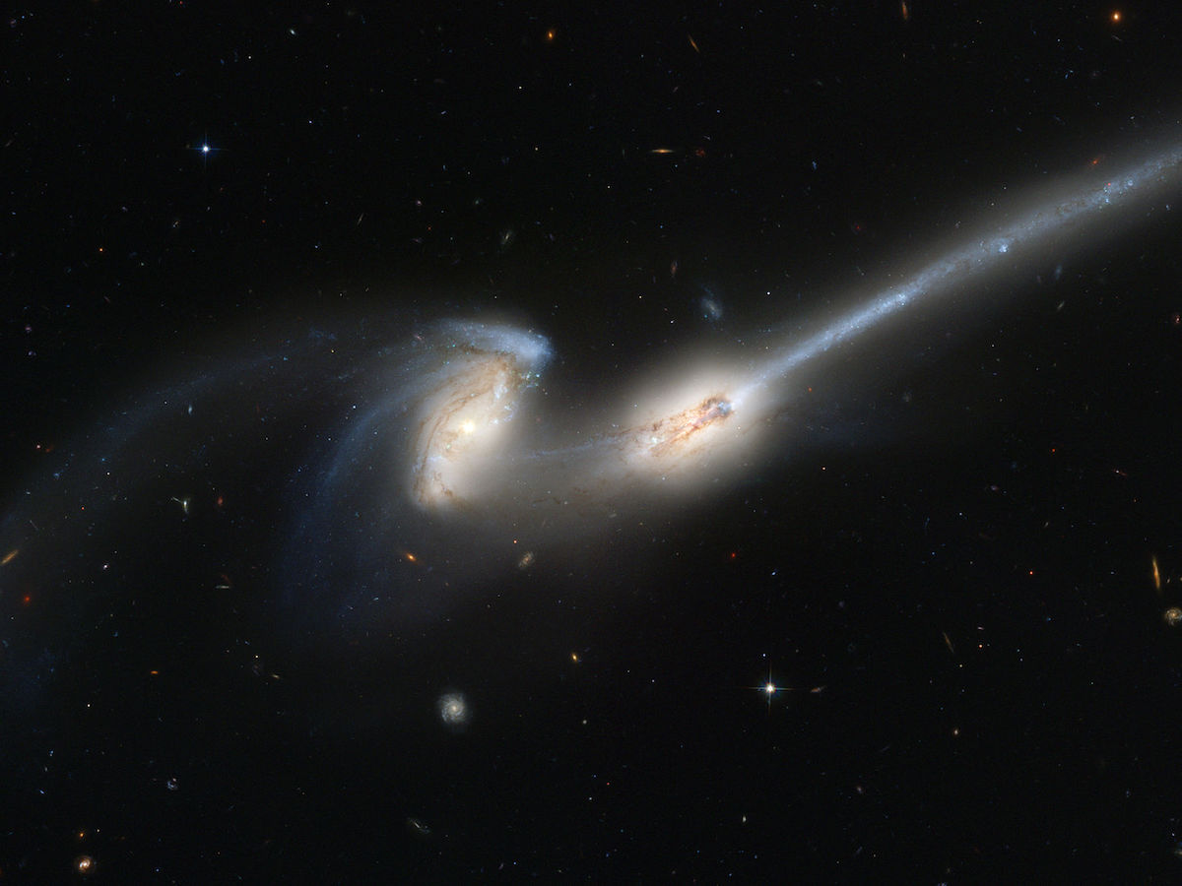

Slide 34
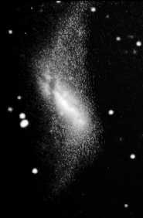
What type do you think this irregular is going to become?

Slide 35
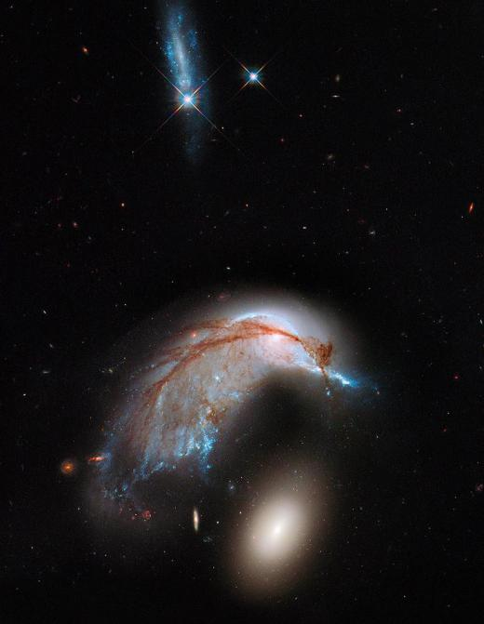
4 irregular- odd shaped galaxies that follow no pattern
A least common
B youngest
C contain many young stars
D gravity in the middle hasn’t had enough time to pull it into an elliptical shape yet

Slide 36
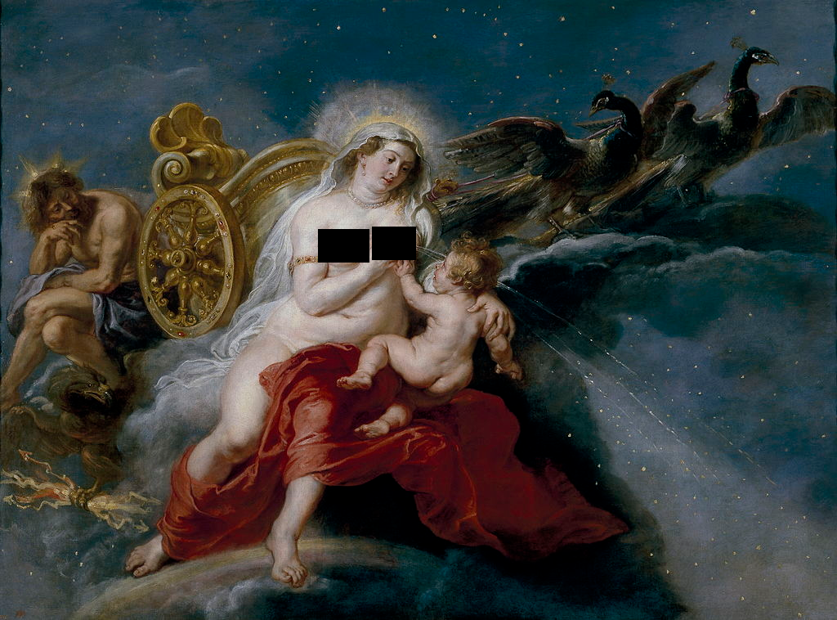
OUR GALAXY IS:
named after spilled milk ☺

Slide 37
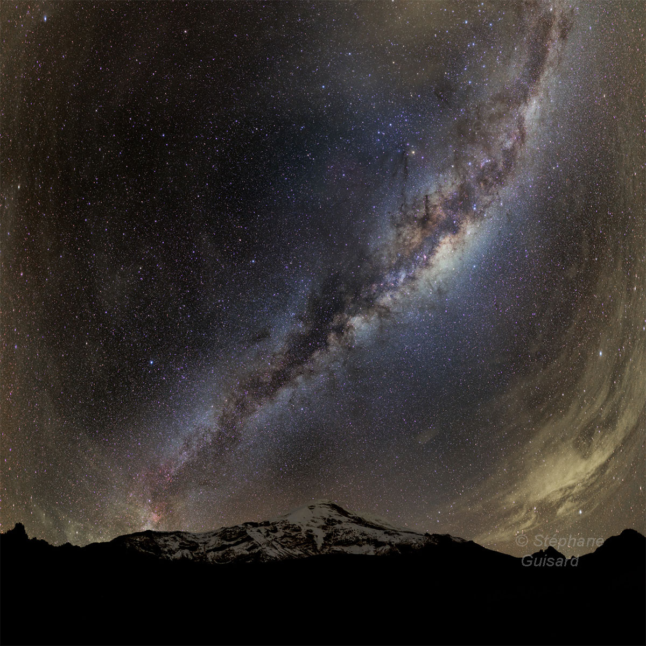
See the milky white streak?
Center of galaxy
(the bulge)
You are looking sideways
Through our galaxy

Slide 38
2. it is a barred spiral galaxy
3. Contains 200 billion + stars [even on the darkest nights we can only see about 3000 stars in the northern hemisphere and 3000 in the southern for a total of 6000]

Slide 39
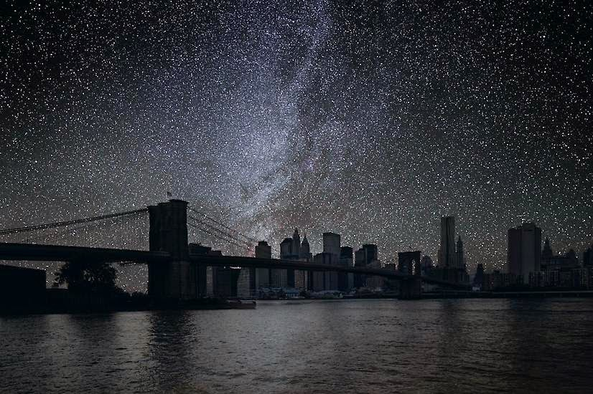
CAMERAS CAN SEE MANY MORE STARS THAN WE CAN

Slide 40
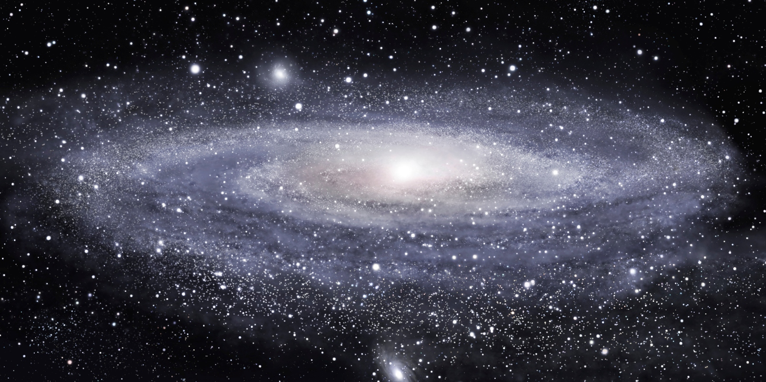
4. 100,000 light years wide

Slide 41
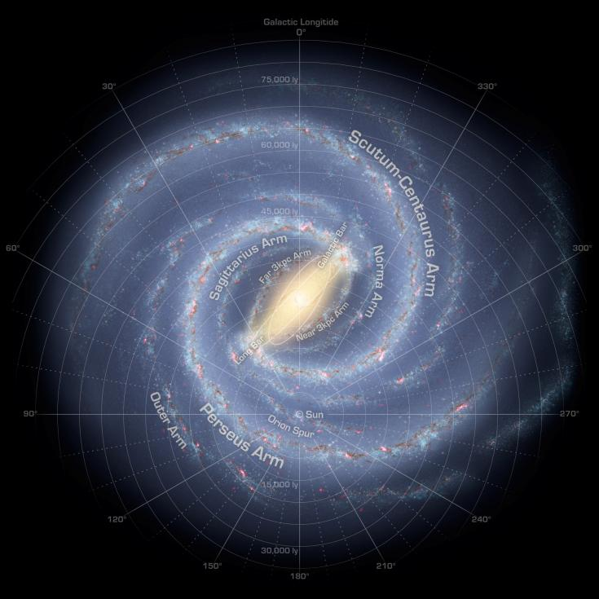
5. sun is 30,000 light years from the center, and located on Orion’s arm

Slide 42
A. sun orbits the center of the milky way one time every 230,000 years

Slide 43
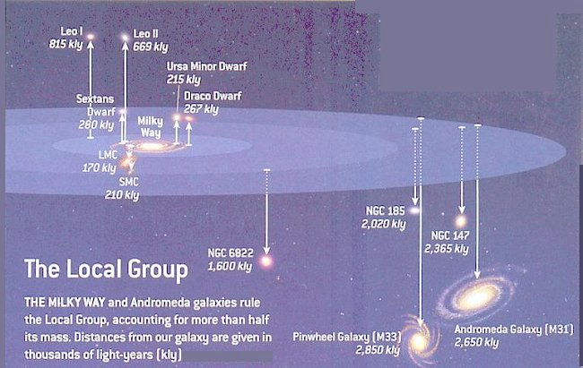
LOCAL GROUP – the 28 galaxies that are nearest to us (our neighborhood)

Slide 44
Galaxies are attracted to each other by gravity

Slide 45
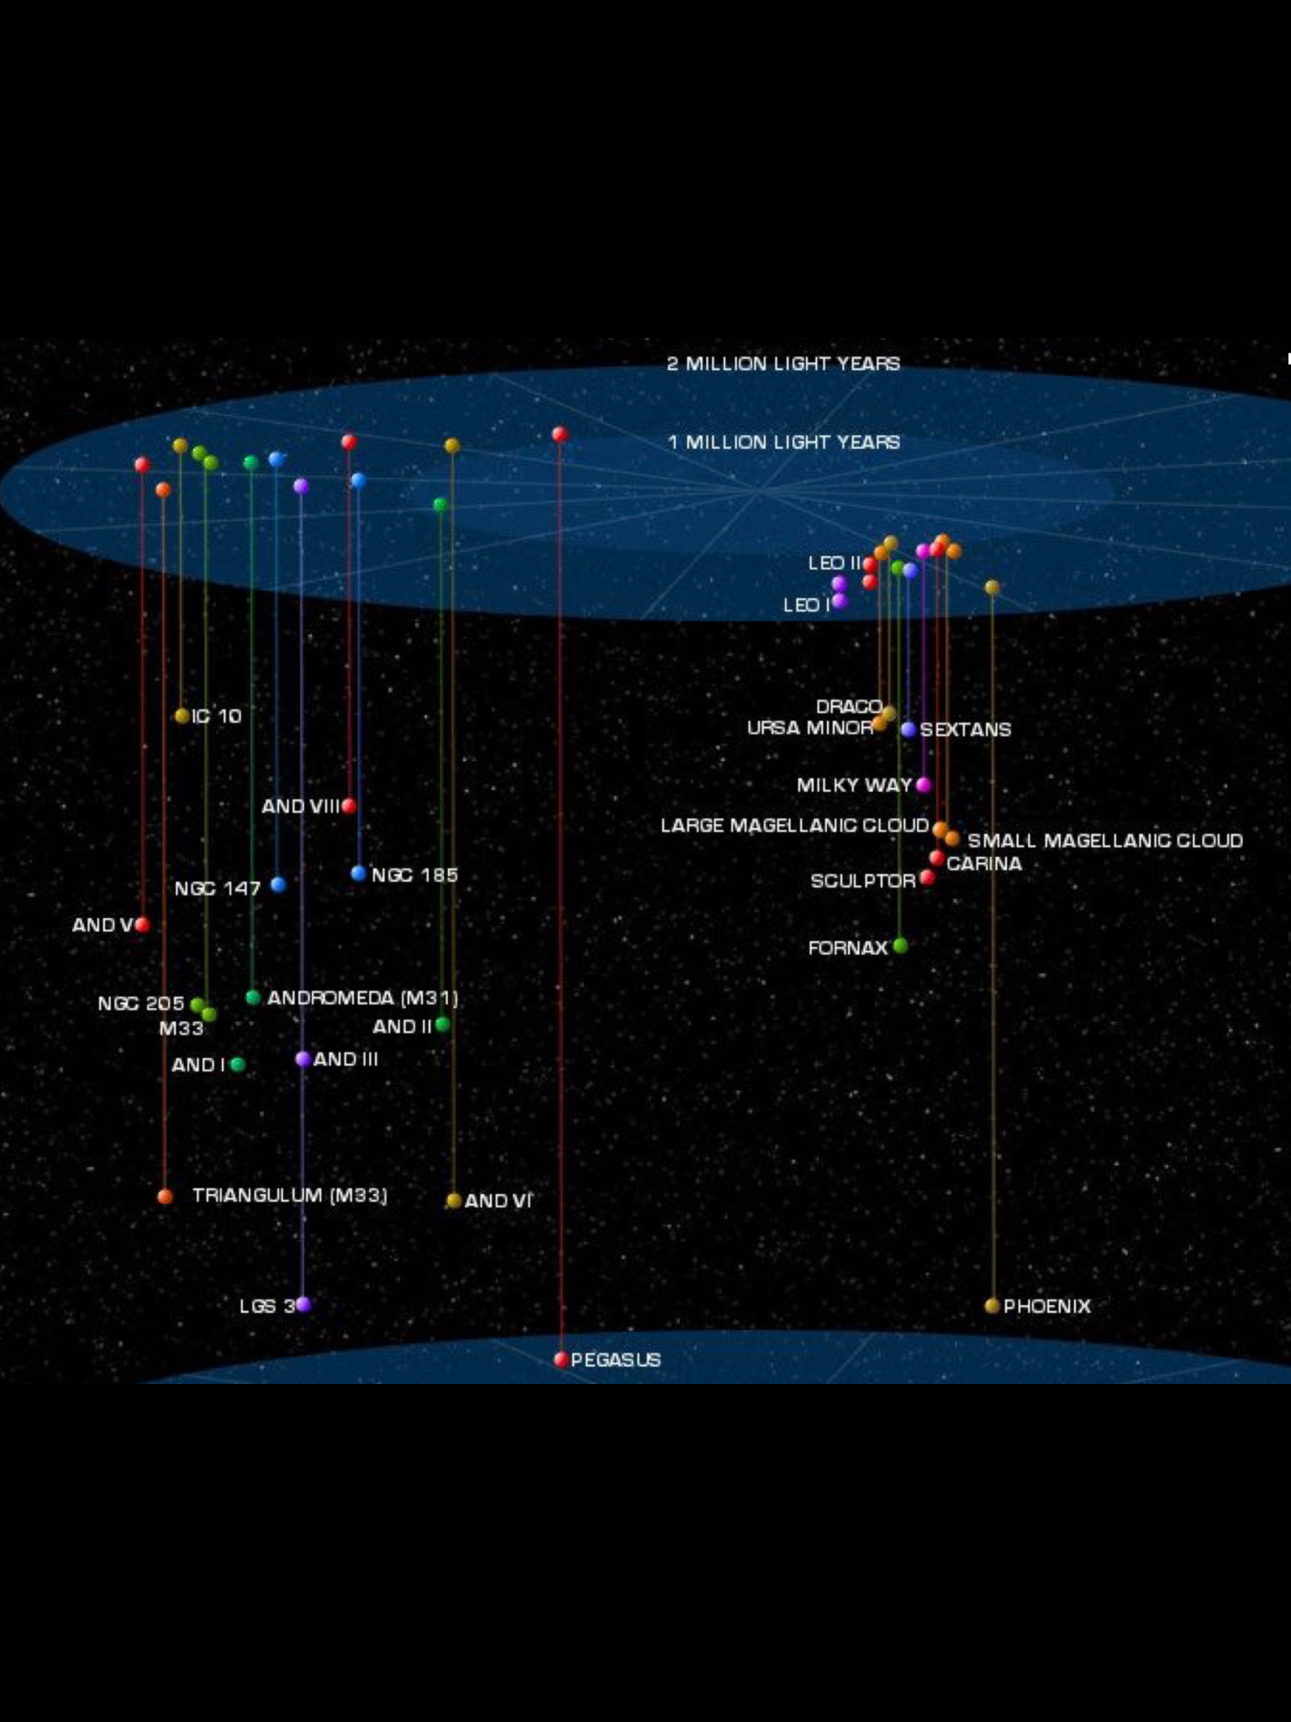
LOCAL GROUP – the 28 galaxies that are nearest to us (our neighborhood)

Slide 46
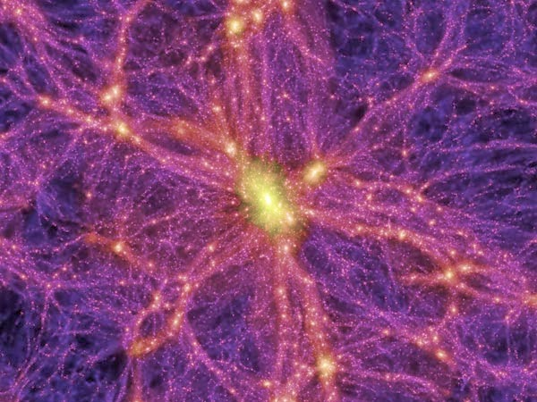
GALACTIC CLUSTER (aka supercluster– several local groups near each other
(our city 47,000 galaxies)

Slide 47
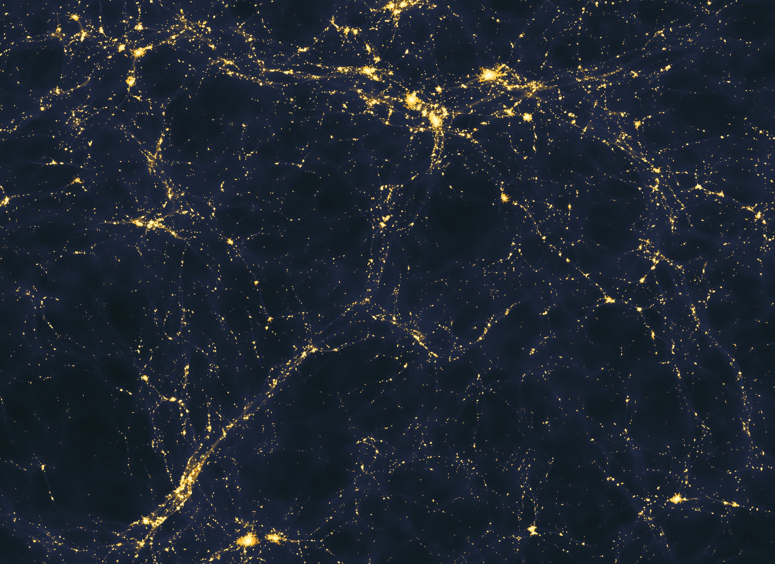
FILAMENT- superclusters joined to form “threadlike” structures.

Slide 48
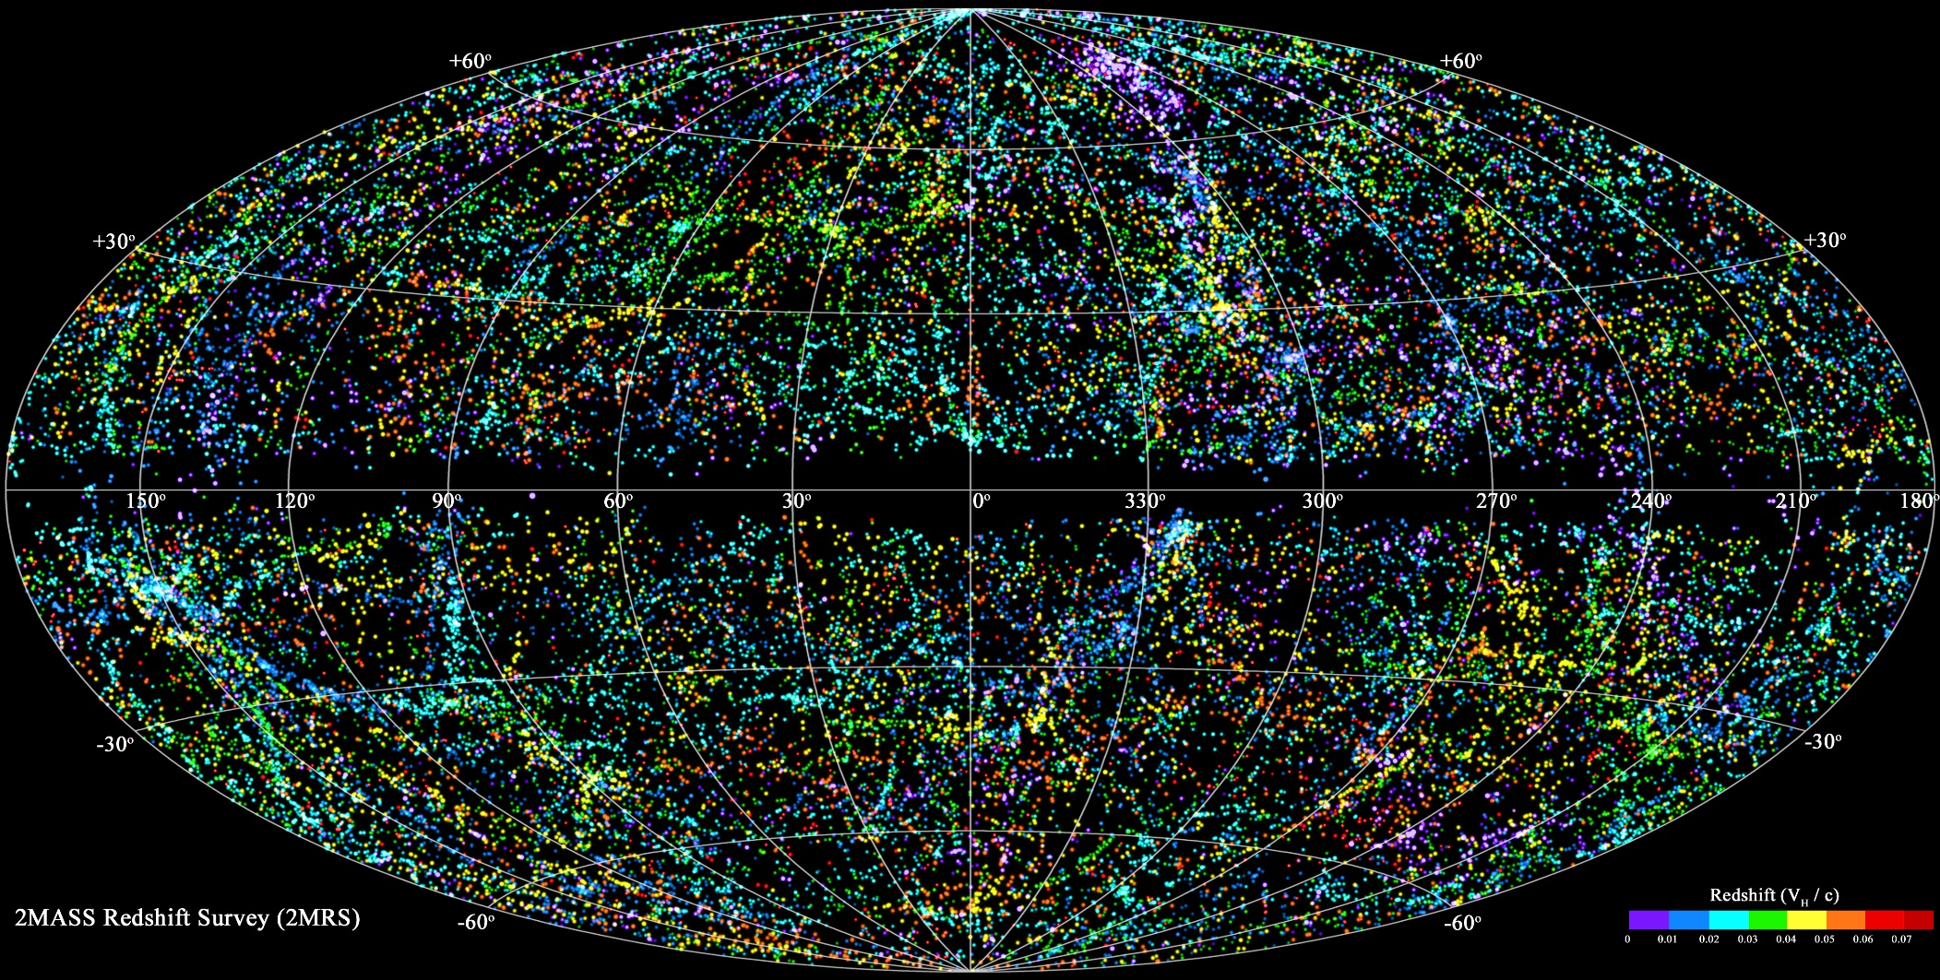
UNIVERSE- all filaments added together

Slide 49
This is a zoom of the bottom left of the previous picture. The dots are superclusters

Slide 50
Big Bang- the name given to the start of the universe
the entire universe was a dense, hot, supermassive ball.
13.7 billion years ago a violent explosion occurred
All matter and energy launched outwards
Evidence: 1] cosmic microwave background radiation and 2] all galaxies are red-shifting

Slide 51
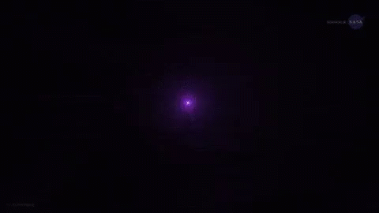

Slide 52
The big crunch- idea that gravity will pull everything back together
Not likely because universe density is below the critical density
Universe expansion is speeding up, (possibly due to dark matter??)

Slide 53
