Slide 1
What’s your
Niche?
Scum of
The Earth
ECO
pictures
Critter
Relationships
Organization
levels
100
100
100
100
100
200
200
200
200
200
300
300
300
300
300
400
400
400
400
400
500
500
500
500
500

Slide 2
Organisms that use sunlight to make food (plants and algae)

Slide 3
What is a producer?

Slide 4
Organisms that eat other organisms

Slide 5
What is a consumer?

Slide 6
Consumer that eats only plants

Slide 7
What is an herbivore?

Slide 8
Consumer that eats only animals

Slide 9
What is a carnivore?

Slide 10
Consumer that eats both plants and animals

Slide 11
What is an omnivore?

Slide 12
A consumer that eats dead organisms. (Right after they die)

Slide 13
What is a scavenger?

Slide 14
Category of organisms that get energy by breaking down dead organisms

Slide 15
What are decomposers?

Slide 16
A tiny one-celled decomposer.

Slide 17
What is bacteria or bacterium?

Slide 18
A multicellular decomposer. Members include: molds, mildew, yeasts, mushrooms, and puffballs

Slide 19
What is a fungus (singular) or fungi (plural)?

Slide 20
The carnivore of the food chain that stalks and “murders” its prey.

Slide 21
What is a predator?

Slide 22
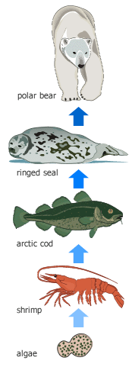
A diagram showing energy flow from one organism to another

Slide 23
What is food chain?

Slide 24
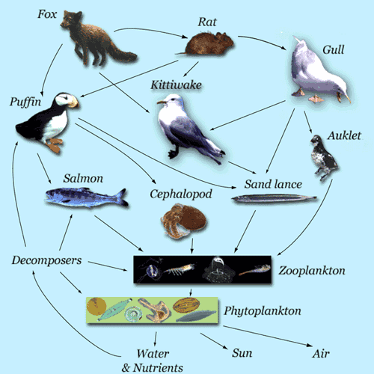
A diagram showing feeding relationships in an ecosystem

Slide 25
What is a food web?

Slide 26
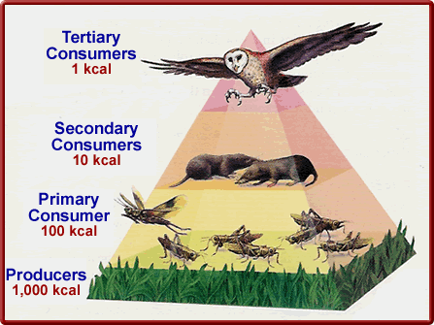
Diagram showing energy loss in an environment

Slide 27
What is an energy pyramid?

Slide 28
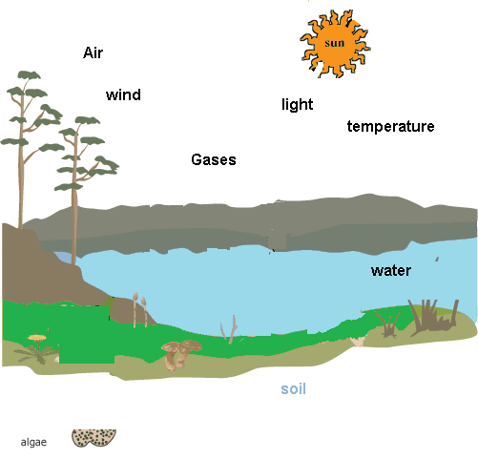
Non living parts of the environment

Slide 29
What are abiotic factors?

Slide 30
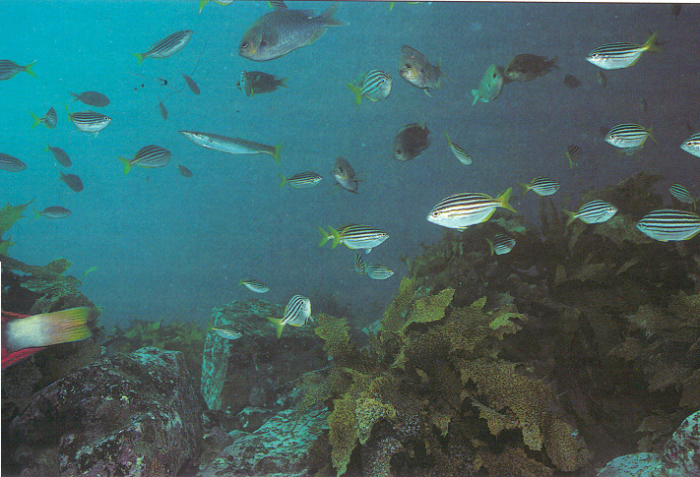
The largest population the environment can support.

Slide 31
What is carrying capacity?

Slide 32
Close long-term relationship between 2 species.

Slide 33
What is symbiosis?

Slide 34
Both organisms benefit

Slide 35
What is mutualism?

Slide 36
One organism benefits and the other is unaffected.

Slide 37
What is commensalism?

Slide 38
One organism benefits and the other is harmed.

Slide 39
What is parasitism?

Slide 40
The victim of the parasite.

Slide 41
What is the host?

Slide 42
A single living thing.

Slide 43
What is an organism?

Slide 44
A group of the same species living in the same area.

Slide 45
What is a population?

Slide 46
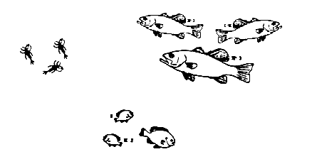
All populations that live in the same area and interact with each other

Slide 47
What is a community?

Slide 48
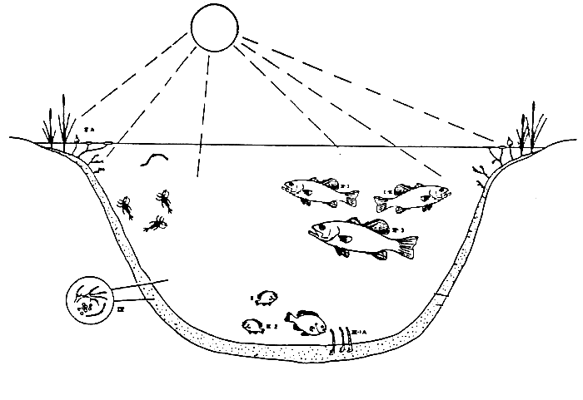
A community of organisms AND their environment

Slide 49
What is an ecosystem?

Slide 50
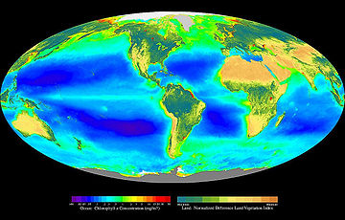
All ecosystems on Earth

Slide 51
What is the biosphere?

