Slide 1
Geologic time
Plant and Animal life throughout Earth’s history

Slide 2
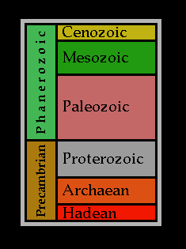

Slide 3
Hadean eon- Earth still molten

Slide 4
Hadean- no life possible

Slide 5
Archaean- rocks solidify

Slide 7
Proterozoic- cell life begins

Slide 8
The plant like cells make oxygen for the atmosphere

Slide 9
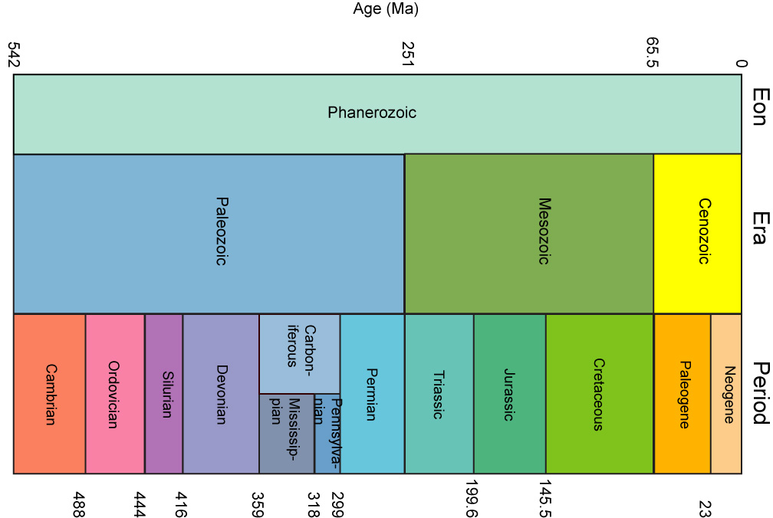
Phanerozoic Eon (paleozoic, mesozoic, cenozoic eras)

Slide 10
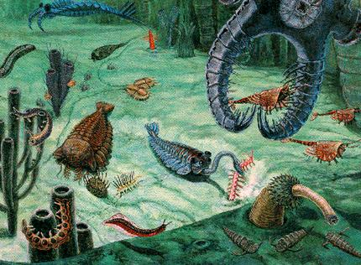
PALEOZOIC-Cambrian

Slide 11
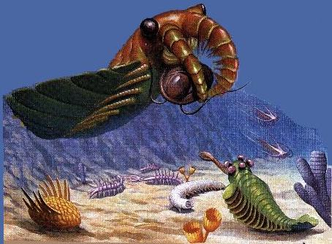

Slide 12
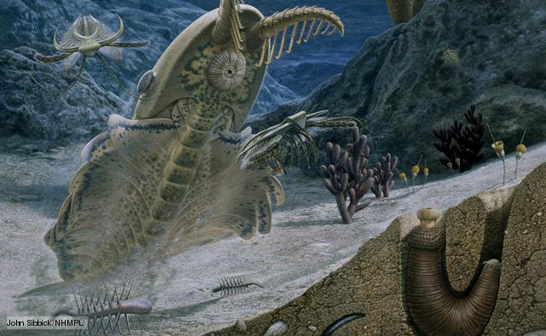

Slide 13
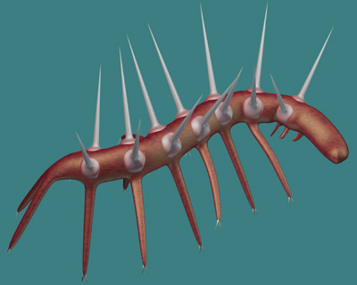
Hallucigenia

Slide 14
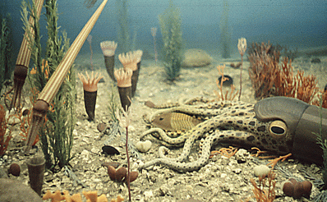
PALEOZOIC-ordivician

Slide 15
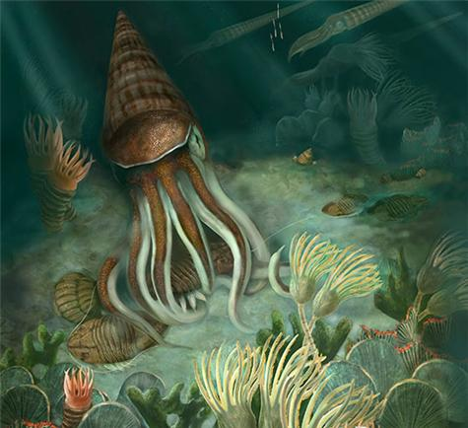

Slide 16
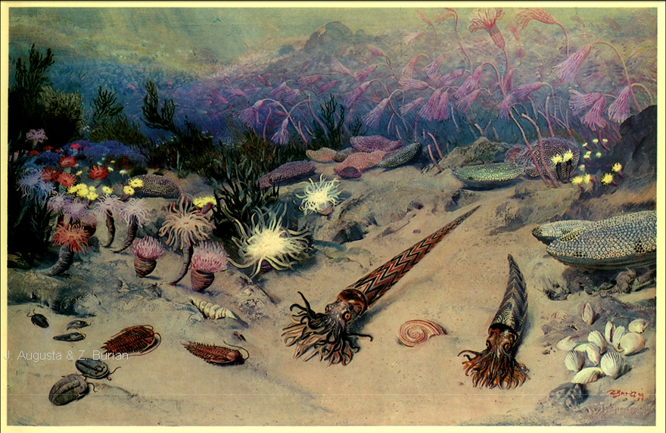

Slide 17
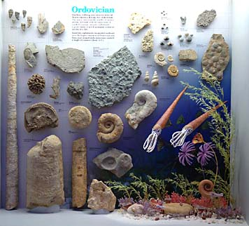

Slide 18
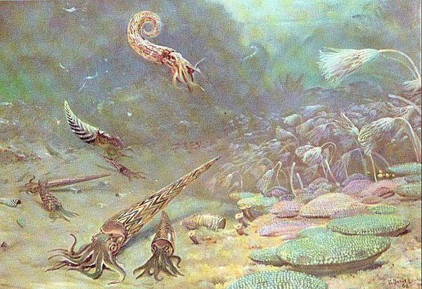
PALEOZOIC--silurian

Slide 19
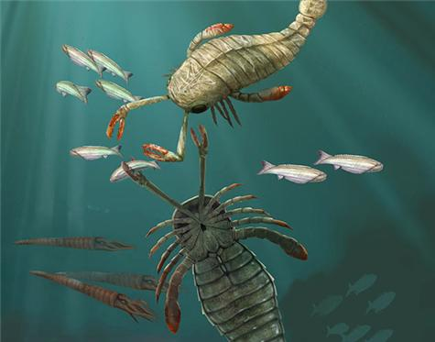

Slide 20
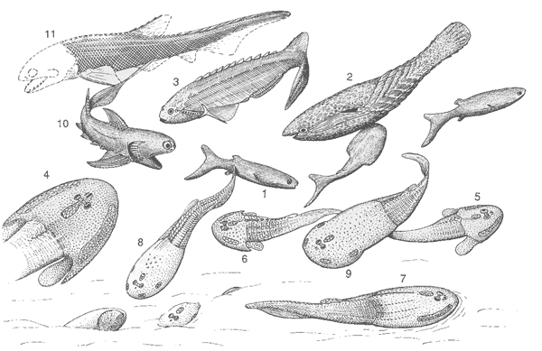

Slide 21
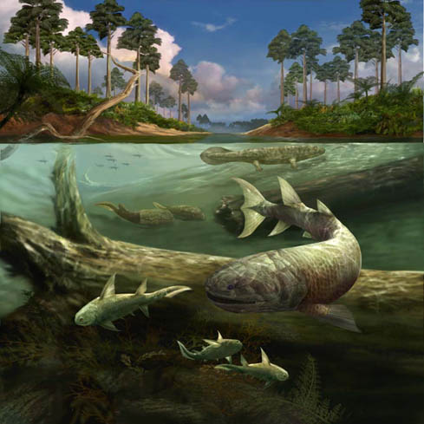
PALEOZOIC--devonian

Slide 22
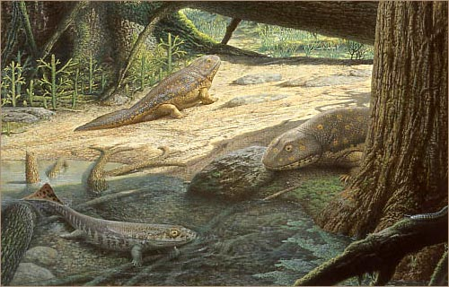

Slide 23
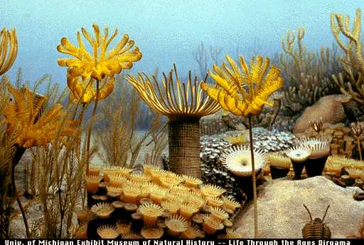

Slide 24
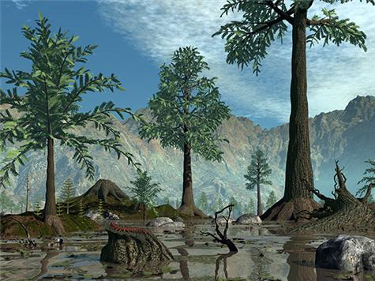

Slide 25
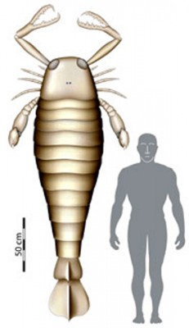
Jaekelopterus

Slide 26
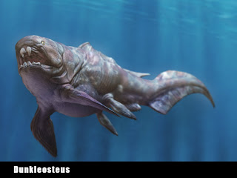
Dunkleosteus-33 ft long 4 tons

Slide 27
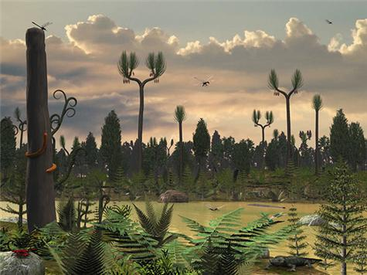
PALEOZOIC- mississippian

Slide 28
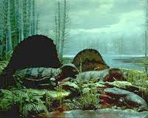
PALEOZOIC- pennsylvanian

Slide 29
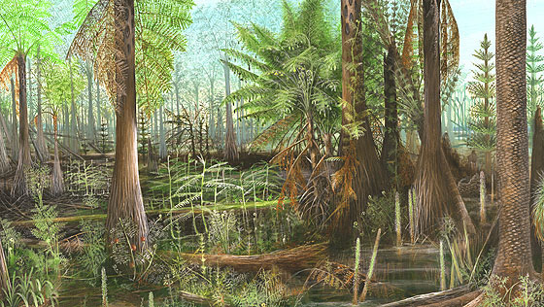

Slide 30
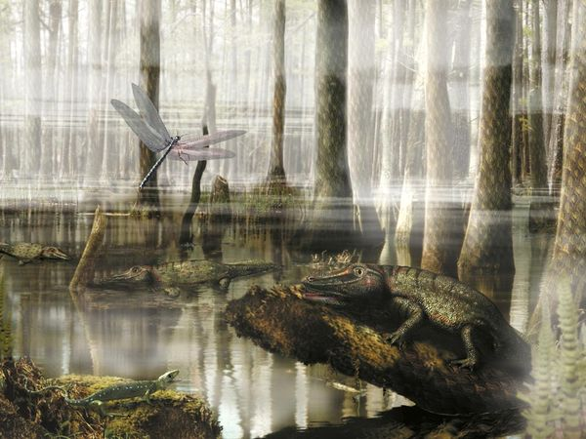
Dragonflies the size of seagulls

Slide 31
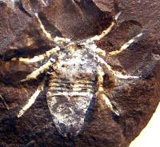
Super sized insects- spider-18 inches

Slide 32
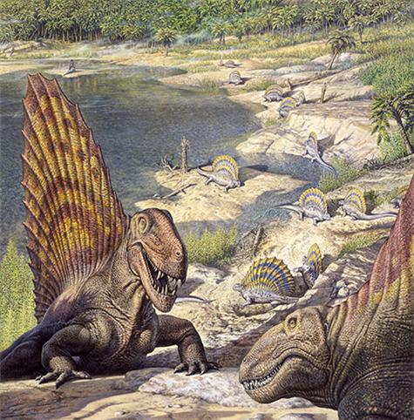
PALEOZOIC- permian

Slide 33
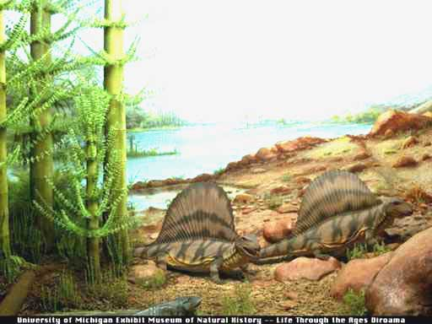

Slide 34
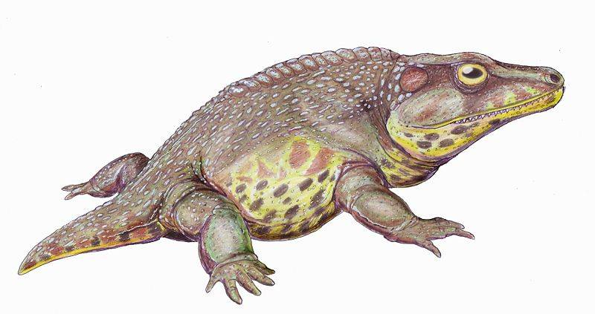

Slide 35
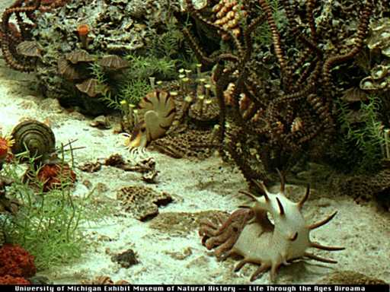

Slide 36
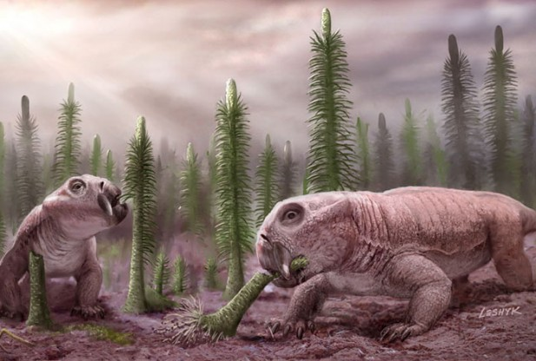

Slide 37
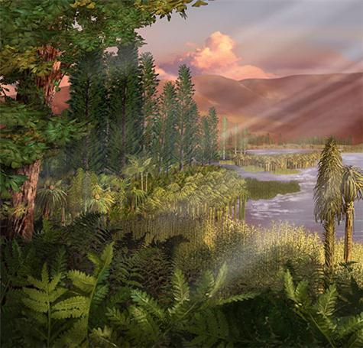
MESOZOIC--Triassic

Slide 38
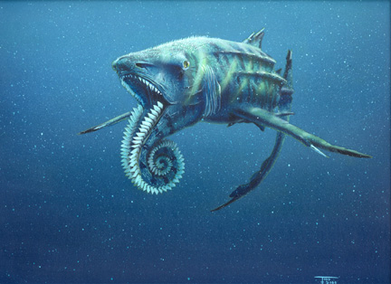
Helicoprion-10-15 ft long

Slide 39
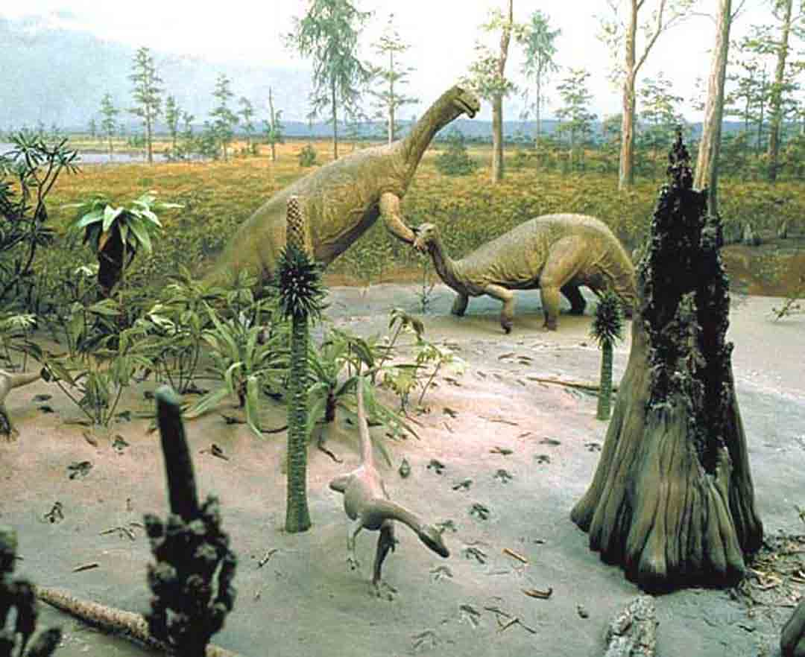
MESOZOIC-- Jurassic

Slide 40
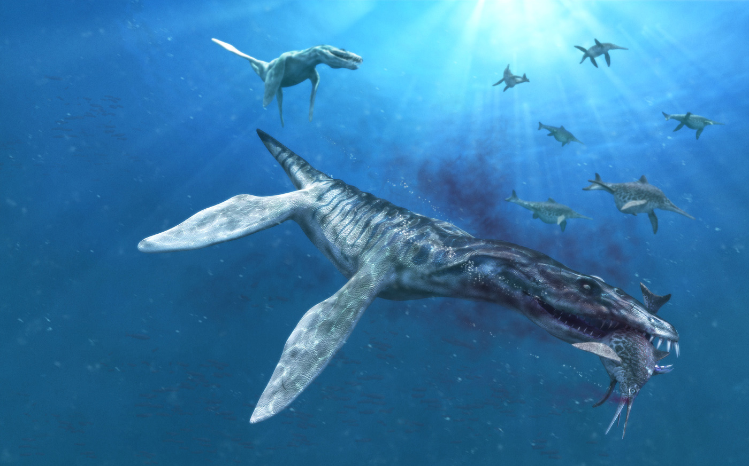
Turtle like limbs-went on land?

Slide 41
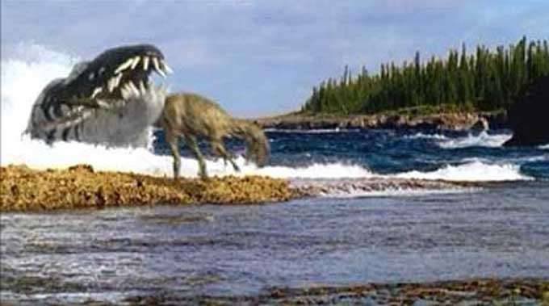
liopleurodon

Slide 42
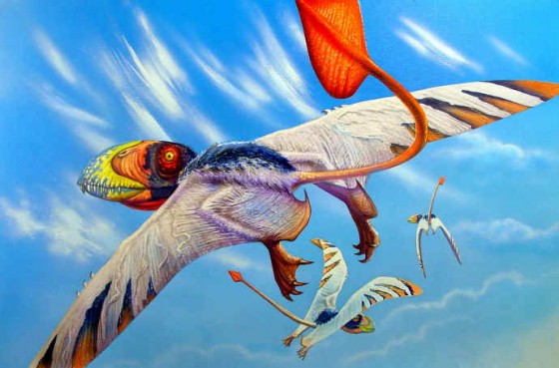
dimorphidon

Slide 43
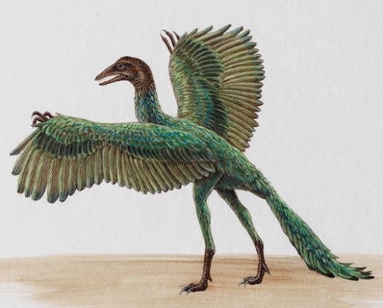
Archaeopteryx-famous first bird

Slide 44
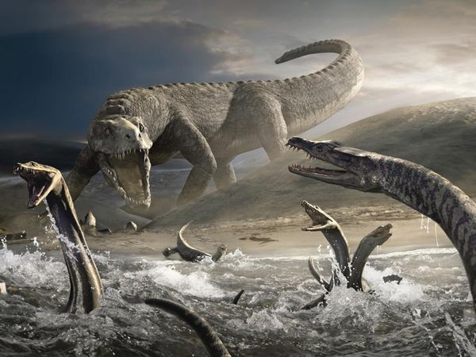

Slide 45
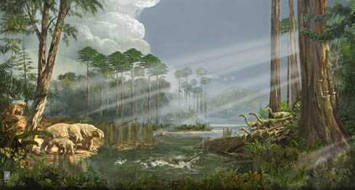

Slide 46
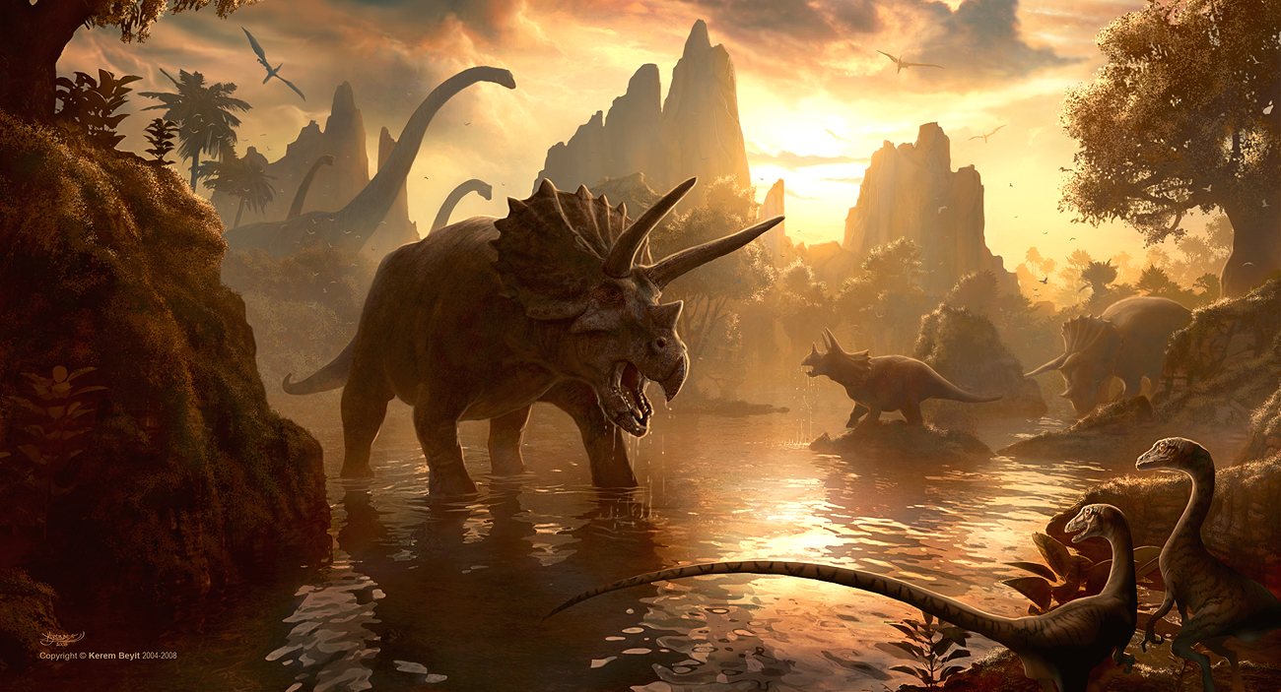
MESOZOIC-- cretaceous

Slide 47
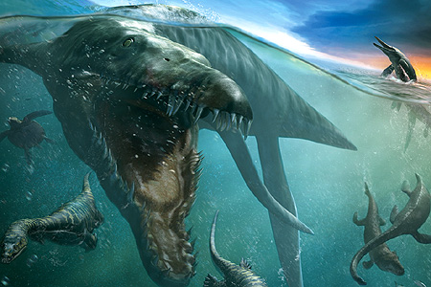
kronosaurus

Slide 48
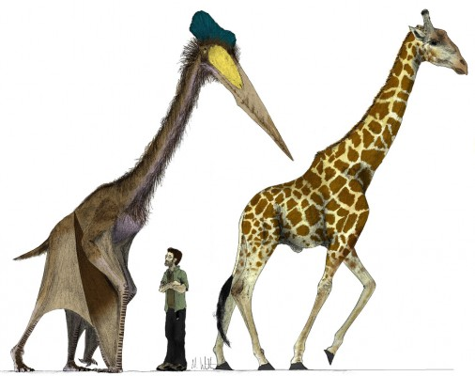
Quetzalcoatlus-could fly

Slide 49
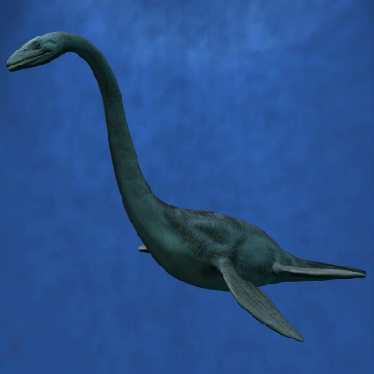
Elasmosaur-46 ft long

Slide 50
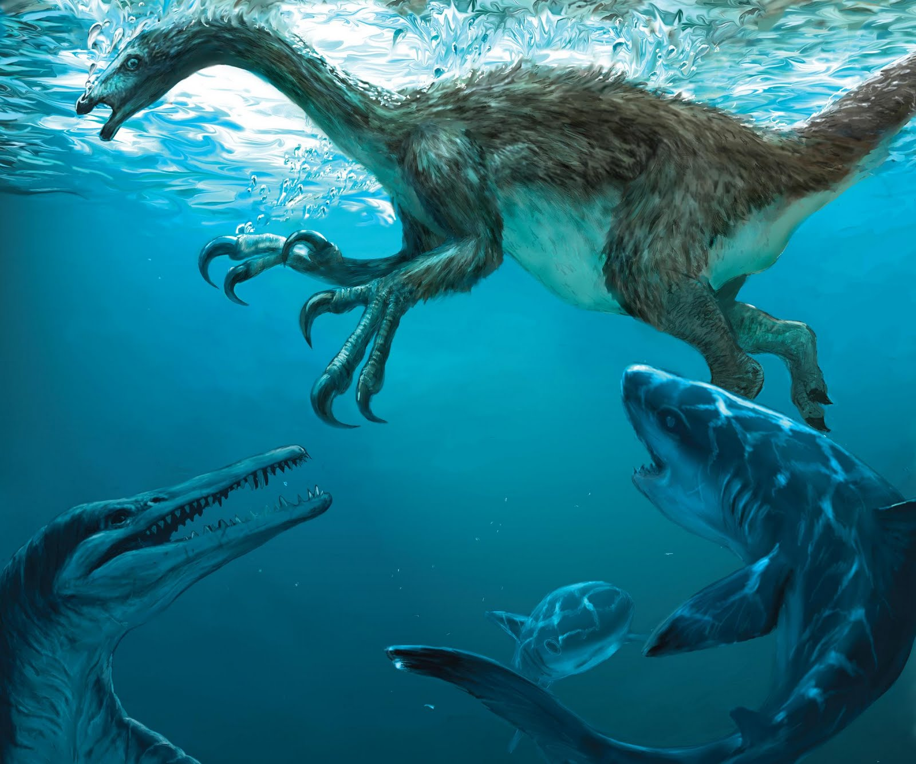

Slide 51
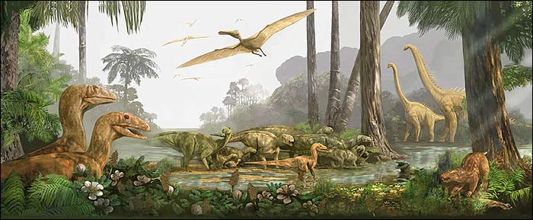

Slide 52
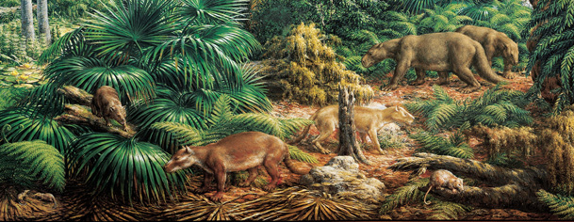
CENOZOIC--Paleocene epoch

Slide 53
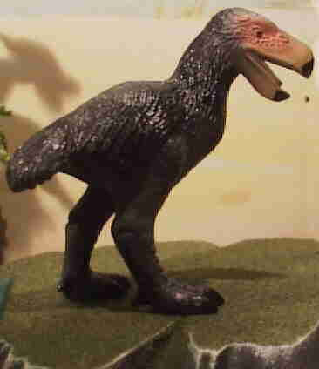

Slide 54
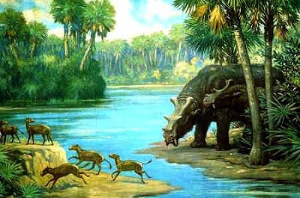

Slide 55
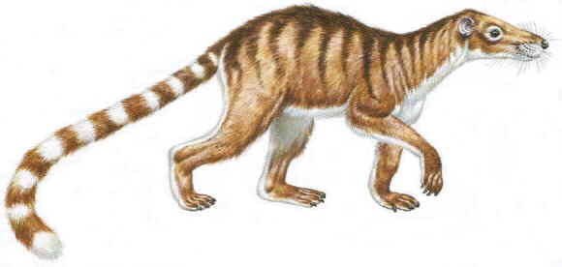

Slide 56
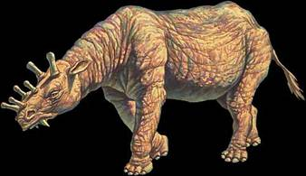
CENOZOIC-- Eocene epoch

Slide 57
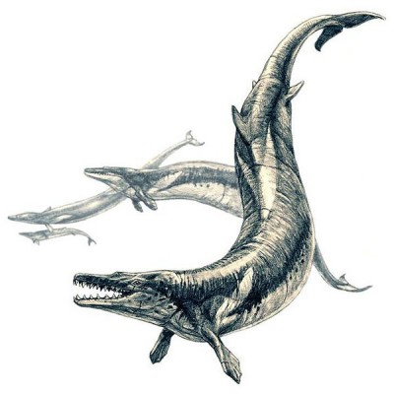
Basilosaur-80 ft aligator-snake-whale

Slide 61
CENOZOIC-- oligocene epoch

Slide 62
Chalicothere-7 ft tall- 700 pounds

Slide 65
CENOZOIC-- Miocene epoch

Slide 67
Deinotherium-15 ft tall

Slide 69
CENOZOIC-- pliocene epoch

Slide 73
CENOZOIC-- pleistocene epoch

Slide 75
Megalodon-size of school bus

Slide 76
FIRST HOMINIDS

Slide 77
CENOZOIC--Holocene epoch

