Slide 3
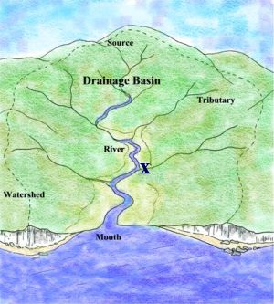
They are sometimes called drainage basins

Slide 5
Animation-click here

Slide 6
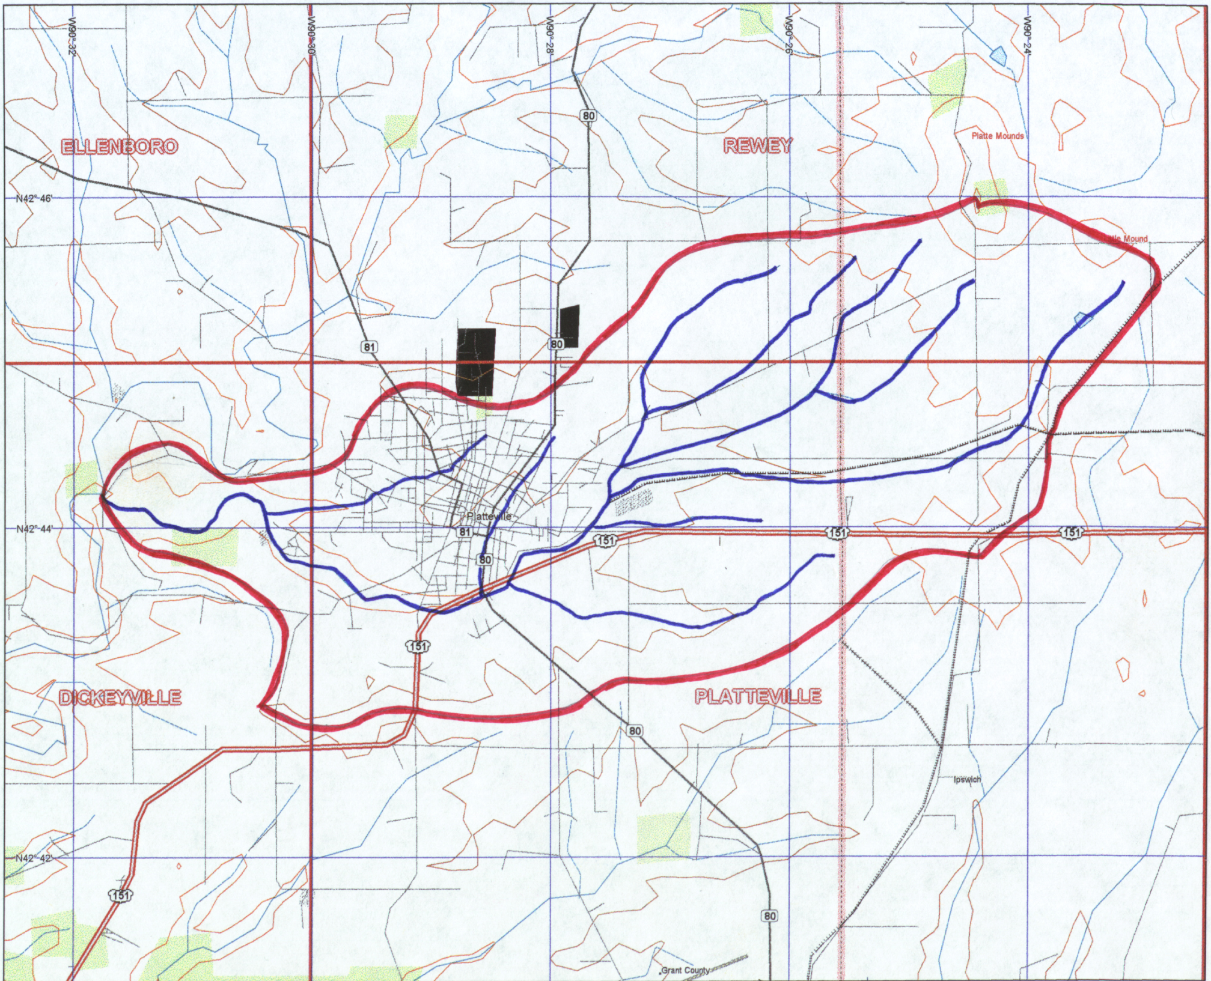
Test- at which letter will the watershed drain?
B
C
D
A

