Slide 1
UNDERSTANDING WEATHER STATION MODELS

Slide 2
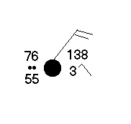
Weather Station Model-SIMPLE

Slide 3
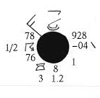
Weather Station Model-COMPLEX

Slide 4
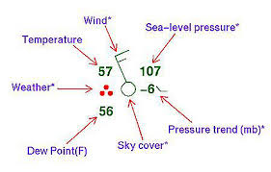
WEATHER STATION MODEL

Slide 5
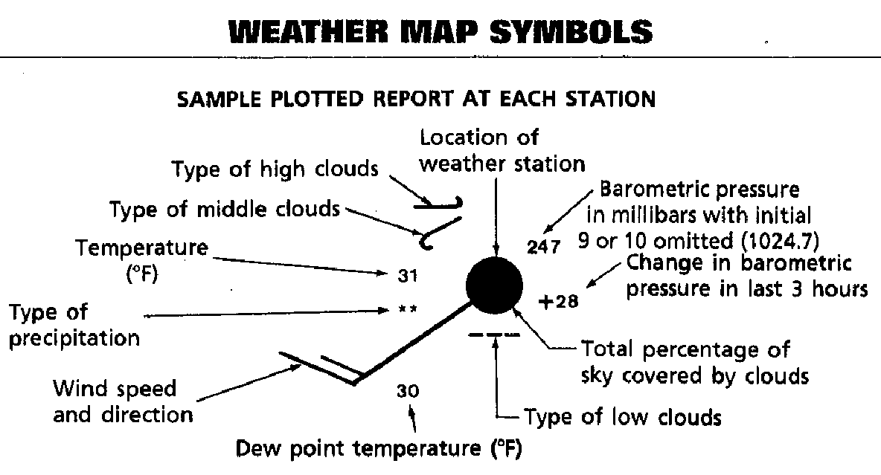

Slide 6
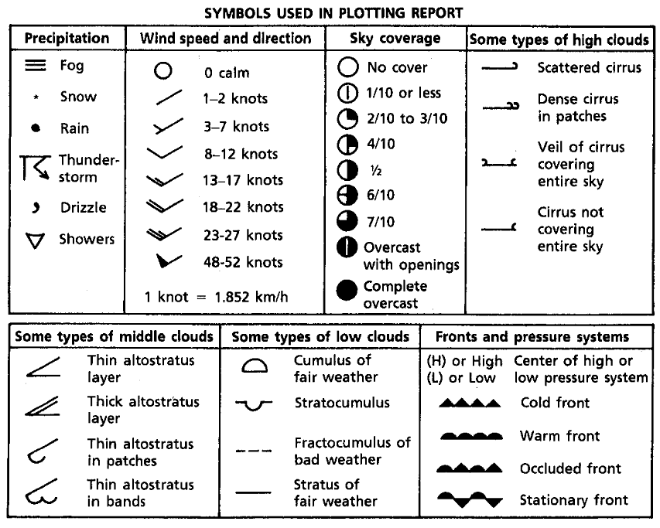

Slide 7
PRACTICE station 1
Barometric Pressure= 243
Change in Barometric Pressure in last 3 hours= decrease of 13
% of sky covered by clouds= Complete overcast
Type of low clouds= Fractocumulus of bad weather
Dew Point Temp= 31
Wind speed and direction= 15 knots
Type of precipitation= light snow
Temperature= 30
Type of middle clouds= Thin altostratus in bands
Type of high clouds= scattered cirrus

Slide 8
Practice station 2
Barometric Pressure= 300
Change in Barometric Pressure in last 3 hours= increase of 33
% of sky covered by clouds= Y. covered
Type of low clouds= stratus of fair weather
Dew Point Temp= 42
Wind speed and direction= 6 knots
Type of precipitation= none
Temperature= 49
Type of middle clouds= thin altostratus layer
Type of high clouds= dense cirrus in patches

