Slide 1
CELLS- Why do cells need food? What are the food components? How do the food pieces get to cells?

Slide 2
CELLS NEED FOOD. WHY?

Slide 3
ENERGY
HEART CELLS-energy to beat
PANCREAS CELLS-energy to secrete enzymes
BRAIN CELLS-energy to send signals
MUSCLE CELLS-energy to move
STOMACH CELLS-energy to make acid
LUNG CELLS-energy to absorb oxygen & exhale CO2
BONE CELLS-energy to make new blood cells

Slide 4
GROWTH
HEART CELLS-grow in number as you get older then once it’s full size new cells grow to replace worn out ones.
BRAIN CELLS-grow in number as your head gets bigger.
MUSCLE CELLS-grow in number (especially if you work out)
STOMACH CELLS-constantly repairing and growing new ones as old ones get destroyed
LUNG CELLS-grow in number until you are full size, then repair and replace cells as needed.
BONE CELLS-grow in number as you get older

Slide 5
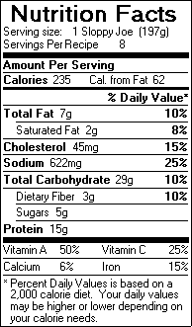
There are 3 components to all food Which items listed are the 3?

Slide 6
FATS
Deep fried
Greasy, oily
Butter
Mayonnaise
Creamy salad dressings
Red meats (beef, pork)
donuts

Slide 7
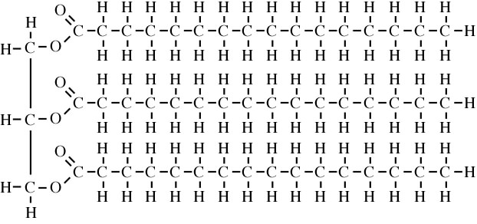
Fat molecule-too big to transport
Notice all the bonds between atoms. Every time you break one, ENERGY is released.

Slide 8
CARBOHYDRATES
BREADS
GRAINS
PASTA
MUFFINS
ROLLS
POTATOES
CORN
PEAS

Slide 9
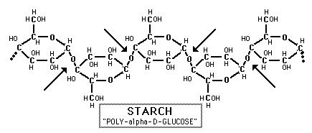
Carbohydrate molecule-too big to transport
Notice all the bonds between atoms. Every time you break one, ENERGY is released.

Slide 10
PROTEINS
CHICKEN
BEANS
TURKEY
RICE
BEEF
LEGUMES
PORK
NUTS
SEEDS

Slide 11
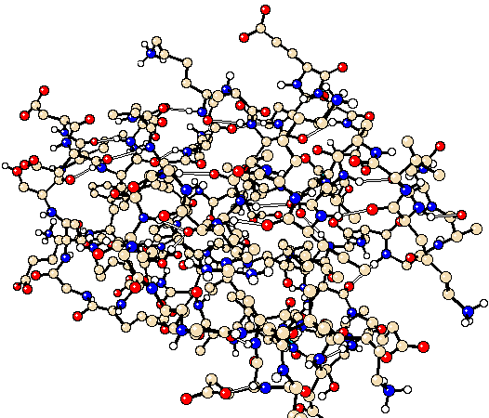
Protein molecule-too big to transport
Notice all the bonds between atoms. Every time you break one, ENERGY is released.

Slide 12
What do the 3 food components break down into?
Fats- fatty acids
Protein- amino acids
Carbohydrates- glucose

Slide 13
Fat chopper (enzyme)-LIPASE

Slide 14
Protein chopper (enzyme)-PEPSIN

Slide 15
Carb chopper (enzyme)-AMYLASE

Slide 16
Where do you think these enzymes are located?
Amylase is made in your mouth
Pepsin is made in your stomach
Lipase is made in your small intestine

Slide 17
All “chopping” gets completed where?
In the small intestine

Slide 18
Where do the tiny food particles go next?
Into the blood stream

Slide 19
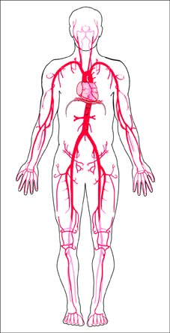
So the body breaks these big molecules into smaller ones, ones that can fit into the bloodstream

Slide 20
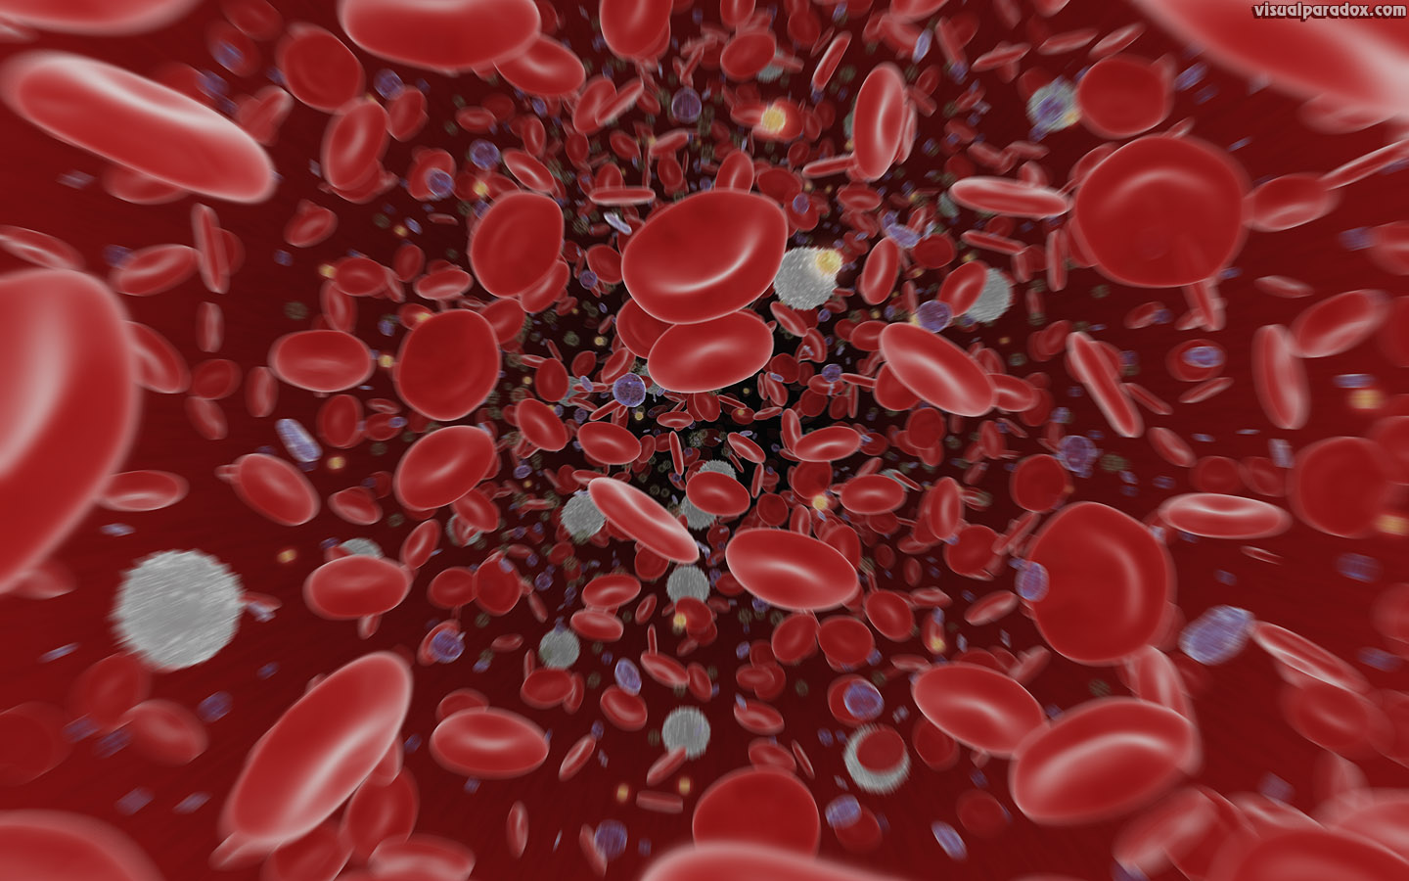
A view inside an artery (blood tube)

Slide 21
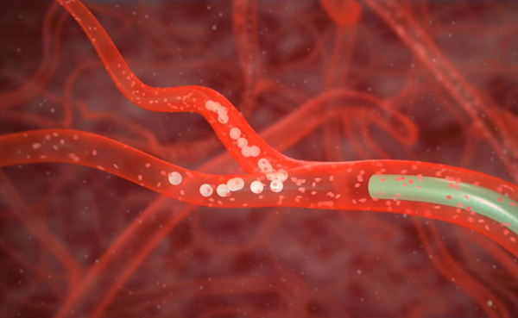
Why put food into the blood?
So it can be delivered to all the cells

Slide 22
The blood is the transport system
It moves small pieces of food
It moves needed gases like oxygen
It moves waste gases like carbon dioxide
Where does each blood tube lead?

Slide 23
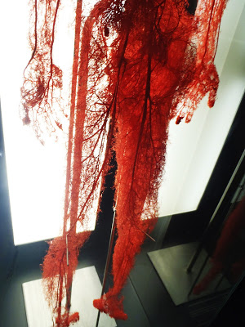
To every single cell in the body! The tubes get tinier and tinier and fit between individual cells. On the left are major arteries, on the right are capillaries (tiny ones)

Slide 24
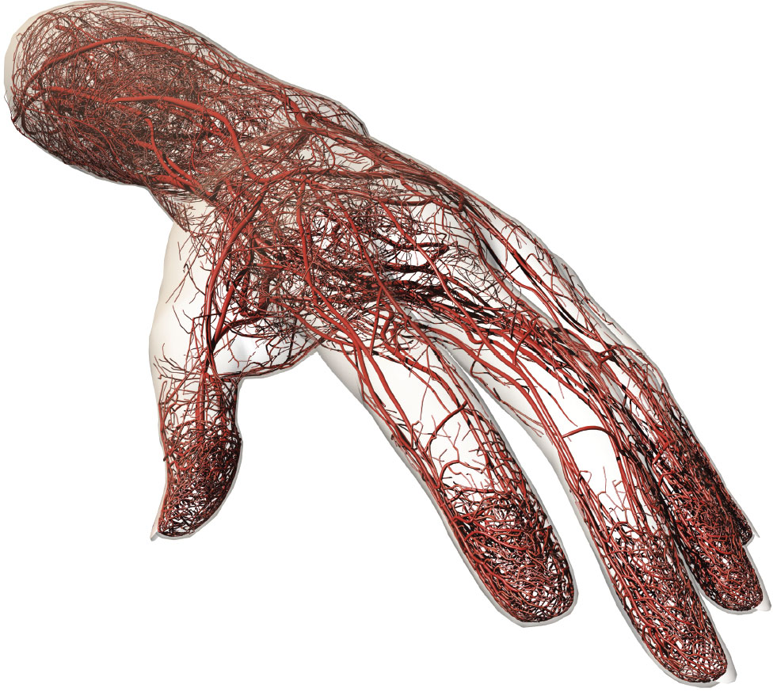

Slide 26
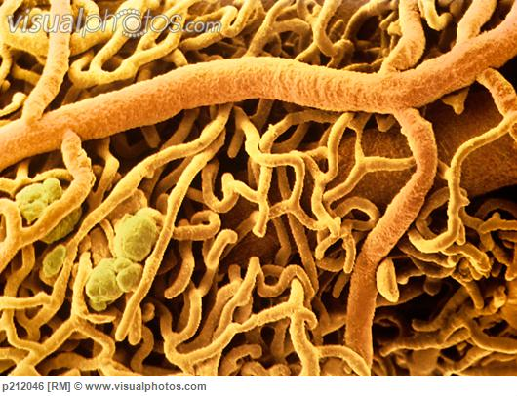
Tiny capillaries near fat cells

