Slide 1
Characteristics of
Living Things &
Cell Theory

Slide 2
Living things are different from
nonliving things...
You are surrounded by life, but how would you define a living thing?
Does it move?
Does it have to move?
Does it eat?
Does it have to eat?
What is it made of?
Organism- any living thing. (plant, animal, bacteria, protist, fungus, etc.)

Slide 3
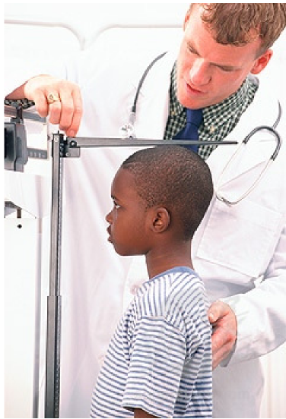
Characteristics of Living Things
All living things:
need and use energy
grow and develop
respond to their environment
reproduce
get rid of waste materials

Slide 4
1. Need and Use Energy
organisms need energy to keep going.
Some eat to get energy
Some use the sun to get energy
Sunlight is the source of energy for most living things. (even things that eat)
Energy is the ability to do work.

Slide 5
2. Grow and Develop
All organisms grow and develop.
Living things change in appearance and develop into adult forms during their lifetimes.

Slide 6
3. Respond to their environment
When the environment changes, living things also change in order to survive.
All organisms have features that help them survive in their surroundings.
For example: fish have gills, polar bears have fur, eagles have claws, etc

Slide 7
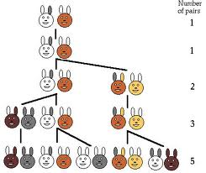
4. Reproduce
Organisms produce more organisms of their own kind.
Reproduction allows organisms to continue living on the earth.

Slide 8
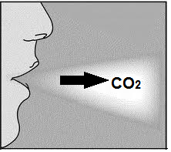
5. Get rid of wastes
When organisms use energy, waste is always created.
If organisms don’t get rid of wastes, they build up and become toxic
Wastes can be solids, liquids, or gases

Slide 9
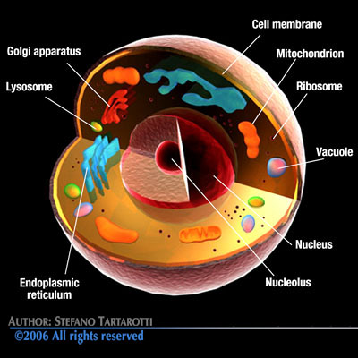
What thing in nature can do all 5 of these life functions?
CELLS!
All organisms are made up of one or more cells.
Cells are the building blocks of life

Slide 10
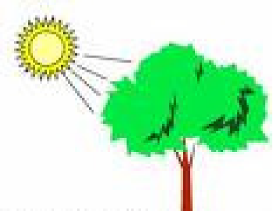
Needs for life...
Organisms need energy, materials, and living space to carry out these 5 tasks.
All energy comes from the sun.
Some organisms use this energy directly (photosynthesis)
Others harness this energy by eating food
Materials (atoms) needed are Carbon, oxygen, hydrogen, nitrogen, phosphorus, sulfur, and they come from food and the environment.

Slide 11
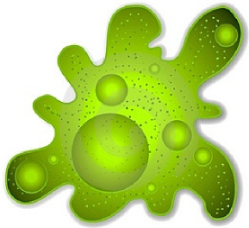
Types of organisms...
If an organism is unicellular,
all functions of life happen
within that one cell.
If an organism is multicellular,
different cells have different jobs and they all work together.

Slide 12
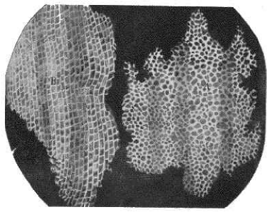
How did we figure out cells existed?
1660’s – Robert Hooke discovered the cell
He looked at cork under the microscope (30x)
He noticed little compartments, which he named after the little rooms that monks lived in...“Cells”
1670’s – Anton von Leeuwenhoek described microorganisms in pond water
He looked at pond water under the microscope (300x) He noticed that the
water was full of moving living things

Slide 13
There are three parts to the cell
theory...
All living things have cells.
Cells are the basic unit of life. (can do all 5 functions)
Cells come only from other living cells

Slide 14
Concept #3- Baby polar bear cells came from its parents’ cells.
Concept #1- A polar
bear is made up of
many cells!
Concept #2-
a polar bear’s cells carry out all the functions of life

Slide 15
So what is the definition of a cell?
The smallest unit of life.
The smallest thing that exists and still is living.
The building block of all life.

