Slide 1
Measurement Review

Slide 2
The skin or surface of an object is called…

Slide 3
AREA

Slide 4
How tightly packed an object is…

Slide 5

DENSITY

Slide 6
How hard one object pushes on another…

Slide 7
PRESSURE

Slide 8
The space an object takes up…

Slide 9
VOLUME

Slide 10
The amount of matter or “stuff” an object has…

Slide 11
MAss

Slide 12
Measuring a line or single distance

Slide 13
LINEAR

Slide 14
How hard gravity is pulling down on an object

Slide 15
WEIGHT

Slide 16
cm³ m³ in³ mL
These units are used for

Slide 17
VOLUME

Slide 18
cm² m² in²
These units are used for

Slide 19
AREA

Slide 20
cm m in
These units are used for

Slide 21
LINEAR

Slide 22
grams
These units are used for..

Slide 23
MASS

Slide 24
N/cm² lb/in²
These units are used for

Slide 25
PRESSURE

Slide 26
g/cm³ these units are used for…

Slide 27
DENSITY

Slide 28
What is the length?
top
side
front
3 cm
2 cm
4 cm

Slide 29
What is the width?
top
side
front
3 cm
2 cm
4 cm

Slide 30
What is the height?
top
side
front
3 cm
2 cm
4 cm

Slide 31
What is the bottom surface?
8 CM2
top
side
front
3 cm
2 cm
4 cm

Slide 32
What is the back surface?
12 CM2
top
side
front
3 cm
2 cm
4 cm

Slide 33
What is the left side surface?
6 CM2
top
side
front
3 cm
2 cm
4 cm

Slide 34
What is the volume?
top
24 CM3
side
front
3 cm
2 cm
4 cm

Slide 35
What is the mass?
top
48 g
side
front
3 cm
2 cm
4 cm

Slide 36
What is the density?
2 G/CM3
top
48 g
side
front
3 cm
2 cm
4 cm

Slide 37
What is the pressure?
top
24 N
side
3 N/CM2
front
3 cm
2 cm
4 cm

Slide 38
How many newtons?
3.6 N

Slide 39
How many milliliters?
344 mL

Slide 40
Name the metric prefixes in order
Kilo | Hecta | Deka | base | deci | centi | milli

Slide 41
23 DKL = ? dL
Kilo | Hecta | Deka | base | deci | centi | milli
2300

Slide 42
.23 Kg = ? g
Kilo | Hecta | Deka | base | deci | centi | milli
230

Slide 43
415 mm = ? Hm
Kilo | Hecta | Deka | base | deci | centi | milli
.00415

Slide 44
What is this graph about?

Slide 45
How much pressure does the side put on the surface?
22 N/CM2

Slide 46
A thin piece of paper can withstand 12 N/cm2 of pressure but after that it will rip. Which position can the block be in without ripping the paper?

Slide 47
If the block weighs the same in all positions, why does the pressure change?
WEIGHT IS SPREAD ON DIFFERENT SURFACES

Slide 48
One student claims that popped popcorn is less dense than unpopped popcorn. Design an experiment that would prove this hypothesis to be correct or false. Density equals mass divided by volume.

Slide 49
A group of students set up two identical ramps with distinctly different slopes (one steep slope and one gradual slope). They used two identical toy cars in the experiment.
CARS WILL HAVE DIFFERENT SPEEDS OR CARS WILL GO DIFFERENT DISTANCES
WHAT MIGHT THEIR HYPOTHESIS BE?

Slide 50
A group of students set up two identical ramps with distinctly different slopes (one steep slope and one gradual slope). They used two identical toy cars in the experiment.
KEEP THE TEST FAIR
WHY DID THEY USE IDENTICAL CARS?

Slide 51
A group of students set up two identical ramps with distinctly different slopes (one steep slope and one gradual slope). They used two identical toy cars in the experiment.
RAMP SLOPE
WHAT WAS THE INDEPENDENT VARIABLE?

Slide 52
A group of students set up two identical ramps with distinctly different slopes (one steep slope and one gradual slope). They used two identical toy cars in the experiment.
DISTANCE OR SPEED
WHAT WAS THE DEPENDENT VARIABLE?

Slide 53
A group of students set up two identical ramps with distinctly different slopes (one steep slope and one gradual slope). They used two identical toy cars in the experiment.
SAME CAR, SAME SURFACE, ETC
WHAT WERE THE CONTROLLED VARIABLES?

Slide 54
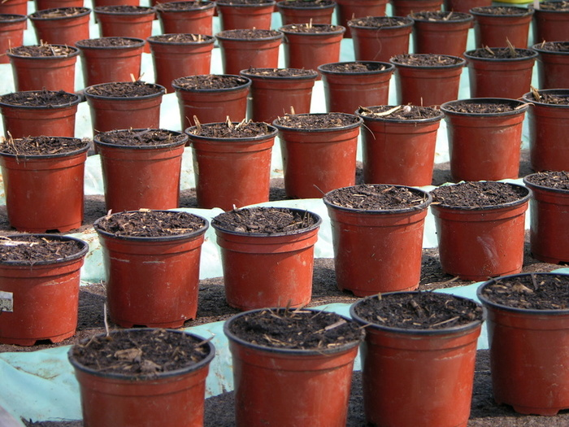
Scientist Jones did an experiment testing different types of soils. She used 100 plants. Scientist Smith did the same experiment but used only 10 plants. Which experiment was better and why?
THE ONE WITH 100 PLANTS BECAUSE BIGGER SAMPLE SIZE MAKES MORE ACCURATE RESULTS

