Slide 1
Which came first?

Slide 2
Principle of original horizontally
Sedimentary strata are horizontal, or nearly so, when deposited. Strata that are not horizontal have been deformed by movements of the earth's crust.
Principle of superposition
In any section of undisturbed sedimentary strata the oldest stratum is at the base and the youngest is at the top. The order of deposition is from the bottom upward.
Principle of cross-cutting relationships
A rock body (or feature) that cuts across another rock body ( or feature) is the younger of the two.
Principle of inclusion
A rock body that contains inclusions (unmelted fragments, boulders, etc.) of pre-existing rock is younger that the rocks from which the inclusions were derived.

Slide 3
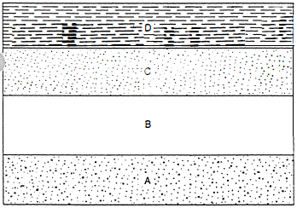

Slide 4
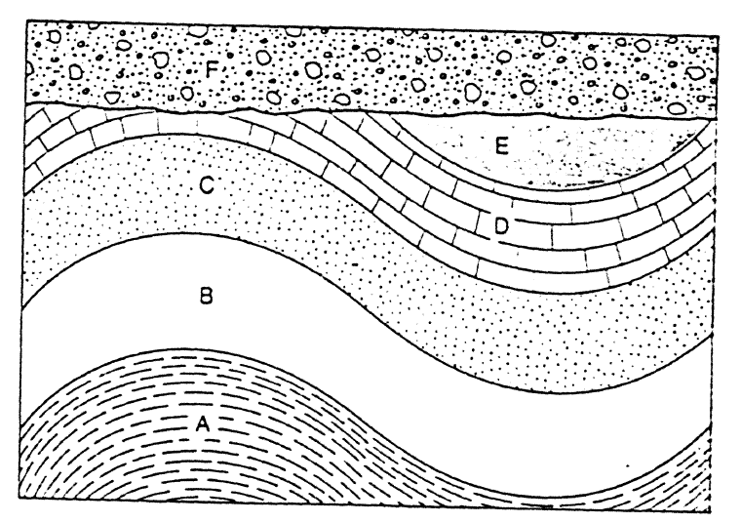

Slide 5
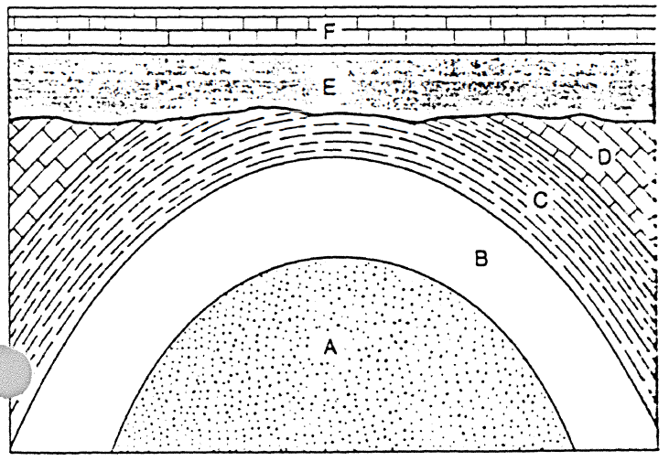

Slide 6
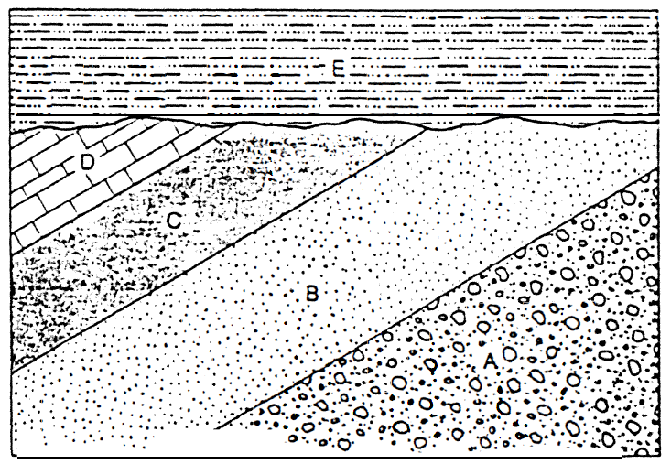

Slide 7
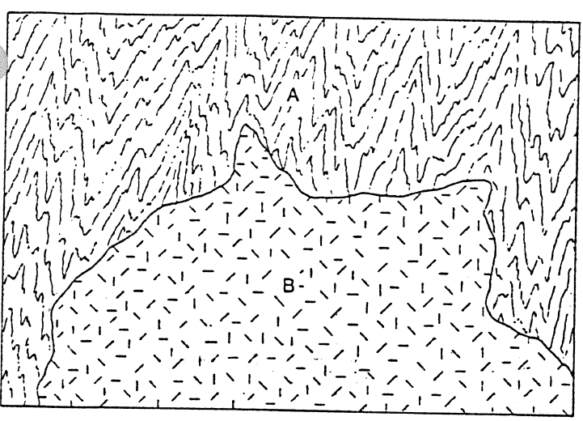
B is younger than A. It is an igneous intrusion

Slide 8
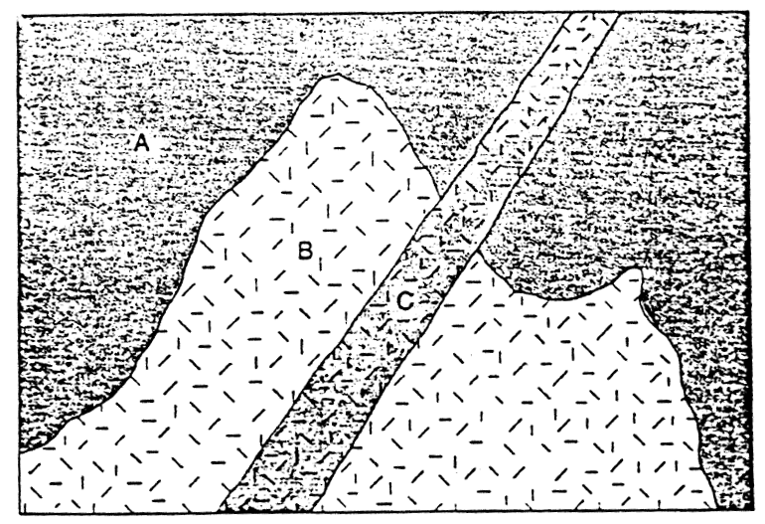
The intrusion B is younger than A. C is a dyke that cut through B and A, so it must be youngest

Slide 9
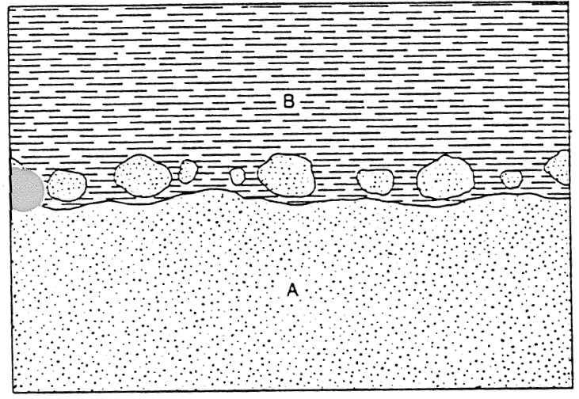

Slide 10
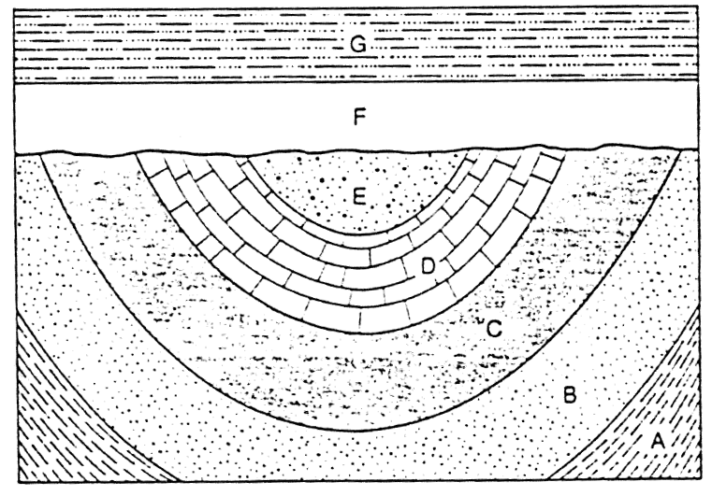

Slide 11
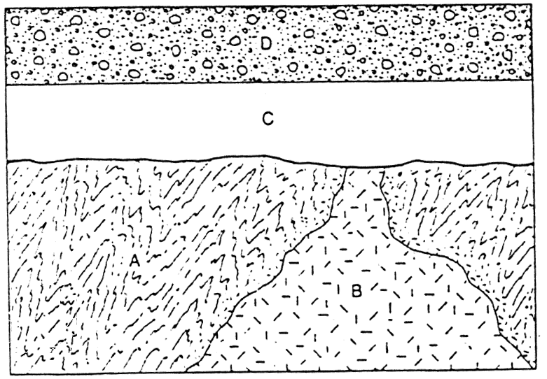
The intrusion B is younger than A. Erosion occurred, then C formed, and finally D formed on top of C

Slide 12
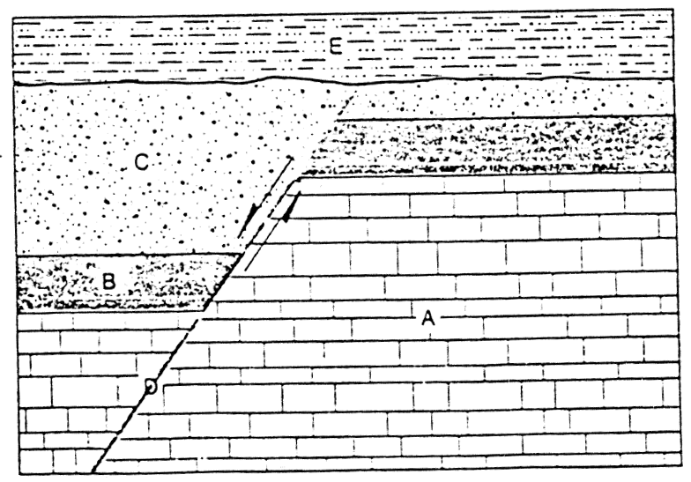
A is youngest, then B, then C. D is a fault that split the layers and lowered the left side. Then erosion, then E

Slide 13
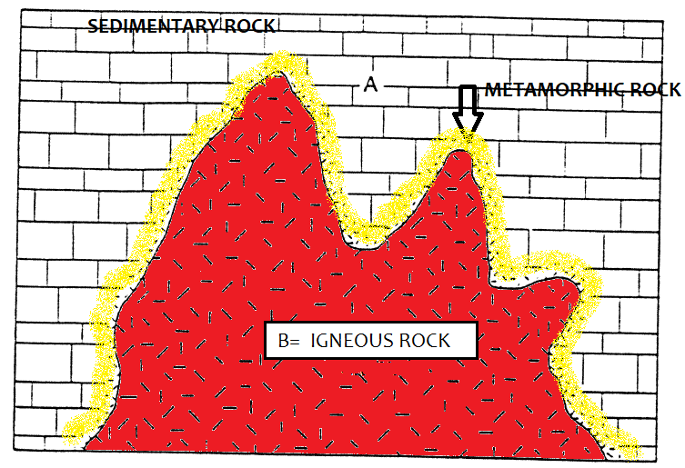
The intrusion B is younger than A. The metamorphic rock in yellow would be about the same age as B

Slide 14
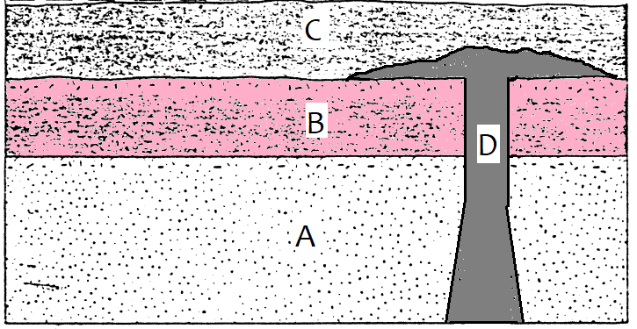
Assuming the grey mass is a sill (magma flow between igneous layers), A is youngest, then B, then C, then D

