Slide 1
STARS
Hot glowing sphere of gas that produces energy by fusion

Slide 2
How do we measure distances in space?
Light year—distance light travels in a year
9.5 trillion km or 6 trillion miles

Slide 3
Star brightness
Absolute (actual) magnitude the real brightness of a star
Apparent magnitude—what the brightness SEEMS to be (but is not true)

Slide 4
Formation of stars
Nebula (cloud of dust and gas) collapses under its own gravity
A protostar forms- it is not fusing yet, just hot
Friction in core causes temperature to reach 10,000,000 c
Fusion begins and a star is born

Slide 5
How stars are found
Loner-by itself (our sun)
Binary system- 2 stars orbiting each other
Star cluster- 100’s or 1000’s of stars held together by gravity (naked eye sees this as 1 point of light)

Slide 6
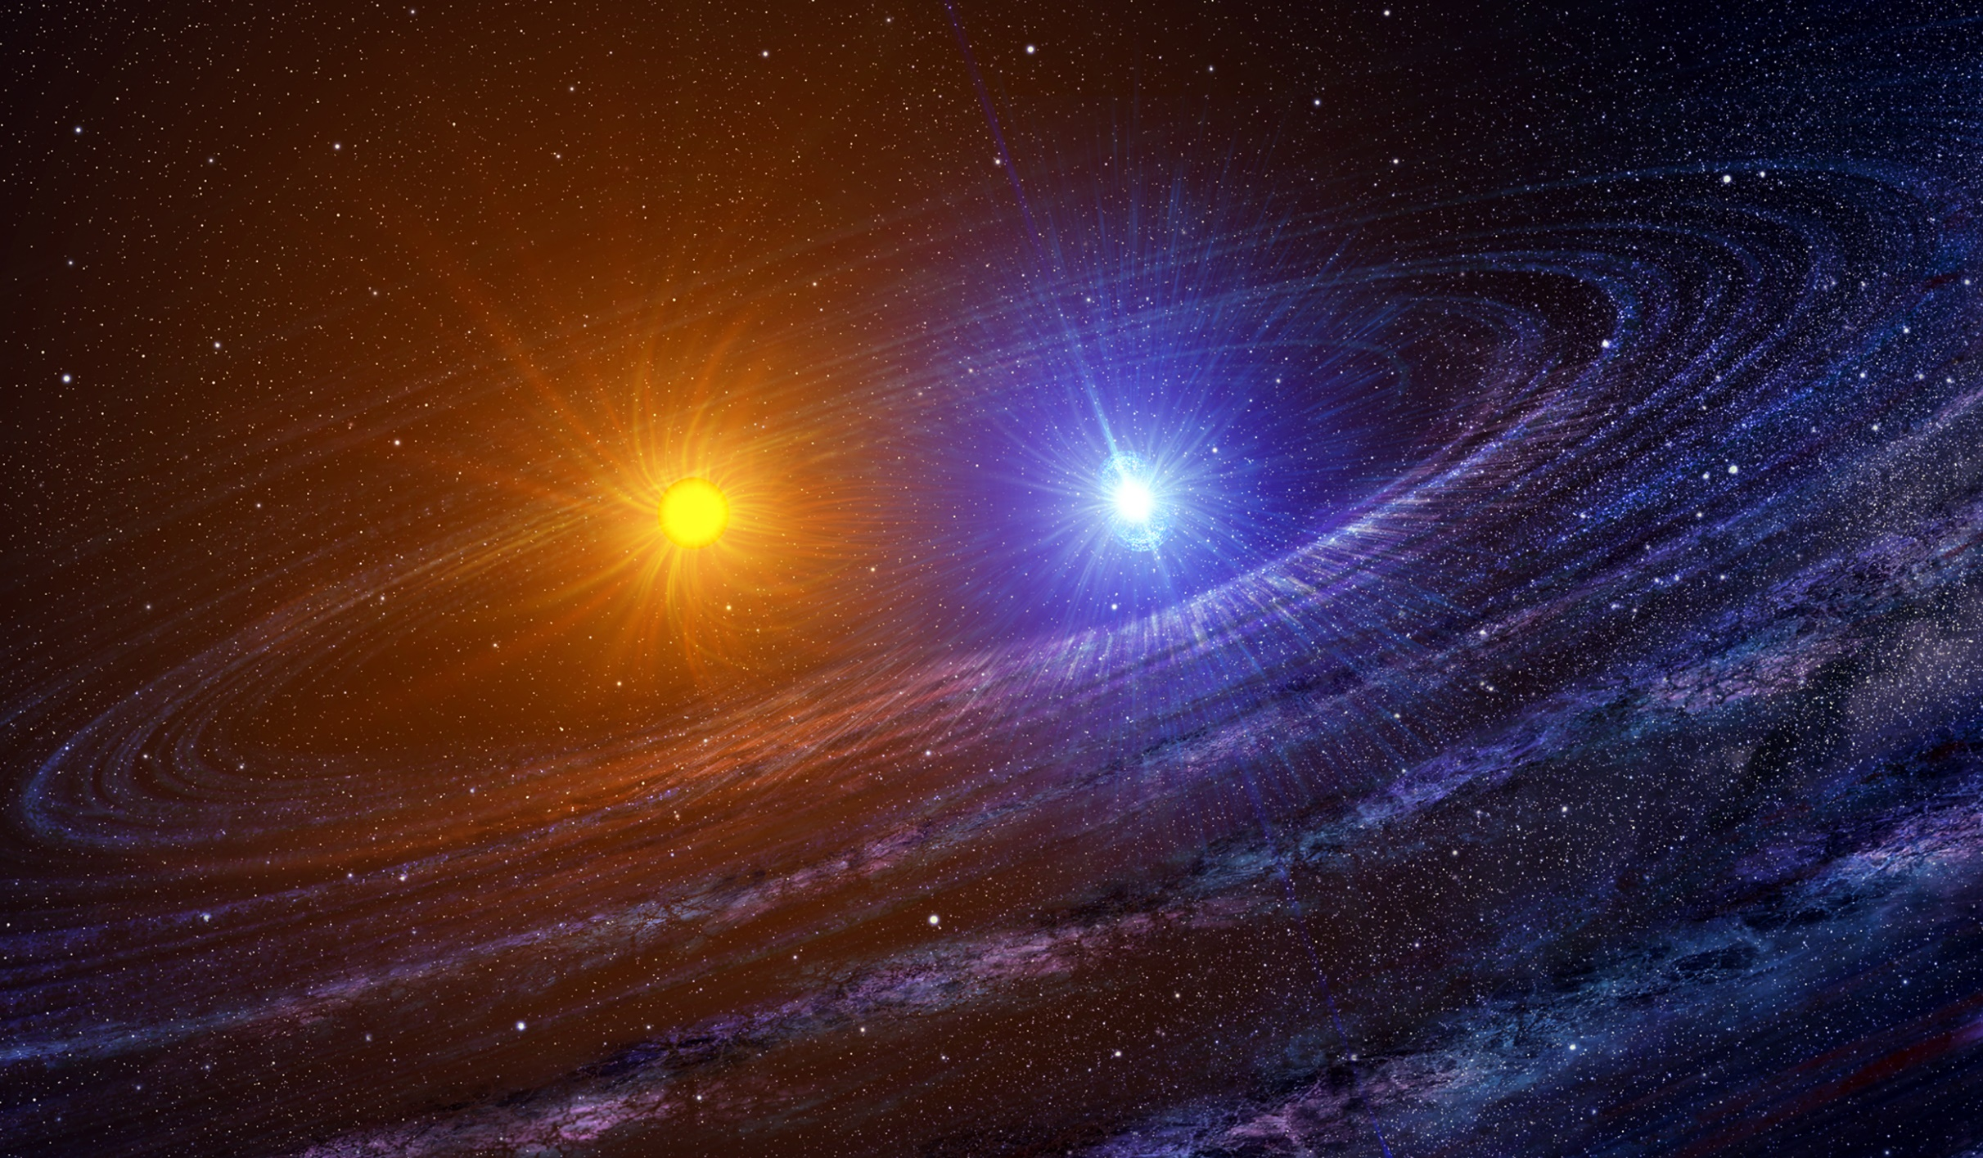
BINARY STAR SYSTEM

Slide 7
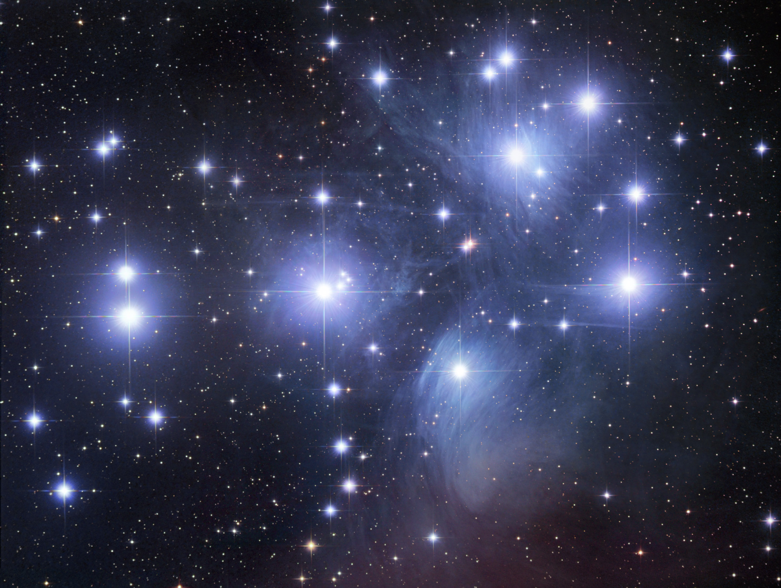
Star cluster

Slide 8
Star Composition
Dark line spectrum analysis- way of finding out what a star is made of--compare a star’s spectrum to an element’s spectrum (its fingerprint)
The elements up to iron are made in stars
The elements heavier than iron are made in supernova explosions

Slide 9
Star Temperature
3500 degrees c= red
5500 degrees c= orange
7500 degrees c=yellow
11,000 degrees c= white
20,000 degrees c= blue

Slide 10
Hertzsprung Russell Diagram- (see handout)
Star life
Red dwarf- lasts hundreds of billions of years (small car- small tank but fuses its fuel slowly)
Sun class-last billions of years (mid sized car- medium tank, fuses medium speed)
Blue giant- millions of years (gas guzzler- huge tank of fuel, does fusion very quickly)

Slide 11
Hertzsprung Russell Diagram-
Star death
Red dwarf- shrink into a white dwarf, then black dwarf
Sun class- swell into red giant then shrink into a white dwarf, then black dwarf
Blue giant- swell into super giant then explode into a supernova performing nucleosynthesis- makes all atoms past iron
Small ones blast apart completely (new nebula)
Larger ones make a new nebula with a neutron star in the center
Largest ones shrink into a black hole

Slide 12
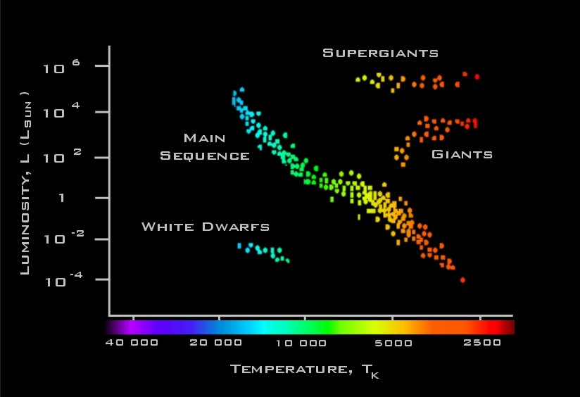

Slide 13
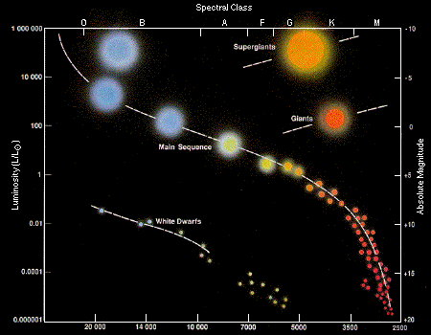

Slide 14
How stars work
A] hydrogen and hydrogen fuses to make helium in the core
B] tiny bits of matter are transformed into enormous energy
C] huge amount of energy is released
D] once there, it has transformed into heat and light at the surface

Slide 15
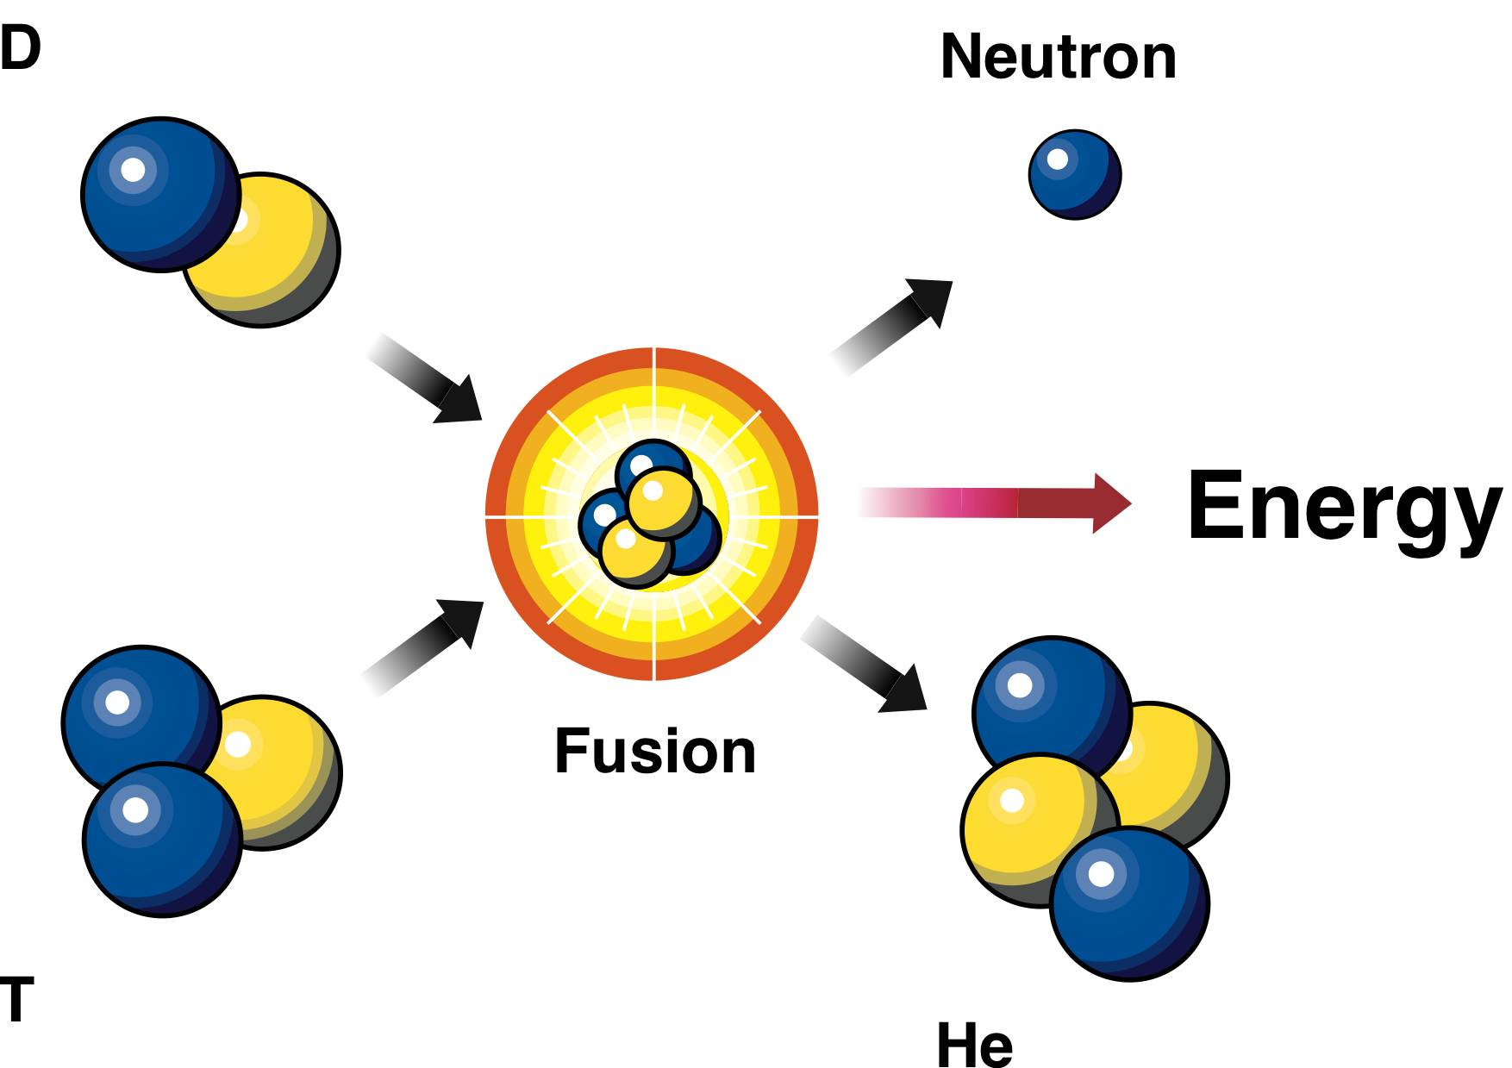

Slide 16
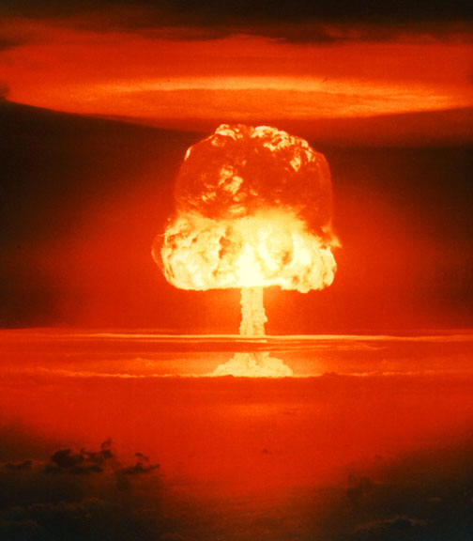
Tiny amounts of matter = HUGE amounts of energy

Slide 17
Forces in Stars
A] Fusion pushes out

Slide 18
Forces in Stars
A] Fusion pushes out
B] Gravity pulls in

Slide 19
Forces in stars continued
• When forces are balanced star is “living”
• When fuel runs out + mass decreases there is less gravity, thus fusion expands it
• When fusion slows down, gravity forces start to win again and shrink the star

Slide 20
Which force is winning here?

Slide 21
So what is the star doing?

Slide 22
SHRINKING

Slide 23
Which force is winning here?

Slide 24
So what is the star doing?

Slide 25
EXPANDING

