Slide 1
Notes – chapter 12-1
Determining relative age

Slide 2
Relative age
Age of an object compared to the ages of other objects
Shows order of events only
Does not tell exact age in years

Slide 3
A] uniformitarianism
theory that states that gradual geological processes that occur today happened the same way in the past.

Slide 4
B] Law of Superposition
The law that a sedimentary rock layer is older than the Layers above it and younger than the layers below it if the layers are not disturbed.

Slide 5
C] Principle of original horizontality
sedimentary rock will remain in horizontal layers
Only true if layers are left undisturbed.
Gravity always pulls sediments flat and parallel to each other
If disturbed, scientists look for clues to determine the original order of layers.

Slide 6
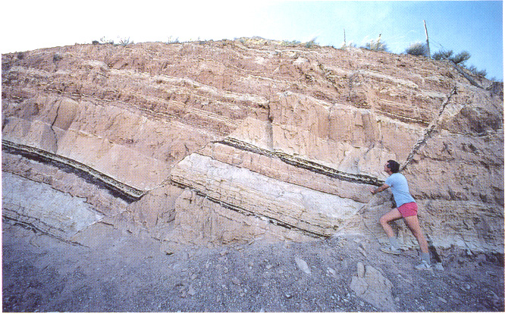
1] WAYS ROCK LAYERS GET DISTURBED:
a) fault-a break in the Earth's crust where pieces slide past each other

Slide 7
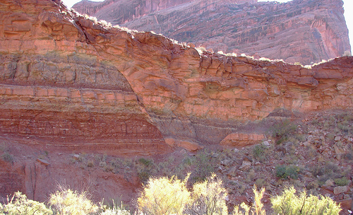
fault

Slide 8
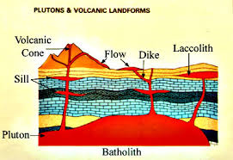
WAYS ROCK LAYERS GET DISTURBED:
b) intrusion-molten rock that squeezes into existing rock and cools

Slide 9
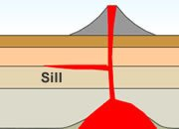
Sill- magma seeps in between layers of rock
(horizontal magma flow)

Slide 10
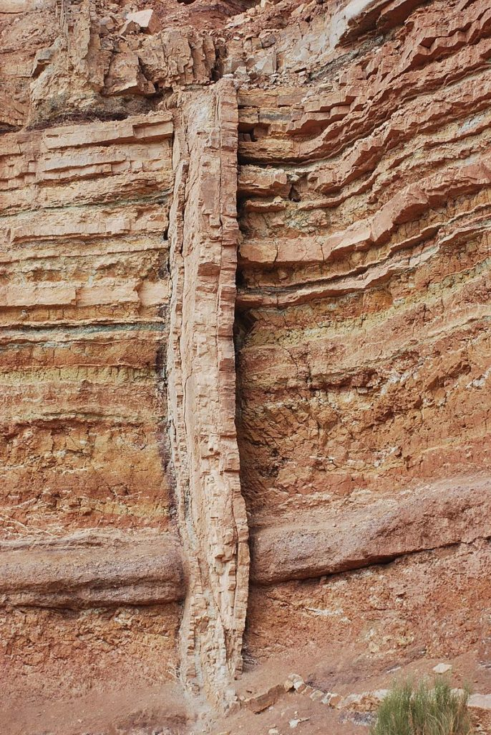
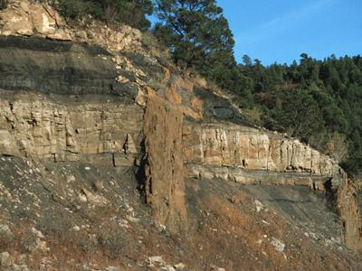
Dike- magma breaks a crack through several layers (vertical magma flow)

Slide 11
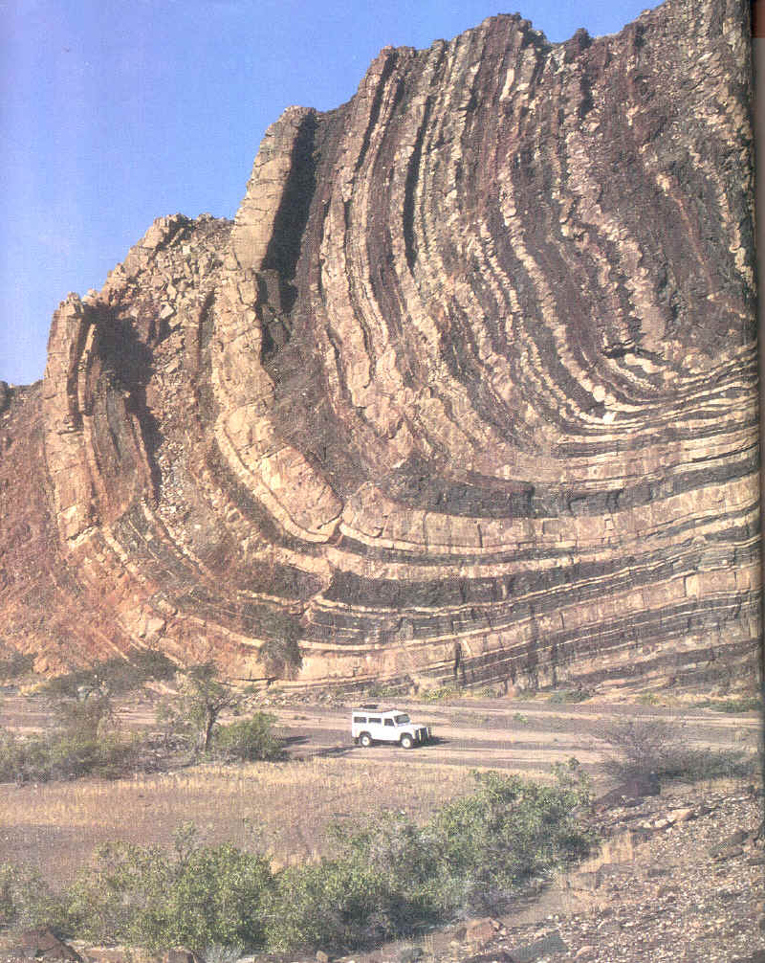
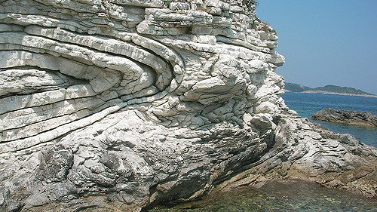
WAYS ROCK LAYERS GET DISTURBED:
c) folding-when rock layers bend and buckle from Earth's internal forces

Slide 12
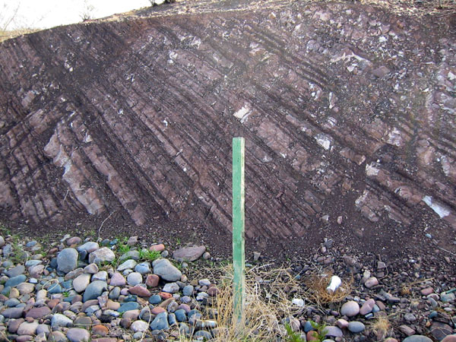
WAYS ROCK LAYERS GET DISTURBED:
d) tilting-when internal forces in the Earth slant rock layers

Slide 13
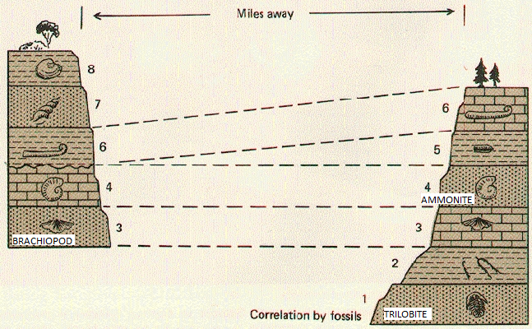
WAYS ROCK LAYERS GET DISTURBED:
e) non-deposition – when rock layers never form in an area (but do in other areas)
On the right side, layers 7 and 8 never formed

Slide 14
d] unconformity
The break in the geologic record created when rock layers are eroded or when sediment is not deposited for long periods of time.

Slide 15
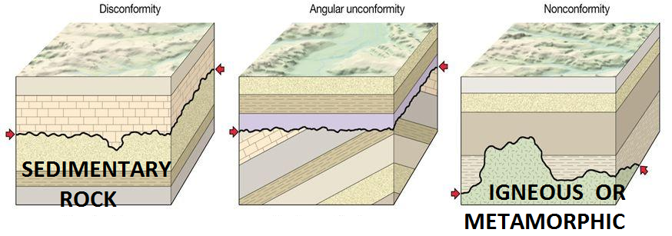
3 TYPES OF UNCONFORMITES:

Slide 16
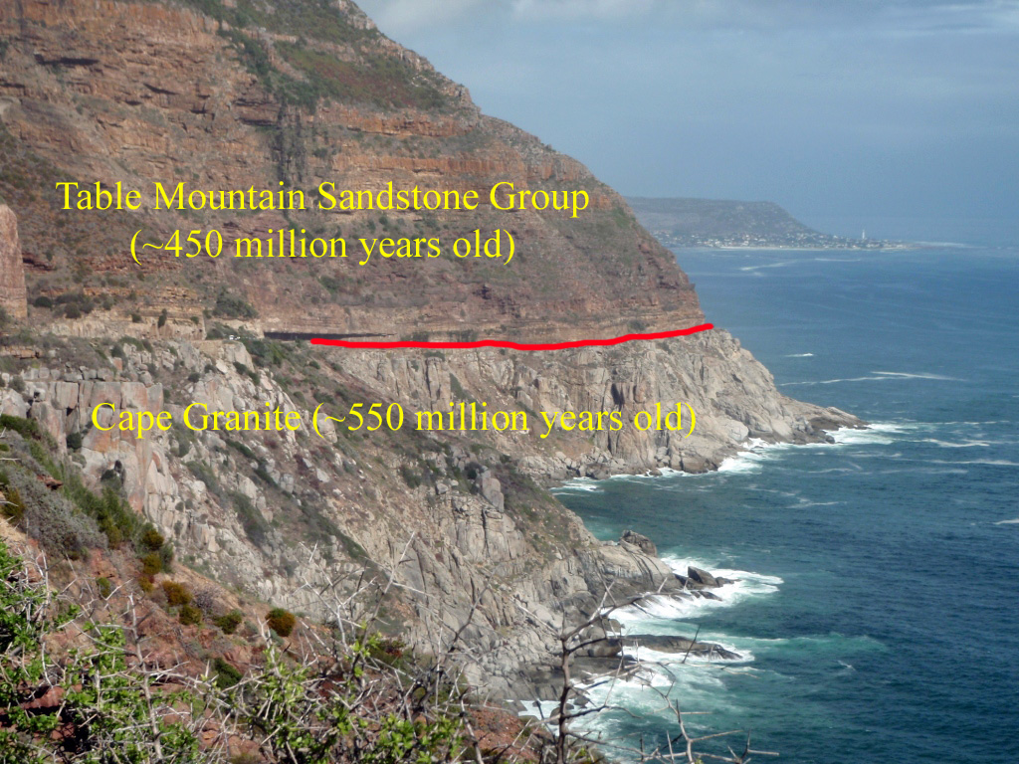
1] Nonconformity
sedimentary rock layers form on top of eroded metamorphic or igneous rock. The eroded rock represents missing time.

Slide 17
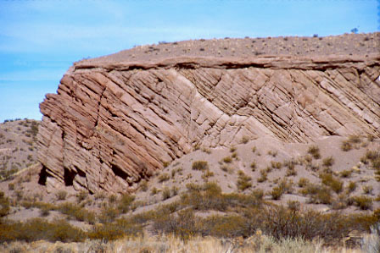
2] Angular Unconformity
rock layers tilt, erode flat, and then have sedimentary rock layers form on top of them. The eroded rock represents missing time.

Slide 18
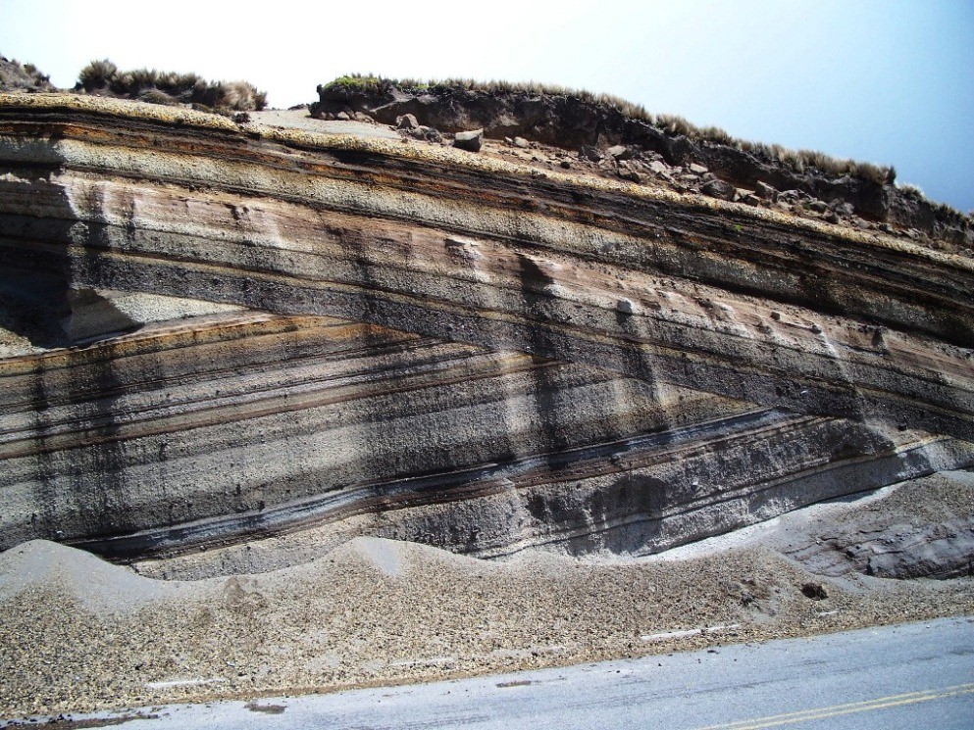

Slide 19
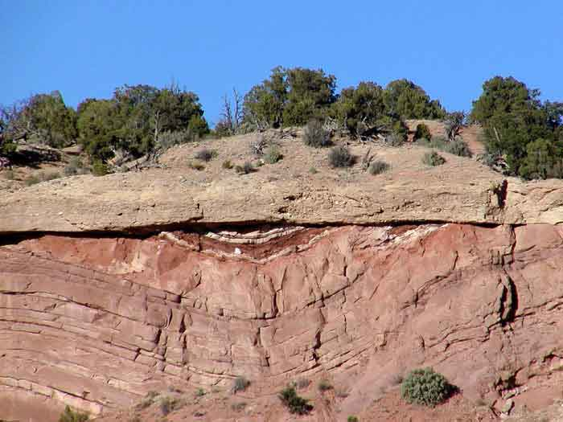

Slide 20
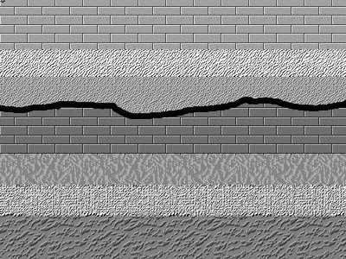
3] DISCONFORMITY
sedimentary rock layers form on top of eroded sedimentary rock. The eroded rock represents missing time..

Slide 21
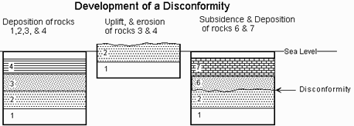

Slide 22
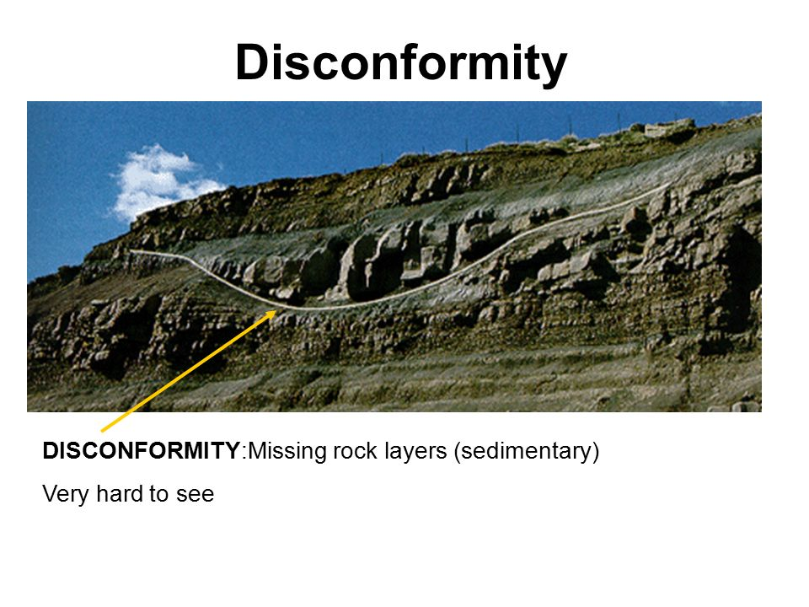

Slide 23
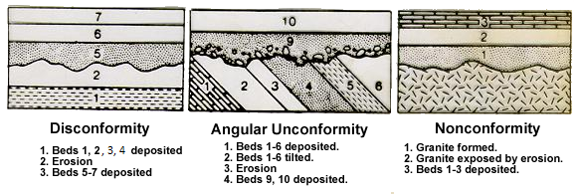

Slide 24
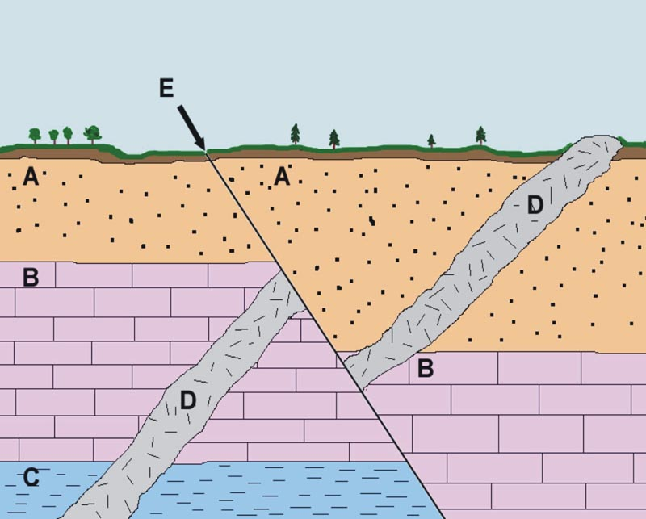
e] Law of crosscutting relationships
The principle that a fault or intrusion of rock is younger than any other body of rock that it cuts through.

